Slide 1
Supplement figures

Slide 2
a
blanket W film
b
0.5 μm W line
silicon substrate
2 μm
silicon substrate
5 μm
c
2 μm W line
d
10 μm W line
silicon substrate
silicon substrate
10 μm
20 μm
Figure S1. SEM micrograph reveal cross-sectional images of blanket tungsten film and comb structures.
Notes:
X-section_tilt076

Slide 3
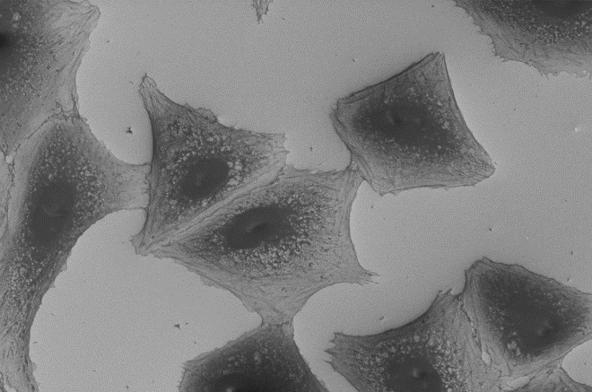
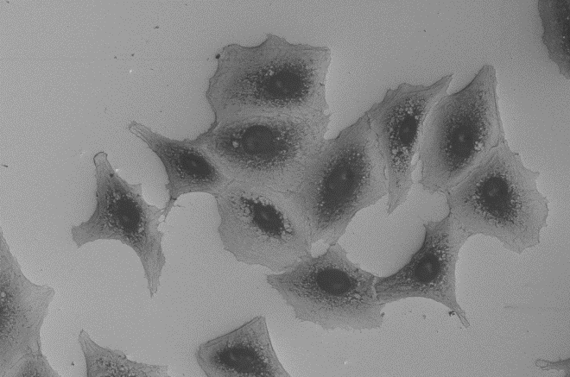
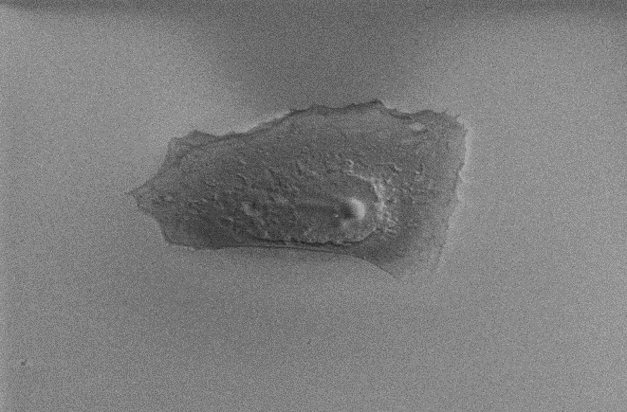
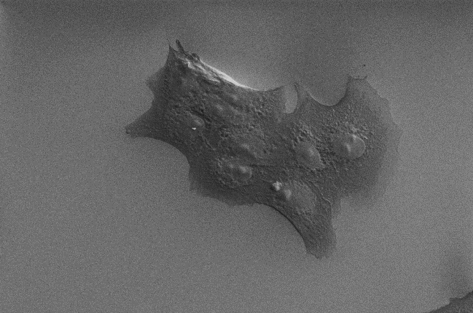
a
tungsten
tungsten
50 μm
60 μm
b
silicon oxide
silicon oxide
20 μm
30 μm
Figure S2. SEM micrographs reveal cell morphology on (a) polished tungsten and (b) polished silicon oxide surface.

Slide 4
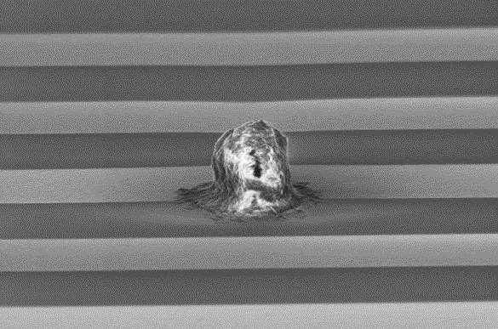
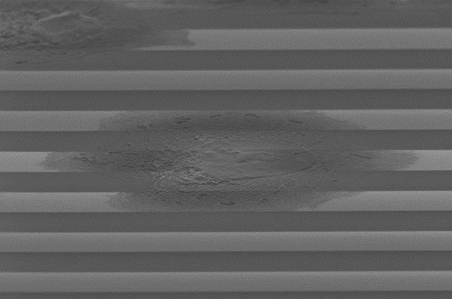
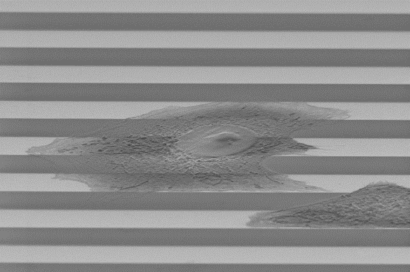
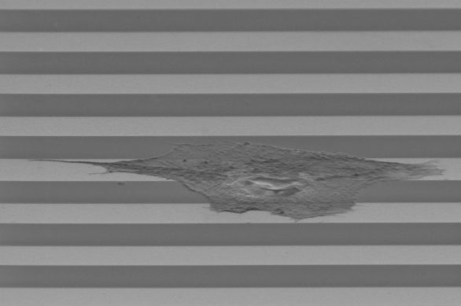
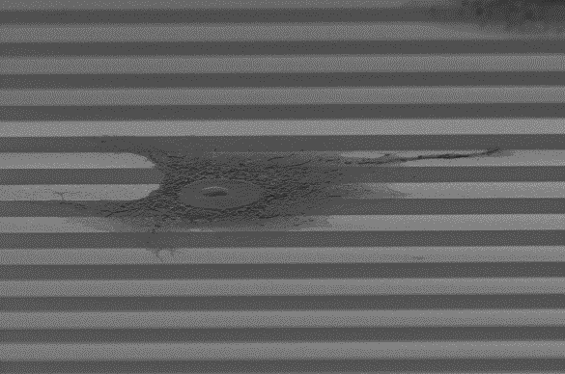
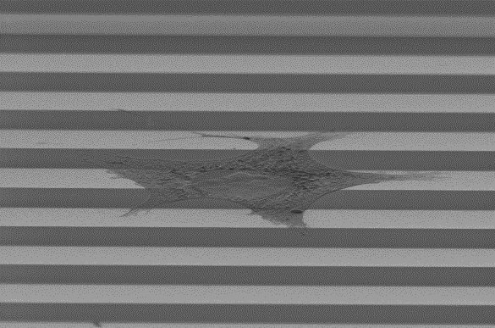
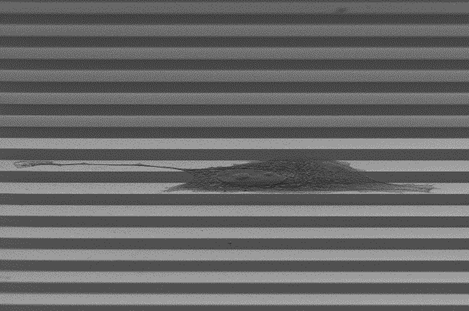
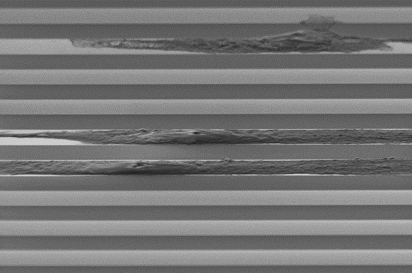
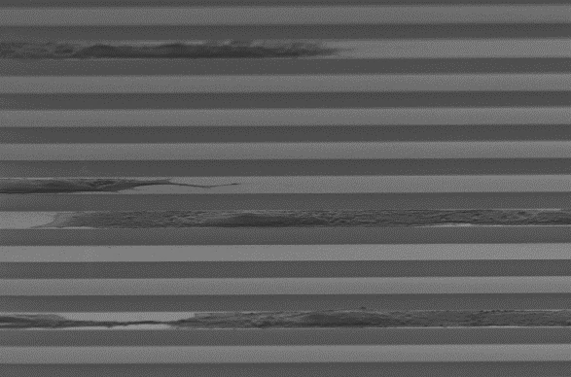
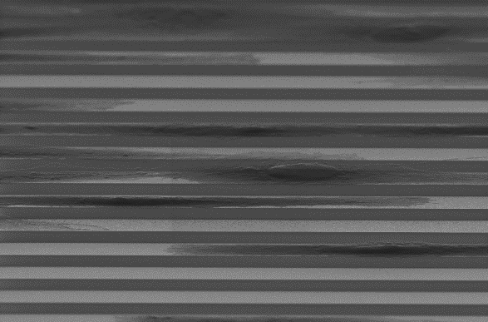
0.5 hours
1.25 hours
10 μm
10 μm
2.25 hours
4.30 hours
10 μm
10 μm
6.0 hours
8.25 hours
10 μm
10 μm
12.20 hours
26.0 hours
10 μm
10 μm
36.2 hours
49.25 hours
10 μm
10 μm
Figure S3. SEM micrographs (70º tilted) of Vero cells on 10 μm comb structures with incubation time from 0.5 to 49.25 hours.

Slide 5
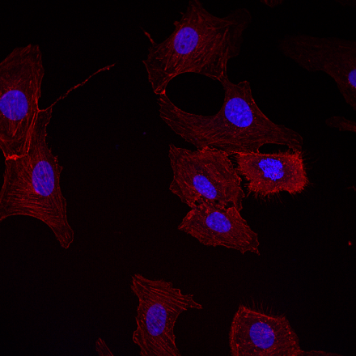
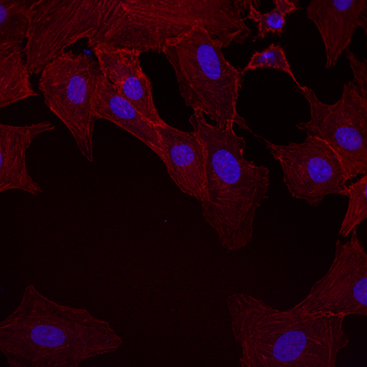
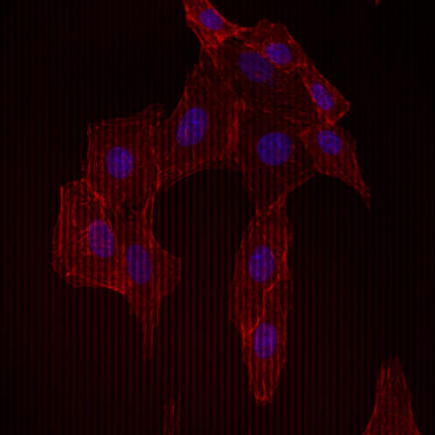
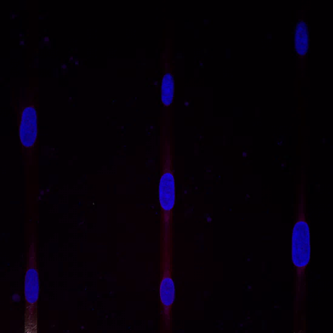
a
b
0.18 μm comb
0.25 μm comb
50 μm
c
d
50 μm comb
2 μm comb
e
10 μm W/ 90 μm SiO₂
Figure S4. Fluorescence confocal micrographs reveal adherent cells on comb structures with line widths of (a) 0.18 μm, (b) 0.25 μm, (c) 2 μm, (d) 50 μm, and (e) line structures with 10 μm tungsten and 90 μm silicon dioxide. Scale bars represent 50 μm.
Notes:
C:\tttsui\Veero AP WCMP\2016_6_16_Veero_cells_Megan_24hrs_batch3_IC_0.18x0.18_random\tif

Slide 6
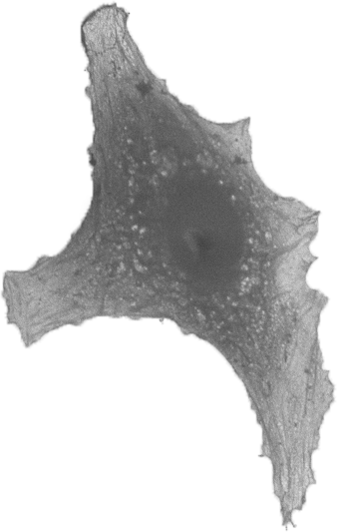
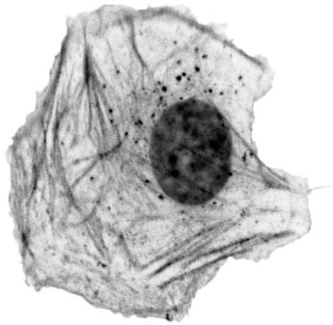
a
b
field W
bare silicon
20 μm
20 μm
c
2 μm isolated line
d
0.18 μm isolated line
50 μm
50 μm
Figure S5. Example cell geometries used for the modeling . They were selected from actual cells adhered on (a) field tungsten area, (b) bare silicon,(c) 2 μm, and (d) 0.18 μm wide isolated tungsten lines.

Slide 7
before-rework
after-rework
a
10μm W-90μm SiO₂
500 μm
500 μm
b
10μm W-10μm SiO₂
200 μm
200 μm
c
200 μm
200 μm
0.18μm W-0.18μm SiO₂
Figure S6. Examples of comb structures before and after mechanical scrubbing rework process: a) 10 μm tungsten-90 μm silicon dioxide; (b) 10 μm tungsten-10 μm silicon dioxide; (c) 0.18 μm tungsten-0.18 μm silicon dioxide.

