Slide 1
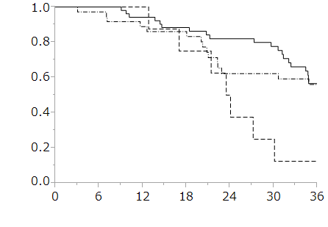
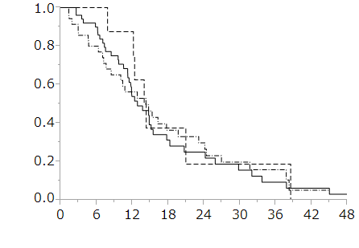
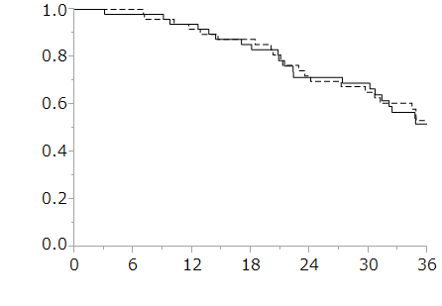
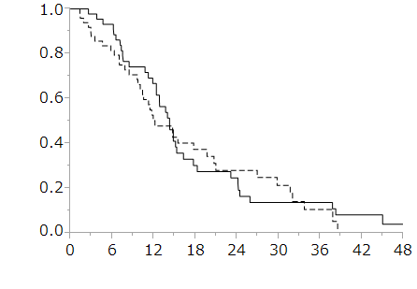
A
B
*
+
KRAS/BRAF
wt/wt (n = 52)
mt/wt (n = 35)
wt/mt (n = 8)
KRAS/BRAF
wt/wt (n = 55)
mt/wt (n = 36)
wt/mt (n = 8)
*
Overall Survival (%)
+
Progression Free Survival (%)
* P = 0.62
+ P < 0.01
* P = 0.93
+ P = 0.67
Time (months)
Time (months)
C
D
P = 0.35
high miR-193a-3p (n = 46)
low miR-193a-3p (n = 49)
Overall Survival (%)
high miR-193a-3p (n = 50)
low miR-193a-3p (n = 49)
Progression Free Survival (%)
P = 0.67
Time (months)
Time (months)

