Slide 1
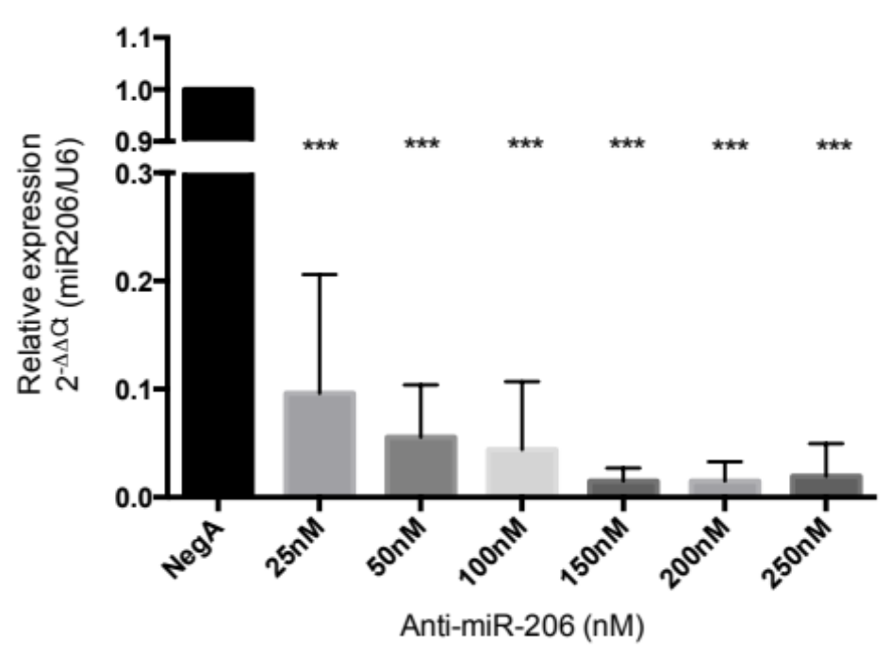
Supplemental figure 1 | Transfection conditions in C2C12 myoblasts. MiRNA-206 level was assessed upon 48hours silencing using an anti-miR-206 locked nucleic acid in C2C12 myoblasts. A dose-response analysis shows that 150nM of locked nucleic acid against miR-206 represent the optimal concentration (n=2). * p<0,001 VS Negative control A transfected C2C12

Slide 2
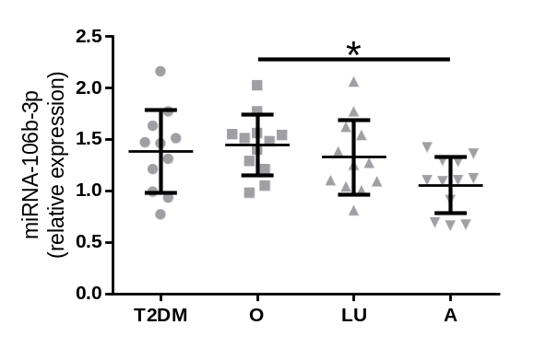
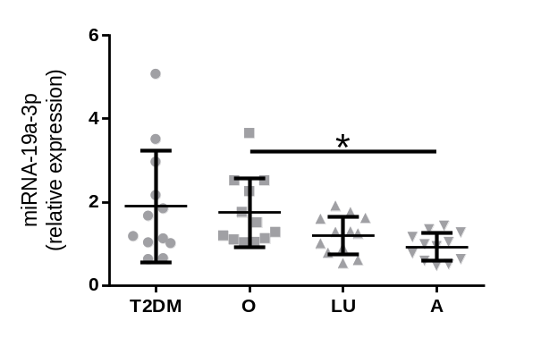
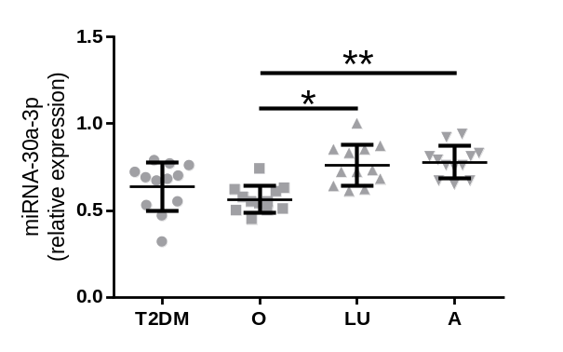
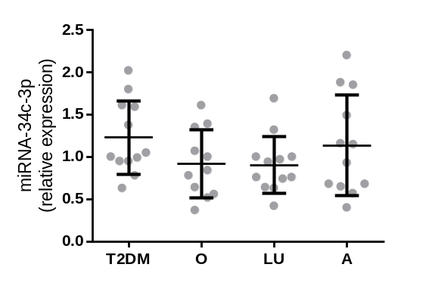
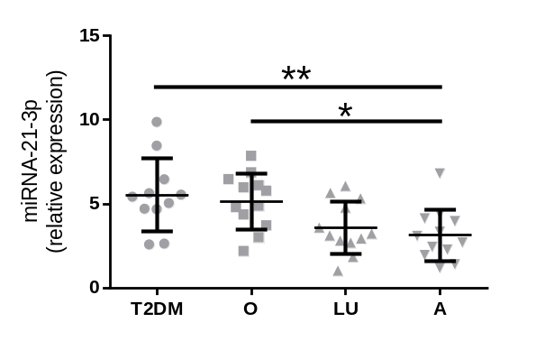
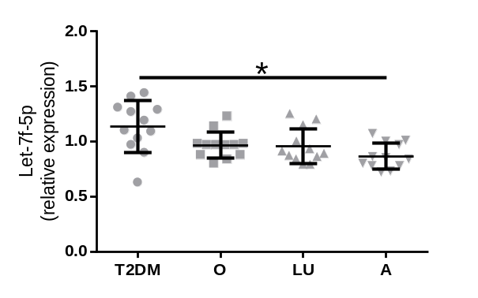
Supplemental figure 2 | miRNA expression levels between subject groups. Relative miRNA expression between type 2 diabetic (T2DM), obese (O), lean untrained (LU) and Athletic (A) subjects. Significance is indicated with * and ** representing p< 0.05 and p < 0.01 respectively.

