Slide 1
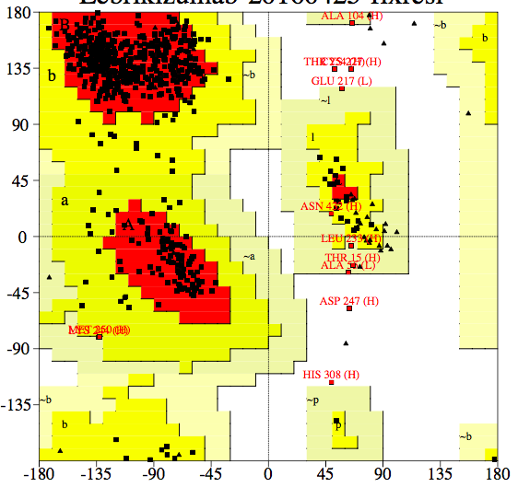
Psi
Phi
Structure | Ramachandran plot (%)
 | Most favoured | Allowed | Generously allowed | Disallowed
Lebrikizumab | 87.0 | 10.9 | 1.4 | 0.7
Notes:
Disallowed: Chain HのCys227, Asp247, Thr254, His308
これらはいずれもFcドメインに存在。

