Slide 1
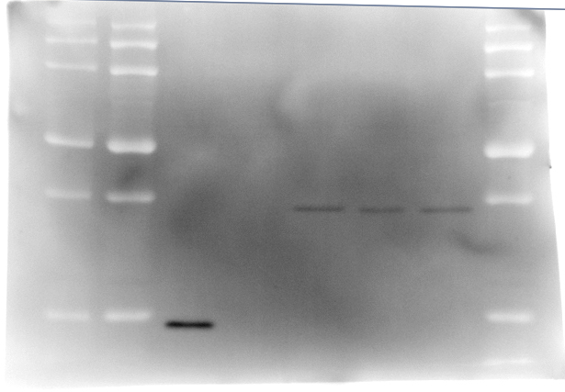
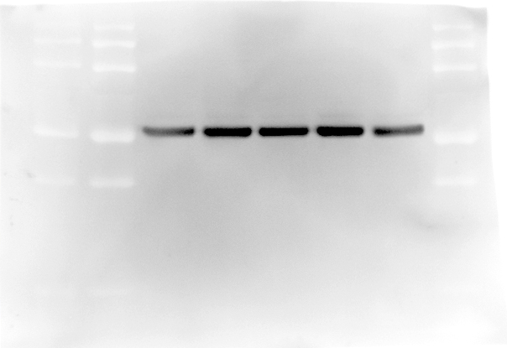
DKO
63-65A
WT
WT
92-94A
Unt.
St.
SF
Bax
Bak
20kDa -
50kDa -
25kDa -
αTubulin
50kDa -
Figure 2-figure supplement 1-source data 1. Raw western gel images for Figure 2-figure supplement 1A and C

