Slide 1
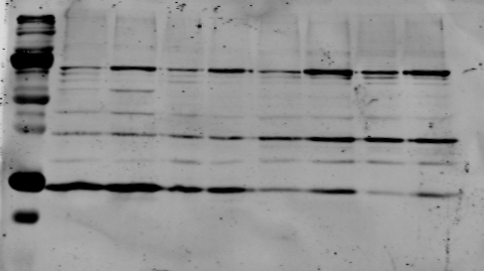
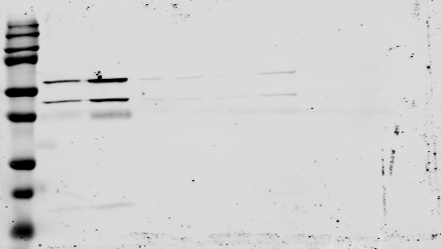
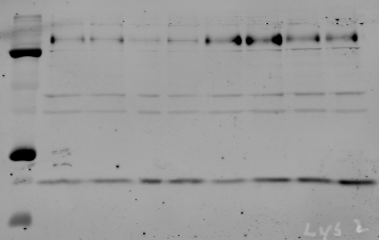
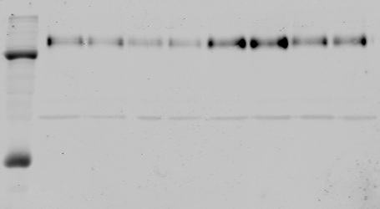
Crude fraction
Lyso. fraction
Pellet
Supern.
Pellet
Supern.
Serum starve: - + - + - + - +
Ox. Phos.
BAK
50kDa -
25kDa -
Lamp1
75kDa -
BAX
25kDa -
Figure 4-source data 1. Raw western gel images for Figure 4A.

