Slide 1
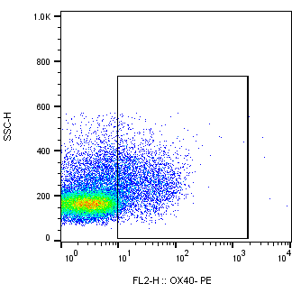
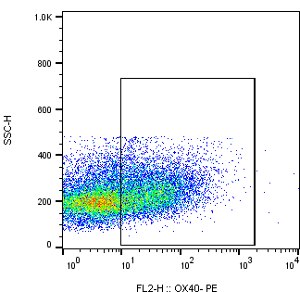
Supp. Figure 1.
(A)
HIV+/cART - UT
(B)
HIV+/cART- antiCD3/CD28
(C)
CD4+OX40+
CD4+OX40+
13.9%
42.3%
SSC
SSC
OX40-PE
OX40-PE

