Slide 1
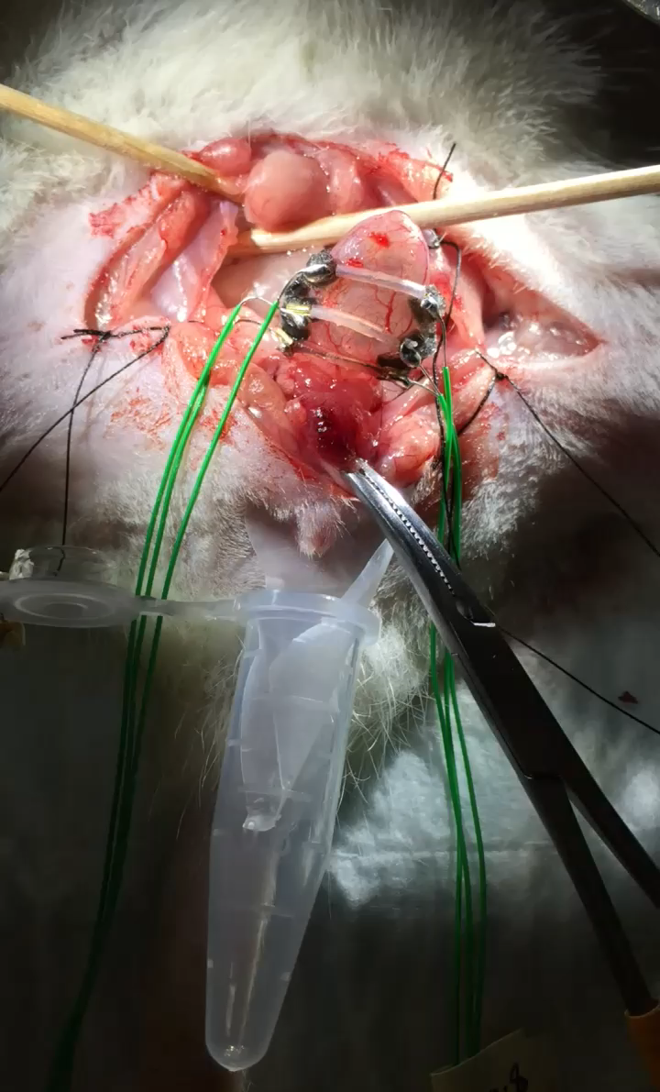
Supplemental Video 1. The voiding process during 25 s of 5 V voltage application to Type 3 device with 9 mm SMA wires.

