Slide 1
Supplementary figures S1-S8
Divide and conquer:
The Pseudomonas aeruginosa two-component hybrid SagS enables biofilm formation and recalcitrance of biofilm cells to antimicrobial agents via distinct regulatory circuits
Olga E. Petrova, Kajal Gupta, Julie Liao, James Goodwine, and Karin Sauer

Slide 2
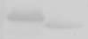

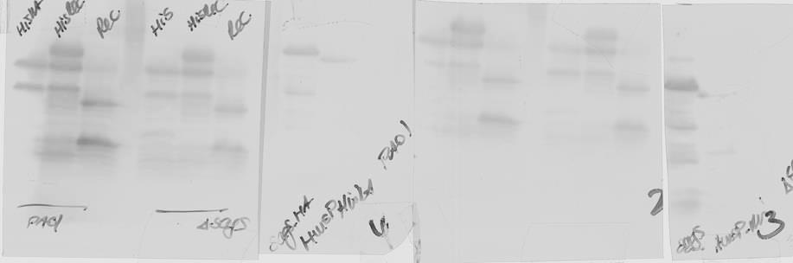
ΔsagS/pJN-
sagS
HmsP-HisKA
HisKA
HisKA-Rec
Rec
TCE
SagS*-HA
Fig. S1. Detection of SagS and SagS domain constructs in cell free total cell extracts by immunoblot analysis using anti-HA antibodies. All SagS domain constructs, including the full-length gene, harbored a C-terminal hemagglutinin (HA) tag (referred to as SagS*-HA). *, SagS domain constructs vary in molecular mass.

Slide 3
Fig. S2. Average number of viable cells, expressed as CFU, present in biofilms formed by P. aeruginosa PAO1 and mutant strains following 2 days of growth at a surface area of 25 cm² at a flow rate of 0.1 ml/min. Experiments were repeated at least 3 times. Error bars indicate standard deviations.

Slide 4
A
B
C
*
*
*
*

Slide 5
Fig. S3. Average and maximum thickness of P. aeruginosa wild-type and ΔsagS mutant biofilms expressing (A) SagS domain constructs or (B) SagS variants harboring site-directed mutations, as determined using confocal images and subsequent COMSTAT analysis. (C) Biofilm biomass of ΔsagS mutant strains expressing wild-type sagS or sagS variants, as determined using confocal images and subsequent COMSTAT analysis. Biofilms were grown for 6 days in flow cells. All experiments were carried out at least in triplicate. Error bars indicate standard deviation.

Slide 6
A
Co-IP
*
B
MOAC
*
*
*
*
Fig. S4. Relative BfiS abundance, based on relative intensity of protein bands detectable following probing for BfiS with anti-V5 antibodies and subsequent analysis using ImageJ (Rasband, W. (1997) ImageJ. US National Institutes of Health, Bethesda, MD.). (A) BfiS protein levels detected following Co-IP. (B) BfiS protein levels following enrichment by MOAC. Experiments were carried out in triplicate. Error bars denote standard deviation. *, significantly different from the values for P. aeruginosa PAO1 (p ≤ 0.01), as determined by ANOVA and SigmaStat.

Slide 7
Fig. S5. c-di-GMP levels present in wild-type and ΔsagS mutant biofilm cells overexpressing sagS domain constructs. The strains were grown in tube reactors under flowing conditions for 6 days prior to c-di-GMP extraction and quantitation by HPLC analysis. pmol/mg refers to c-di-GMP levels (pmol) per total cell protein (in mg). ΔsagS harboring the empty vector pJN105 was used as vector control. All experiments were carried out at least in triplicate. Error bars indicate standard deviation.

Slide 8
A
B
Fig. S6. Total biofilm biomass (A), and average and maximum thickness (B) of P. aeruginosa ΔsagS and ΔsagSΔgacA mutant biofilms expressing intact sagS or the Rec domain construct, as determined using confocal images and subsequent COMSTAT analysis. Biofilms were grown for 6 days in flow cells. All experiments were carried out at least in triplicate. Error bars indicate standard deviation.

Slide 9
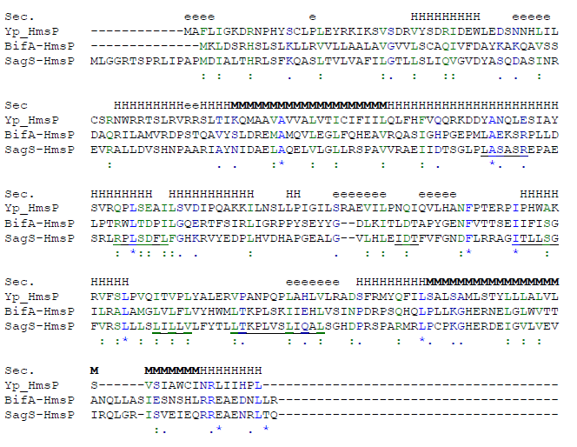
A
B

Slide 10
Fig. S7. (A) Localization of transmembrane helices present in SagS as determined using the TMHMM Prediction of transmembrane helices in proteins software (http://www.cbs.dtu.dk/services/TMHMM-2.0/). (B) Alignment of HmsP domains of P. aeruginosa SagS and BifA and Yersinia pestis HmsP (Yp_HmsP). Sec, predicted secondary structure of Yp_HmsP; H, helical regions; e, extended regions; M, membrane spanning regions, from www.blackwellpublishing.com/products/journals/.../mmi4253FigS1.doc. Identical/similar AA are shown in color and indicated by symbols (., :, *).

Slide 11
A
B
Figure S8. Contribution of SagS and the HmsP domain to the susceptibility of planktonic cells to tobramycin. All strains were grown planktonically to exponential phase and subsequently exposed to 50 µg/ml tobramycin for 30 min. Strain PAO1 harboring the empty plasmid pMJT1 was used as vector control. Viability was determined via CFU counts. (A) Total CFU prior to treatment. (B) Susceptibility is expressed as log reduction in CFU counts. Experiments were done at least in triplicate. Error bars denote standard deviation.

