Slide 1
Naked 601 DNA
MN H2BTL
DNA ladder
MN H2ATL
MN H3TL
TL MN
MN H4TL
bp
MN
Mononucleosome
800-
600-
601 naked DNA
200-
S1

Slide 2
A-
B-
*
*
S2

Slide 3
H4
SGRGKGGKGLGKGGAKRHRKVLR-GGK(Biotin)-NH₂
H4K20me1
SGRGKGGKGLGKGGAKRHR-K(Me1)VLR-GGK(Biotin)-NH₂
H4K20me2
SGRGKGGKGLGKGGAKRHR-K(Me2)VLR-GGK(Biotin)-NH₂
H4K20me3
SGRGKGGKGLGKGGAKRHR-K(Me3)VLR-GGK(Biotin)-NH₂
H2A
RSSRTKAKARAGGQKGRGS(Biotin)-NH₂
H2BK5me1
PEPAK-(Me1)-SAPAPKKGSKKAVTKAQ-GGK(Biotin)-NH₂
H3K36me3
ATKAARKSAPATGGV-K(Me3)-KPHRYRP-GGK(Biotin)-NH₂
S3

Slide 4
S4

Slide 5
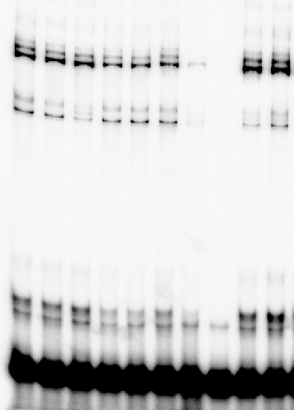
A-
Y227A
B-
D229G
W235A
K236A
D232G
R231G
R231H
D253H
Wt
R231A
Circular
FSI
Circular
HSI
*
Linear FSI
**
**
donor/donor
C-
Acceptor
DNA
Donor
DNA
246 bp
**
*
**
**
S5

Slide 6
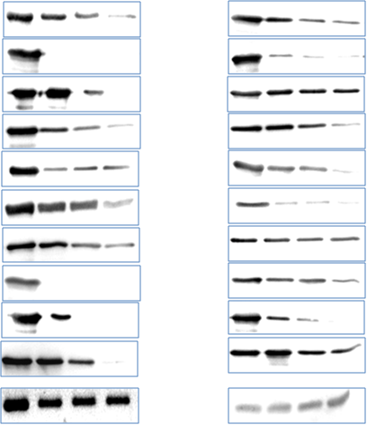
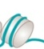
B-
A-
NaCl mM
NaCl mM
Input
140
190
240
Input
140
190
240
WT
WT
Y227A
Y227A
D229G
R229G
**
R231G
R231G
**
**
**
**
**
**
R231A
R231A
R231H
R231H
D232G
R232G
W235A
W235A
K236A
K236A
D253H
D253H
DNA₆₀₁
MN (H4)
DNA₆₀₁
MN₆₀₁
S6

Slide 7
S7

Slide 8
Color key
Depleted
Enriched
20
50
60
Compared to MRC
Random
WT
D253H
R231G
R231A
R231H
S8

Slide 9
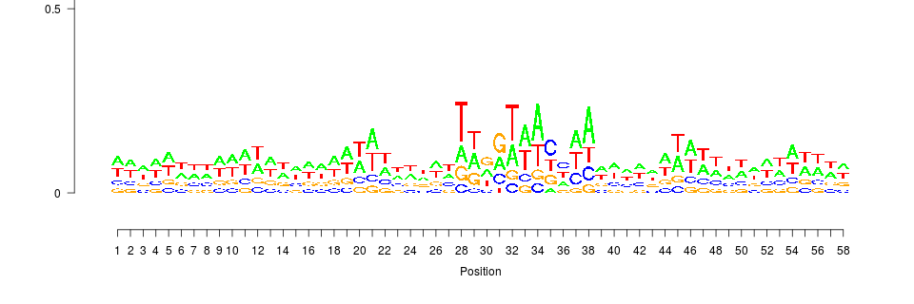
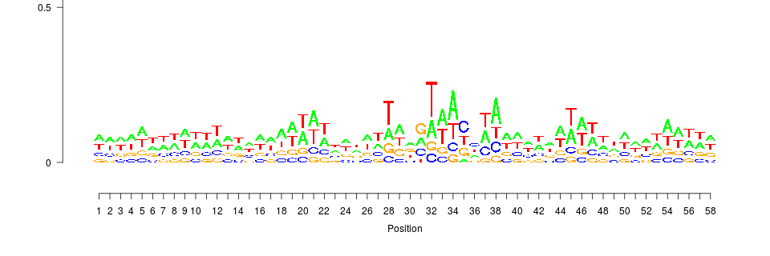
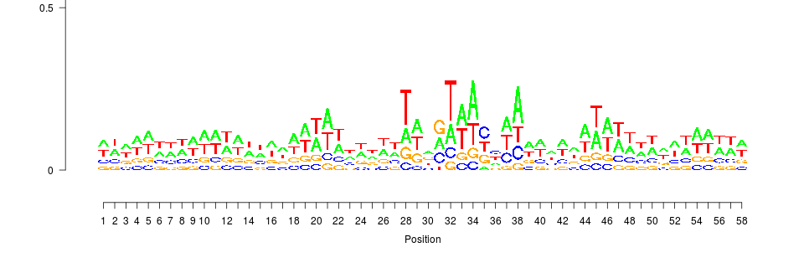
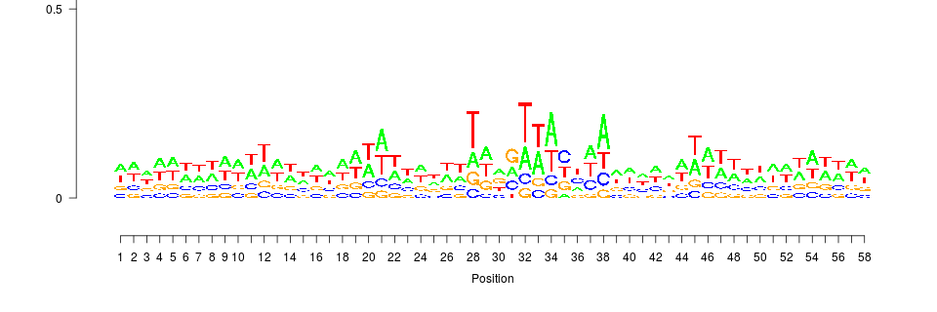
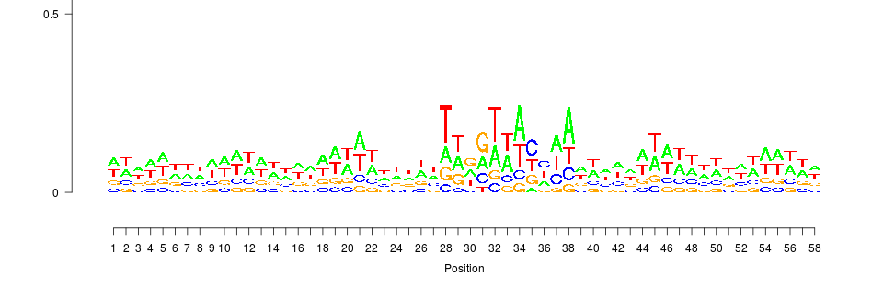
WT
R231A
R231G
R231H
D253H
S9

Slide 10
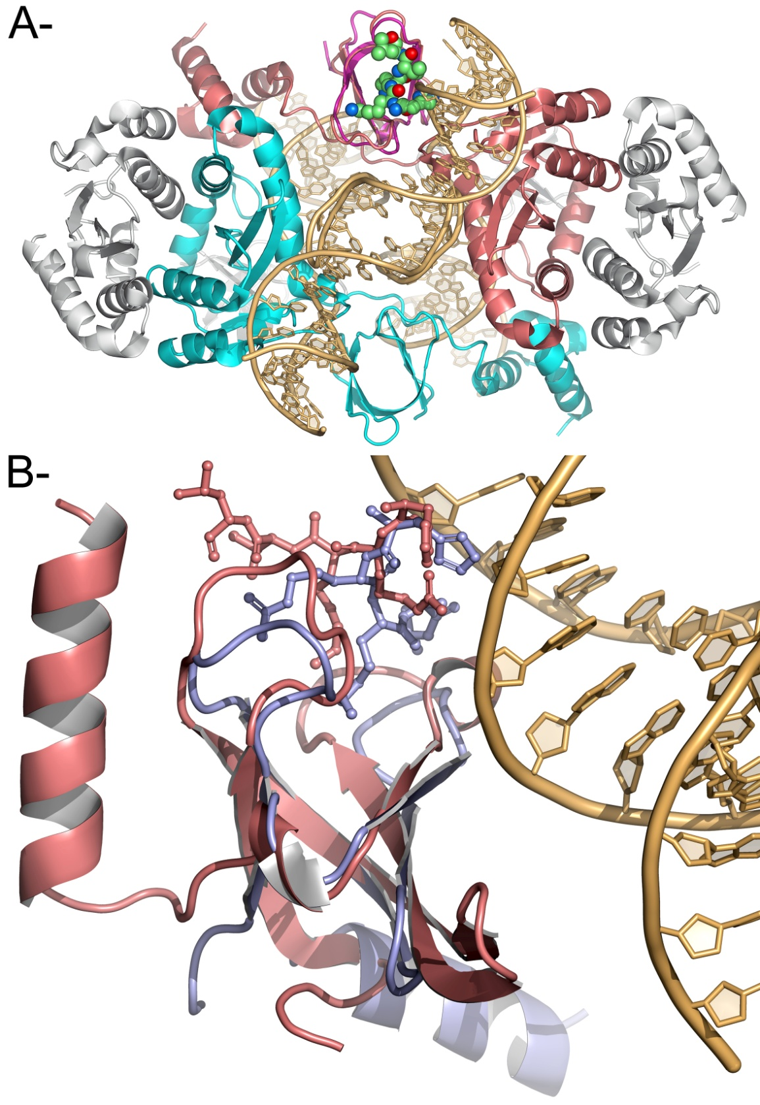
S10

Slide 11
A-
HIV1_U5(+) 5’ GCATTGGCTCAAAGGTCCAAACCatgtggaaaatctctagca 3’
HIV1_U5(-) 5’ actgctagagattttccacatGGTTTGGACCTTTGAGCCAATGC 3’
B-
42/40bp
5' ACTGGAAGGGCTAATTCACTTAACGTTGCCCGGATCCGGTCGCGC CGCGCTGGCCTCGGCCCGTTGCAATTACACCTTTTAGAGATCGTCA 3’
3’ TGACCTTCCCGATTAAGTGAATTGCAACGGGCCTAGGCCAGCGCG GCGCGACCGGAGCCGGGCAACGTTAATGTGGAAAATCTCTAGCAGT 5’
246bp
C-
S11

Slide 12
S12. List of insertion sites

