Slide 1
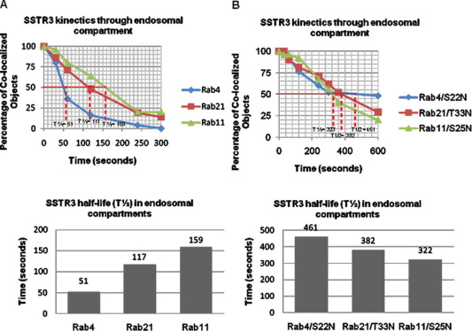
Supplementary Figure 1. SSTR3 traffics through endosomal compartments with distinct kinetics. Data on co-localization coefficients of SSTR3 with Rab4, Rab21, and Rab11 (A) or with Rab4/S22N, Rab21/T33N and Rab11/S25N (B) at select times after start of imaging ...
Cristy Tower-Gilchrist, Eunjoo Lee, Elizabeth Sztul
Endosomal trafficking of the G protein-coupled receptor somatostatin receptor 3
Biochemical and Biophysical Research Communications, Volume 413, Issue 4, 2011, 555–560
http://dx.doi.org/10.1016/j.bbrc.2011.08.137

