Slide 1
JAMA Ophthalmology Journal Club Slides:
Ranibizumab with or without verteporfin photodynamic therapy for polypoidal choroidal vasculopathy
Koh A, Lai TYY, Takahashi K, et al; for the EVEREST II study group.
Efficacy and safety of ranibizumab with or without verteporfin photodynamic therapy for polypoidal choroidal vasculopathy: a randomized clinical trial. JAMA Ophthalmol. Published online October 5, 2017. doi:10.1001/jamaophthalmol.2017.4030

Slide 2
Introduction
Importance:
  Polypoidal choroidal vasculopathy (PCV) is a common subtype of exudative age-related macular degeneration among Asian individuals. To our knowledge, there are no large randomized clinical trials to evaluate intravitreal ranibizumab, with and without verteporfin photodynamic therapy (vPDT), for the treatment of PCV.
Objective:
  To compare the efficacy and safety of combination therapy of ranibizumab and vPDT with ranibizumab monotherapy in PCV.

Slide 3
Methods
Study Design, Setting, and Participants:
  A double-masked, multicenter randomized clinical trial of 322 Asian participants with symptomatic macular PCV confirmed by the Central Reading Center using indocyanine green angiography was conducted between August 7, 2013, and March 2, 2017.
Main Outcomes and Measures:
  Step 1 assessed whether combination therapy was noninferior (5-letter margin) to monotherapy for change in best-corrected visual acuity from baseline and superior in complete polyp regression. If noninferiority was established, step 2 assessed whether combination therapy was superior to monotherapy measured by best-corrected visual acuity change at month 12.

Slide 4
Methods
Limitations:
  The administration of 3 initial monthly injections was presumptive because it was based on neovascular age-related macular degeneration treatment guidelines, which may not apply to combination treatment.
  Only Asian participants with PCV were included, and the results may be ethnospecific.
Key Inclusion Criteria:
  Symptomatic macular PCV confirmed by the Central Reading Center as defined by the presence of active macular polypoidal lesions on indocyanine green angiography and serosanguineous maculopathy on fundus photography and fluorescein angiography.
  Best-corrected visual acuity letter score of 78 to 24 using the Early Treatment Diabetic Retinopathy Study chart at a starting distance of 4 m (approximately 20/32 to 20/320 Snellen equivalent).

Slide 5
Results
Overall, the mean (SD) age of participants was 68.1 (8.8) years, and most participants were men (69.9%).
In total, 322 participants were randomized to receive combination therapy (n = 168) or ranibizumab monotherapy (n = 154).
At baseline, the overall mean best-corrected visual acuity and mean central subfield thickness were 61.1 letters and 413.3 μm, respectively. At 12 months, mean improvement from baseline was 8.3 letters with combination therapy vs 5.1 letters with monotherapy (mean difference, 3.2 letters; 95% CI, 0.4-6.1), indicating that combination therapy met the predefined criterion for noninferiority as well as being superior to monotherapy (P = .01). Combination therapy was also superior to monotherapy in achieving complete polyp regression at month 12 (69.3% vs 34.7%; P < .001). Over 12 months, the combination therapy group received a median of 4.0 ranibizumab injections compared with 7.0 in the monotherapy group. Vitreous hemorrhage was the only ocular serious adverse event (combination therapy group, 1 [0.6%]; monotherapy group, 3 [2.0%]).

Slide 6
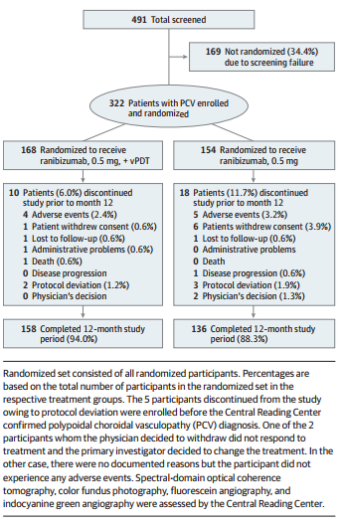
Results
Patient Disposition (Randomized Set)

Slide 7
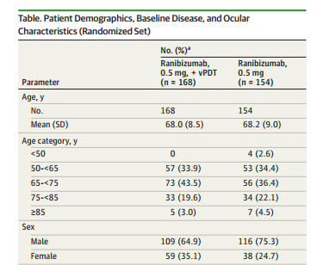


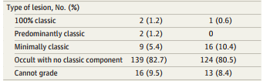

Results

Slide 8
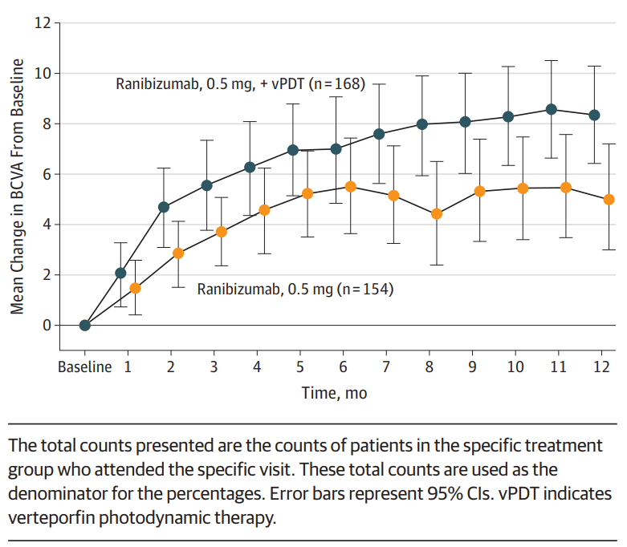

Results
Mean Change in Best-Corrected Visual Acuity (BCVA) From Baseline to Month 12 (Full Analysis Set)

Slide 9
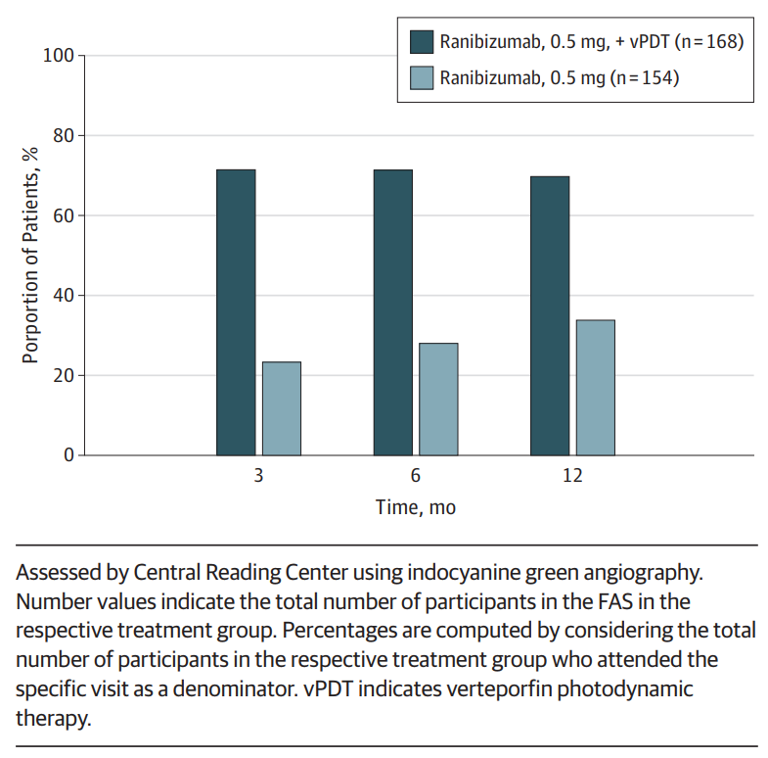
Results
Proportion of Participants With Complete Polyp Regression by Study Visits up to Month 12 in Full Analysis Set (FAS)

Slide 10
Results
Treatment exposure
  Overall, 61% patients in the combination group required only 1PDT treatment.
 | Ranibizumab 0.5 mg + vPDT (n=172)* | Ranibizumab 0.5 mg (n=149)*
Number of injections
Mean (SD) | 5.2 (2.49) | 7.3 (3.27)
Median | 4.0 | 7.0
Number of vPDT/sham PDT treatments
Mean (SD) | 1.5 (0.75) | 2.3 (1.08)
Median | 1.0 | 2.0
Safety set. *Three patients in the combination arm from the randomized set did not receive any vPDT, 7 patients in the ranibizumab monotherapy arm received at least 1 vPDT, and 1 patient randomized to ranibizumab monotherapy did not receive any treatment, and hence was not included in the safety set.
**n is the total number of patients with at least 1 injection.

Slide 11
Results
Deaths, ocular, and nonocular SAEs regardless of study-drug relationship up to month 12
Number of patients, n (%) | Ranibizumab 0.5 mg + vPDT (n=172)* | Ranibizumab 0.5 mg (n=149)*
Deaths** | 1 (0.6) | (0.0)
Ocular SAEs in the study eye, total | 1 (0.6) | 3 (2.0)
Vitreous hemorrhage | 1 (0.6) | 3 (2.0)
Non-ocular SAEs, total | 13 (7.6) | 11 (7.4)
Inguinal hernia | 2 (1.2) | 0 (0.0)
Pneumonia | 0 (0.0) | 2 (1.3)
Non-ocular SAEs >1.0% in any group are shown. Safety set;
**One patient died because of chronic obstructive pulmonary disease
*Three patients in the combination arm from the randomized set did not receive any vPDT, 7 patients in the ranibizumab monotherapy arm received at least 1 vPDT, and 1 patient randomized to ranibizumab monotherapy did not receive any treatment, and hence was not included in the safety set.
SAE, serious adverse event

Slide 12
Comment
The primary objectives of the EVEREST II study were met.
In patients with symptomatic macular PCV, ranibizumab + vPDT was superior to ranibizumab monotherapy in improving best-corrected visual acuity at 12 months and achieving complete polypoidal lesion regression at 12 months.
Importantly, these functional and anatomical outcomes were achieved with fewer injections over 12 months than anti-vascular endothelial growth factor monotherapy, thereby reducing treatment burden.
There were no new safety signals compared with the established safety profiles of ranibizumab and vPDT.

Slide 13
Contact Information
If you have questions, please contact the corresponding author:
  Adrian Koh Hock Chuan, MD, FRCS, Eye and Retina Surgeons, 13-03 Camden Medical Centre, 1 Orchard Boulevard, Singapore 248649 (ak@ers.clinic).
  Funding/Support
This study was funded and managed by Novartis Pharma AG.

Slide 14
Conflict of Interest Disclosures
All authors have completed and submitted the ICMJE Form for Disclosure of Potential Conflicts of Interest. Dr Koh is a consultant for Novartis, Allergan, Carl Zeiss, Meditec, and Heidelberg Engineering. Dr Lai is a consultant for Allergan, Bayer, Novartis, and Genentech. Dr Takahashi is a consultant for Bayer and Novartis. Dr Wong received travel grants, writing/reviewing fees, and consultancy fees from Novartis and Bayer during the conduct of the study and consultancy fees from Abbott, Allergan, Genentech, Roche, and Pfizer outside the submitted work. Dr Chen receives financial support from Novartis and Bayer and is a consultant for Bayer. Dr Ruamviboonsuk is a consultant for Allergan, Bayer, and Novartis. Dr Tan receives conference support from Bayer, Heidelberg Engineering, and Novartis. Ms Feller and Dr Margaron are employees of Novartis Pharma AG, Basel, Switzerland. Dr Lim receives travel support from Heidelberg Engineering and Novartis. Dr Lee is a consultant for Alcon, Allergan, Bayer, Novartis, and Santen and is a trustee/board member for Alcon, Allergan, Bayer, and Novartis. No other disclosures were reported

