Slide 1
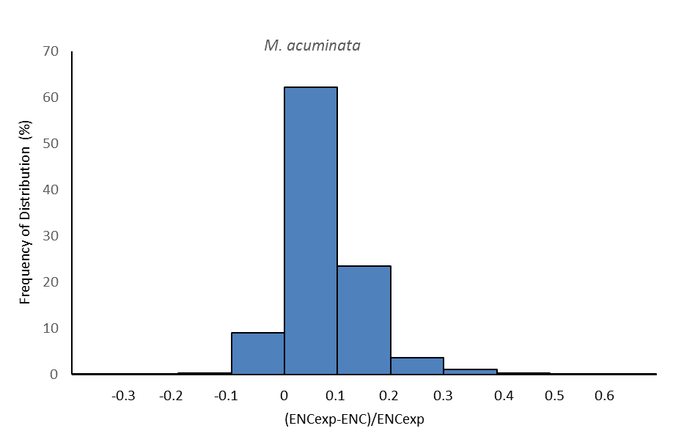
Supplementary Data Fig. S2A

Slide 2
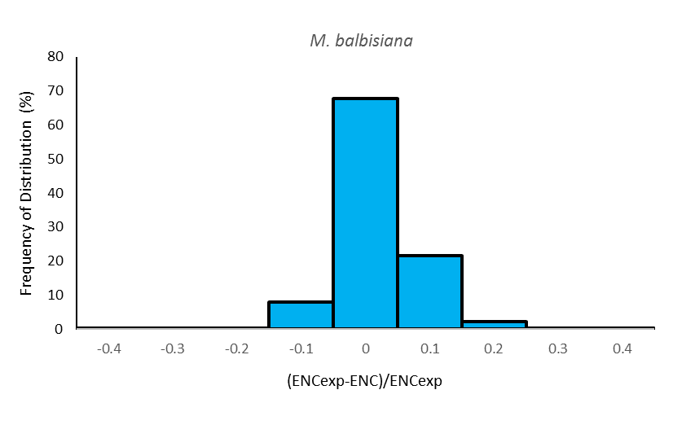
Supplementary Data Fig. S2B

Slide 3
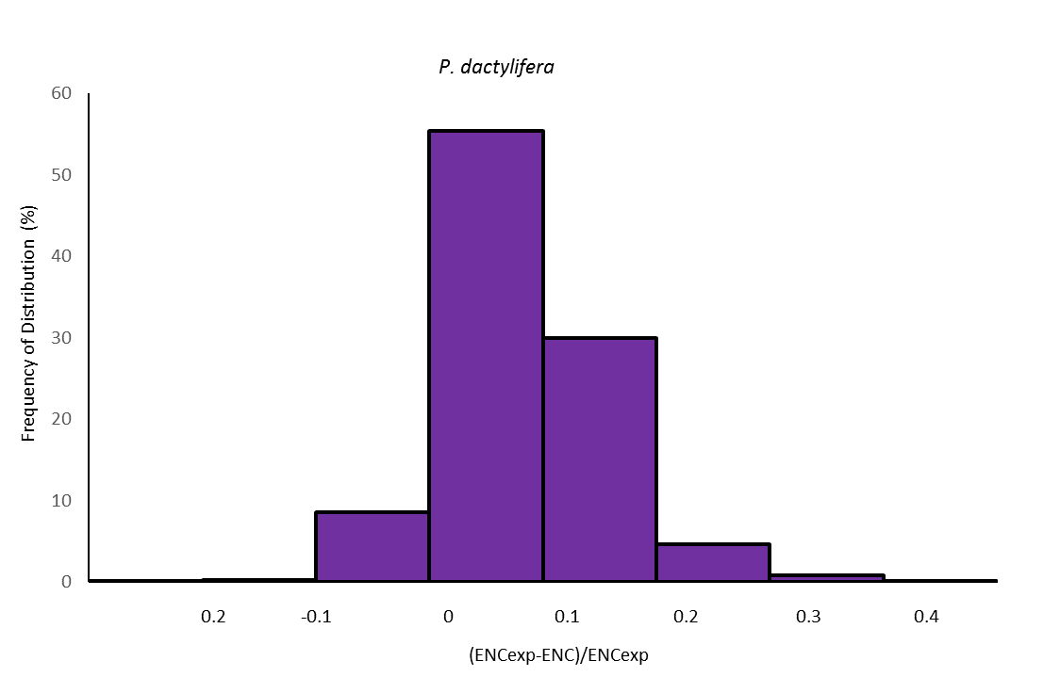
Supplementary Data Fig. S2C

Slide 4
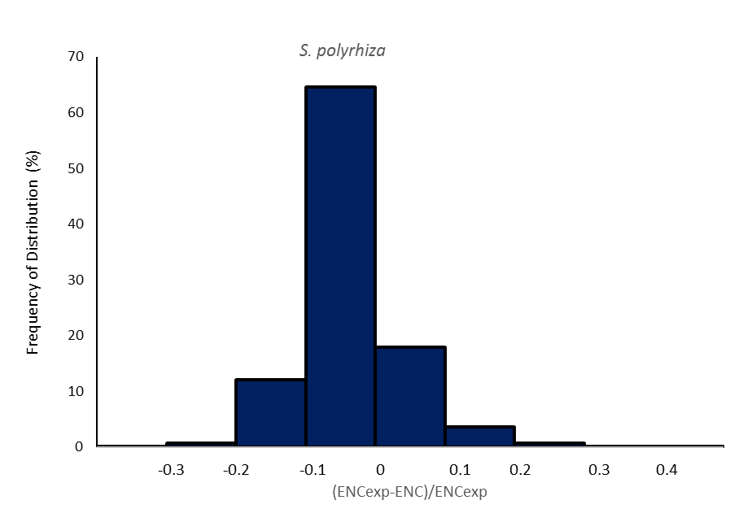
Supplementary Data Fig. S2D

Slide 5
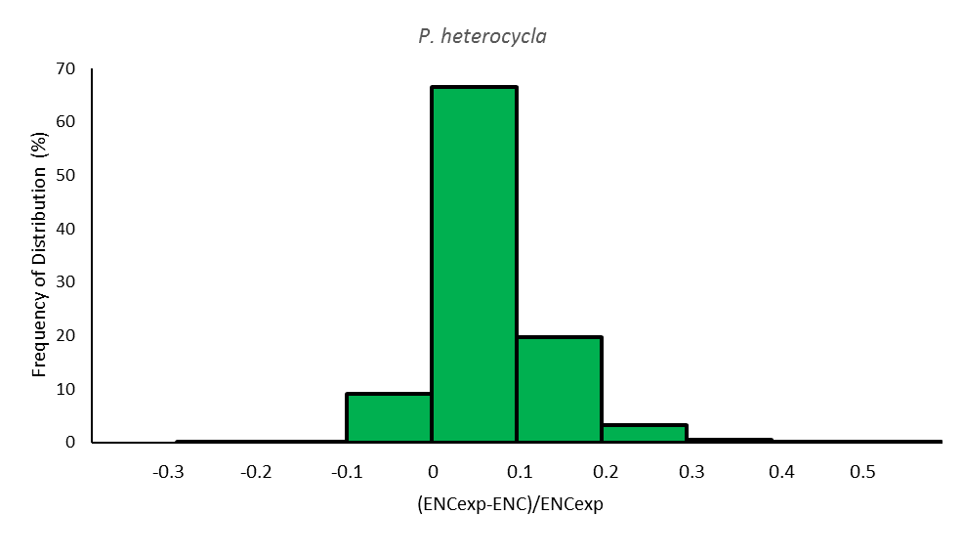
Supplementary Data Fig. S2E

