Slide 1
JAMA Pediatrics Journal Club Slides: e-Cigarette Use and Subsequent Smoking in Adolescents and Young Adults
Soneji S, Barrington-Trimis JL, Wills TA, et al. Association between initial use of e-cigarettes and subsequent cigarette smoking among adolescents and young adults: a systematic review and meta-analysis. JAMA Pediatr. Published online June 26, 2017. doi:10.1001/jamapediatrics.2017.1488

Slide 2
Introduction
Importance:
  Among US high school students, prevalence of past 30-day use of e-cigarettes increased 10-fold from 1.5% in 2011 to 16.0% in 2015.
  Longitudinal studies have reported e-cigarette use is associated with increased risk of cigarette smoking initiation among never cigarette-smoking adolescents and young adults even after adjusting for known demographic, psychosocial, and behavioral risk factors.
  The US Surgeon General noted this increased risk as an important public health concern.
Objective:
  To perform a systematic review and meta-analysis of longitudinal studies that assessed initial use of e-cigarettes and subsequent cigarette smoking.

Slide 3
Methods
Data Sources and Searches:
  Comprehensive literature search of MEDLINE’s PubMed (1946 to present), EMBASE (1974 to present), Wiley’s Cochrane Library (2016 issue 7), and Web of Science (1900 to present) between February 7 and February 17, 2017.
  Search included indexed terms and text words to capture concepts associated with e-cigarettes and traditional cigarettes.
  Comprehensive search of the 2016 Society for Research on Nicotine and Tobacco 22nd Annual Meeting abstracts, the 2016 Society of Behavioral Medicine 37th Annual Meeting & Scientific Sessions abstracts, and the 2016 National Institutes of Health Tobacco Regulatory Science Program Conference.

Slide 4
Methods
Study Selection
  Included studies that evaluated the association between e-cigarette use among never cigarette smokers at baseline and cigarette smoking initiation between baseline and follow-up.
  Included studies that evaluated the association between past 30-day e-cigarette use at baseline and past 30-day cigarette smoking at follow-up.
  Included longitudinal studies and excluded cross-sectional studies given the temporal ordering of the research question.
  Interrater agreement = 86.1%.

Slide 5
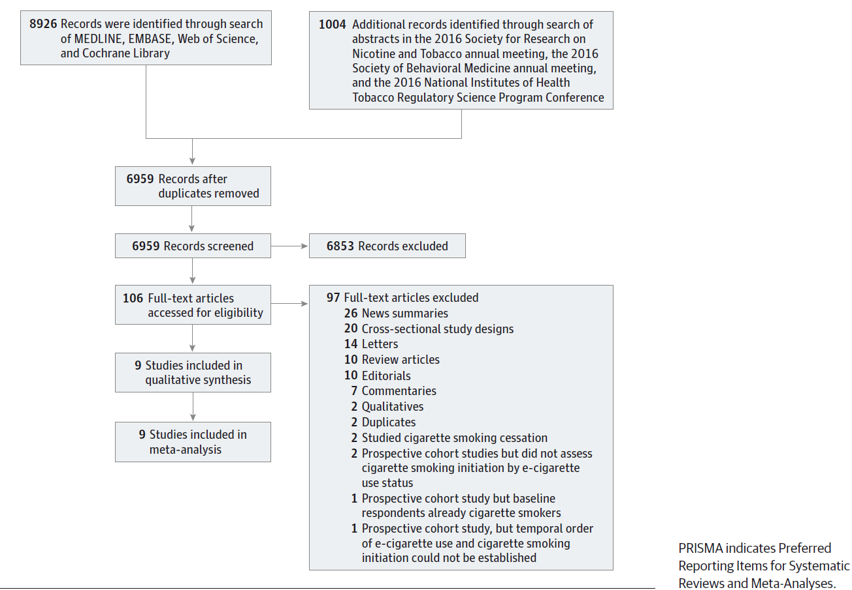
Methods
PRISMA Diagram of Study Selection

Slide 6
Methods
Data Extraction:
  Study location
  Comparison group (eg, never e-cigarette users)
  Time between baseline and follow-up
  Demographic, psychosocial, and behavioral characteristics included in each study’s multivariable statistical analysis
Quality of Studies:
  Newcastle-Ottawa Scale: assess quality of nonrandomized studies
  Risk of Bias in Non-randomized Studies of Interventions tool: assess risk of bias in nonrandomized studies
Statistical Analysis:
  Random-effects meta-analysis
  Subgroup analysis to assess source of heterogeneity between studies
    Adolescent vs young adult (based on mean age of respondents at baseline)
    Baseline year of study (before 2014 vs 2014 or later)
    Regional vs national sample

Slide 7
Methods
Outcomes:
  Among baseline never cigarette smokers, cigarette smoking initiation between baseline and follow-up.
  Among baseline non–past 30-day cigarette smokers who were past 30-day e-cigarette users, past 30-day cigarette smoking at follow-up.
Limitations
  Do not know the type of e-cigarette used by respondents (eg, first-generation “cig-a-likes”) or the proportion of respondents who used nicotine-containing e-cigarettes.
  All included studies were US based despite international literature search; thus, our results may not apply to youth in other countries.
  Overall risk of bias was moderate for all studies, in part, owing to moderate risk of bias from confounding.

Slide 8
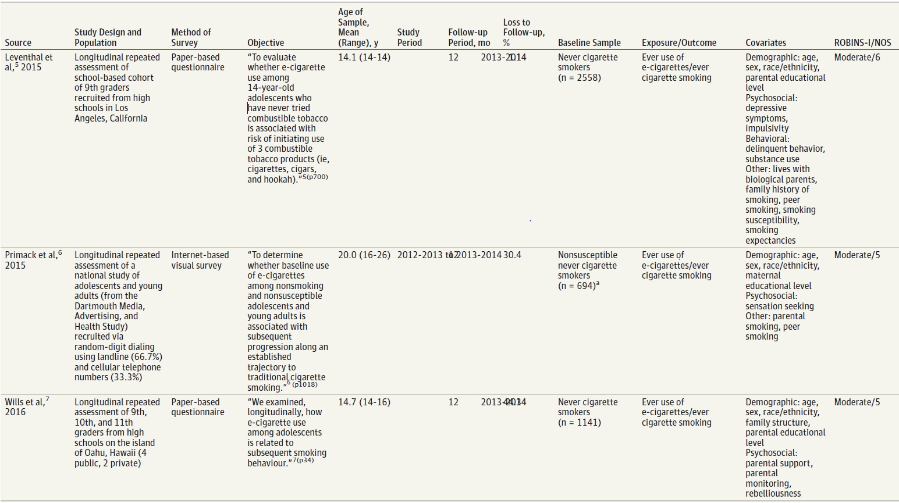
Results
Summary of Studies

Slide 9
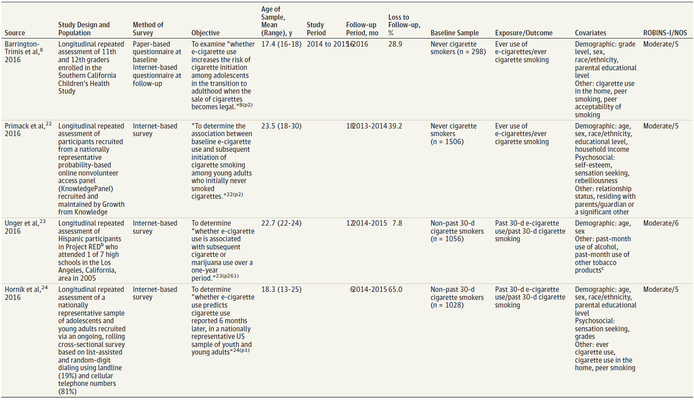
Results
Summary of Studies (Continued)

Slide 10
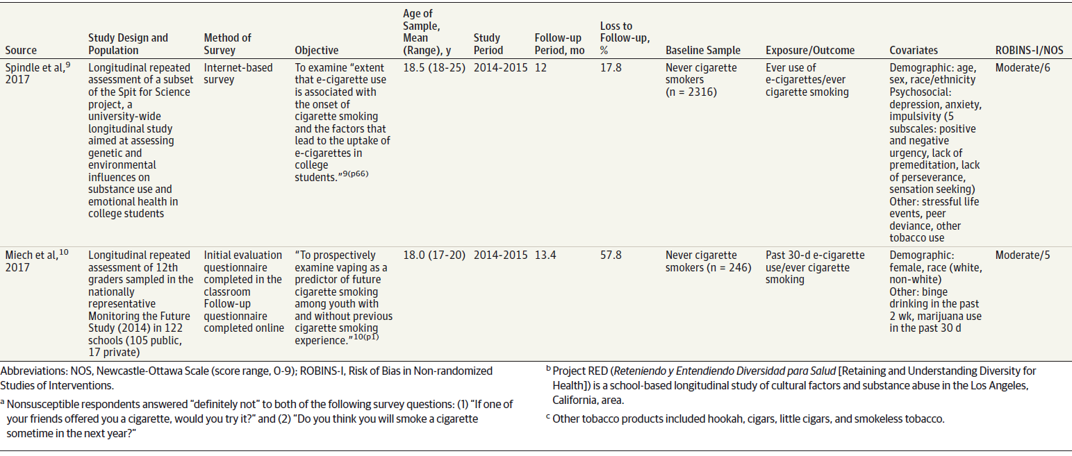
Results
Summary of Studies (Continued)

Slide 11
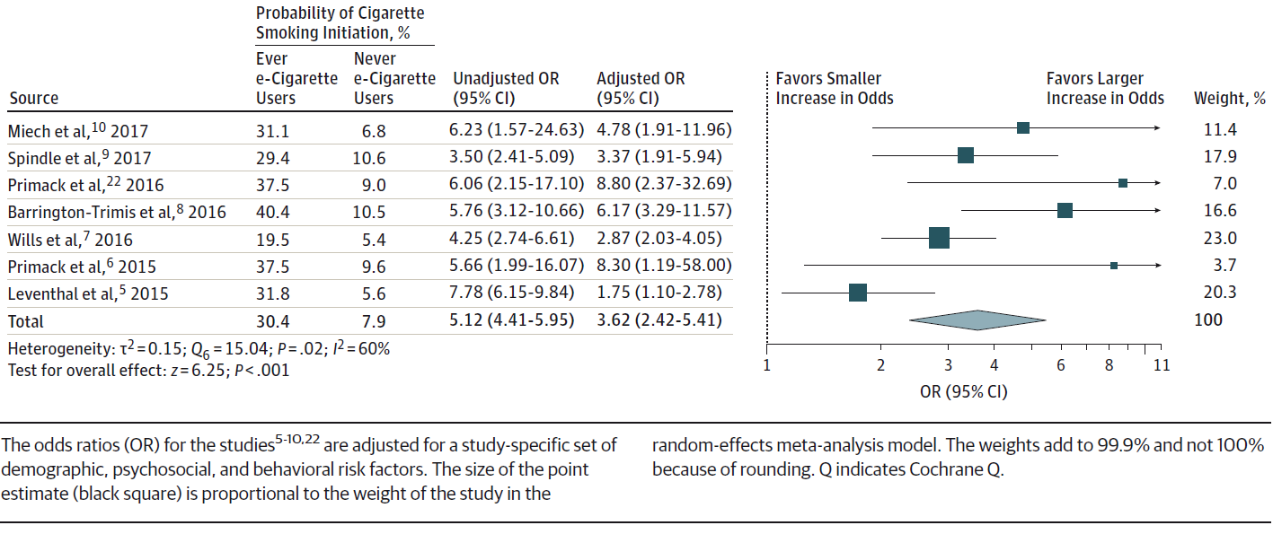
Results
Meta-analysis of Adjusted Odds of Cigarette Smoking Initiation Among Never Cigarette Smokers at Baseline and Ever e-Cigarette Users at Baseline Compared With Never e-Cigarette Users at Baseline
Combining data and multivariable regression results from the 5 studies in a random-effects meta-analysis, the pooled adjusted odds ratio of cigarette smoking initiation was 3.62 (95% CI, 2.42-5.41) for baseline ever e-cigarette users compared with baseline never e-cigarette users.

Slide 12
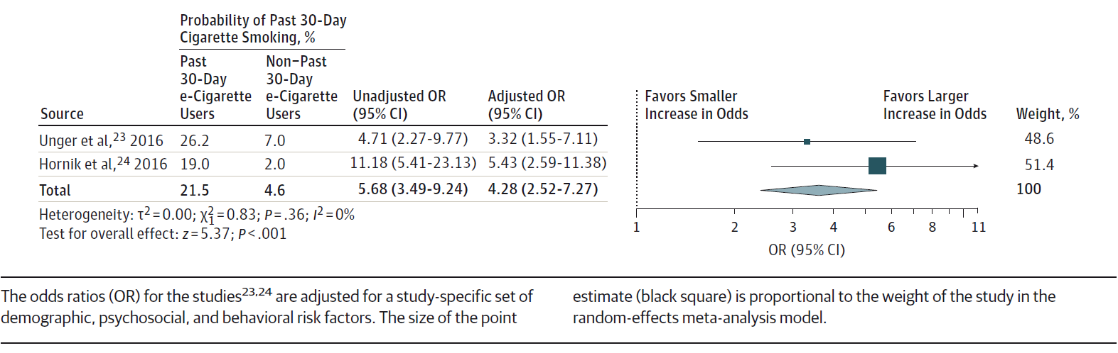
Results
Meta-analysis of Adjusted Odds of Current (Past 30-Day) Cigarette Smoking at Follow-up Among Noncurrent Cigarette Smokers at Baseline and Current e-Cigarette Users at Baseline Compared With Noncurrent e-Cigarette Users at Baseline
Combining data and multivariable regression results from the 2 studies in a random-effects meta-analysis, the pooled adjusted odds ratio of past 30-day cigarette smoking at follow-up was 4.28 (95% CI, 2.52-7.27) for past 30-day e-cigarette vs non–past 30-day e-cigarette users at baseline.

Slide 13
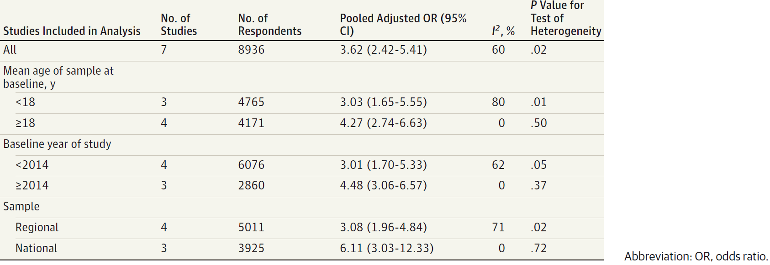
Results
Subgroup Analysis of Cigarette Smoking Initiation
After excluding the 4 studies conducted before 2014, the pooled adjusted odds ratio of cigarette smoking initiation was 4.48 (95% CI, 3.06-6.57) and this exclusion diminished heterogeneity among studies, which was no longer significant (P = .37).

Slide 14
Comment
Results from 9 longitudinal studies were consistent in finding that e-cigarette use is associated with increased risk of future cigarette smoking initiation and current cigarette smoking even after adjusting for potentially confounding demographic, psychosocial, and behavioral factors.
Our results suggest e-cigarette use is a strong risk factor for cigarette smoking among adolescents and young adults because the magnitude of pooled odds ratios approximately equaled or exceeded that of other known risk factors including parental, sibling, and peer cigarette smoking and high levels of sensation seeking and risk taking.
Our results indicate that e-cigarette use is an independent risk factor for cigarette smoking because we included studies that adjusted for numerous known risk factors for cigarette smoking into our analysis.

Slide 15
Comment
e-Cigarette use may represent a risk factor for cigarette smoking initiation and current cigarette smoking for several behavioral and physiological reasons.
  E-cigarette use mimics behavioral scripts of cigarette smoking.
  Adolescents and young adults who use nicotine-containing e-cigarettes may become addicted to nicotine because e-cigarette aerosol contains highly oxidizing free-base nicotine, the most addictive form of nicotine.
  E-cigarette use may activate cognitive or behavioral processes that increase the risk for smoking.
Several aspects of the association between e-cigarette use and cigarette smoking suggest a causal correlation, namely, its association, consistency, specificity, temporality, and biological and behavioral plausibility.

Slide 16
Comment
To minimize potential public health harm from e-cigarettes, the US Food and Drug Administration, as well as state and local agencies, will need to engage in regulatory actions to discourage youth use of e-cigarettes and prevent transition from e-cigarettes to other combustible tobacco products.
In addition to currently enacted age restrictions on in-store sales, regulatory actions could include:
  Restrictions on advertising campaigns that may be viewed by adolescents.
  Limits to characterizing flavors (eg, fruit and candy flavors).
  Strict standards for reporting actual nicotine content in e-liquid.
  Requirements for strict age verification for online and retail sales.
Strong regulation of e-cigarettes could curb use among youth and limit the future population-level burden of tobacco.

Slide 17
Contact Information
If you have questions, please contact the corresponding author:
  Samir Soneji, The Dartmouth Institute for Health Policy and Clinical Practice, One Medical Center Drive, Lebanon, NH 03756 (samir.soneji@dartmouth.edu)
Funding/Support
This study was supported by grants R21-CA197912 (Dr Soneji), R01-CA077026 (Dr Sargent), R01-CA140150 (Dr Primack), R21- CA185767 (Dr Primack), and R01-CA153154 and P30-CA071789-16S2 (Dr Wills) from the National Cancer Institute (NCI) at the National Institutes of Health (NIH); grants P50-CA180905 (Drs Barrington-Trimis and Unger) and P50-CA179546 (Drs Gibson and Hornik) from the NCI and the US Food and Drug Administration Center for Tobacco Products; and grants P50-DA036105 (Mr Spindle and Dr Eissenberg), R01-DA033296 (Dr Leventhal), R01-DA10767 (Dr Andrews), and R01-DA016310 (Dr Unger) from the National Institute on Drug Abuse at the NIH.
Conflict of Interest Disclosures
Dr Eissenberg reported being a paid consultant in litigation against the tobacco industry and reported being named on a patent application for a device that measures the puffing behavior of e-cigarette users. No other disclosures were reported.

