Slide 1
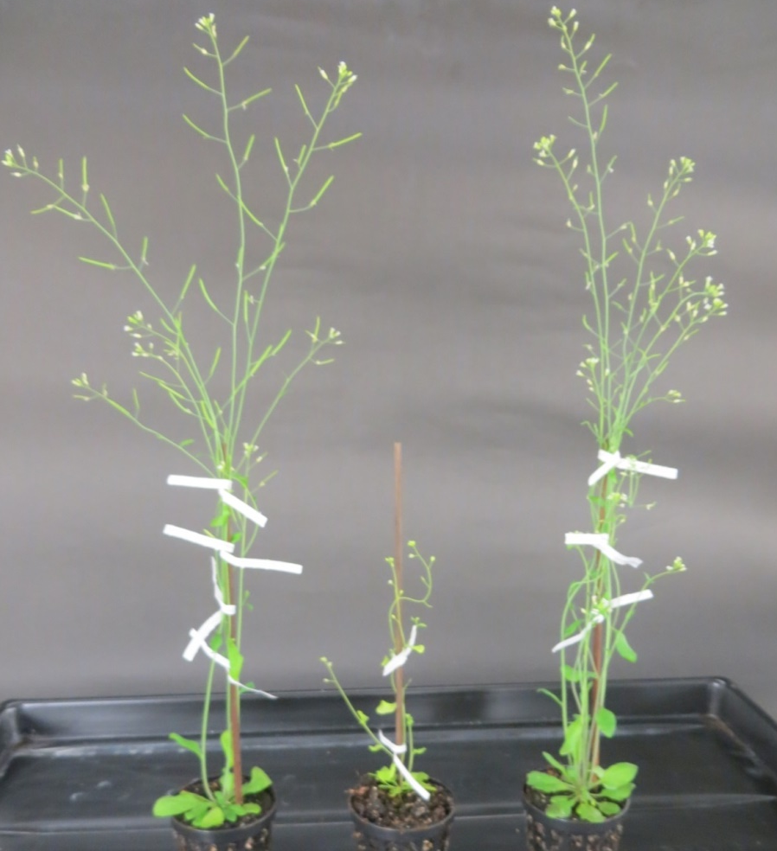
Plant line | Transition to flowering* (days on soil) | Height (cm) | Diameter rosette leaves (cm) | Seed set (mg/plant)
rbm25-3 (n=12) | ave. 8.7 range 6-11 | ave. 15.8 range 10-26 | ave. 3.2 range 2-4 | ave. 9.2 range 5-14
rbm25-4 (n=12) | ave. 7.1 range 4-10 | ave. 30.5 range 16-35.5 | ave. 5.2 range 4-6.5 | ave. 36.5 range 25.5-50.2
T (n=12) | ave. 9.0 range 7-10 | ave. 30.8 range 19.5-35 | ave. 5.8 range 4-9 | ave. 76.5 range 51.2-114
Figure S1: Phenotype comparison of rbm25 mutants with wild-type T line.
Top, left to right: age-matched adult plants of the T line and the rbm25-3 and rbm25-4
mutants. Bottom: To compare phenotypes of rbm25 mutants compared to the wild-type
T line, we grew12 plants from each genotype on soil to maturity and seed set. The
features listed above were determined for individual plants. The ranges and averages of
These values are indicated.
Kanno et al.

