Slide 1
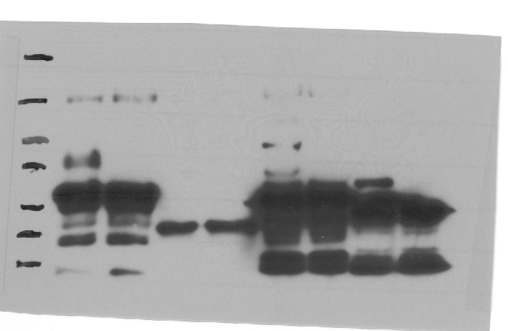
TCP3 is sumoylated in E. coli system
SUMO1:
GG
GG
AA
AA
130
95
70
Sumoylated T7-Myb30
Sumoylated T7-TCP3
55
Unmodified T7-TCP3
43
Unmodified T7-Myb30

Slide 2
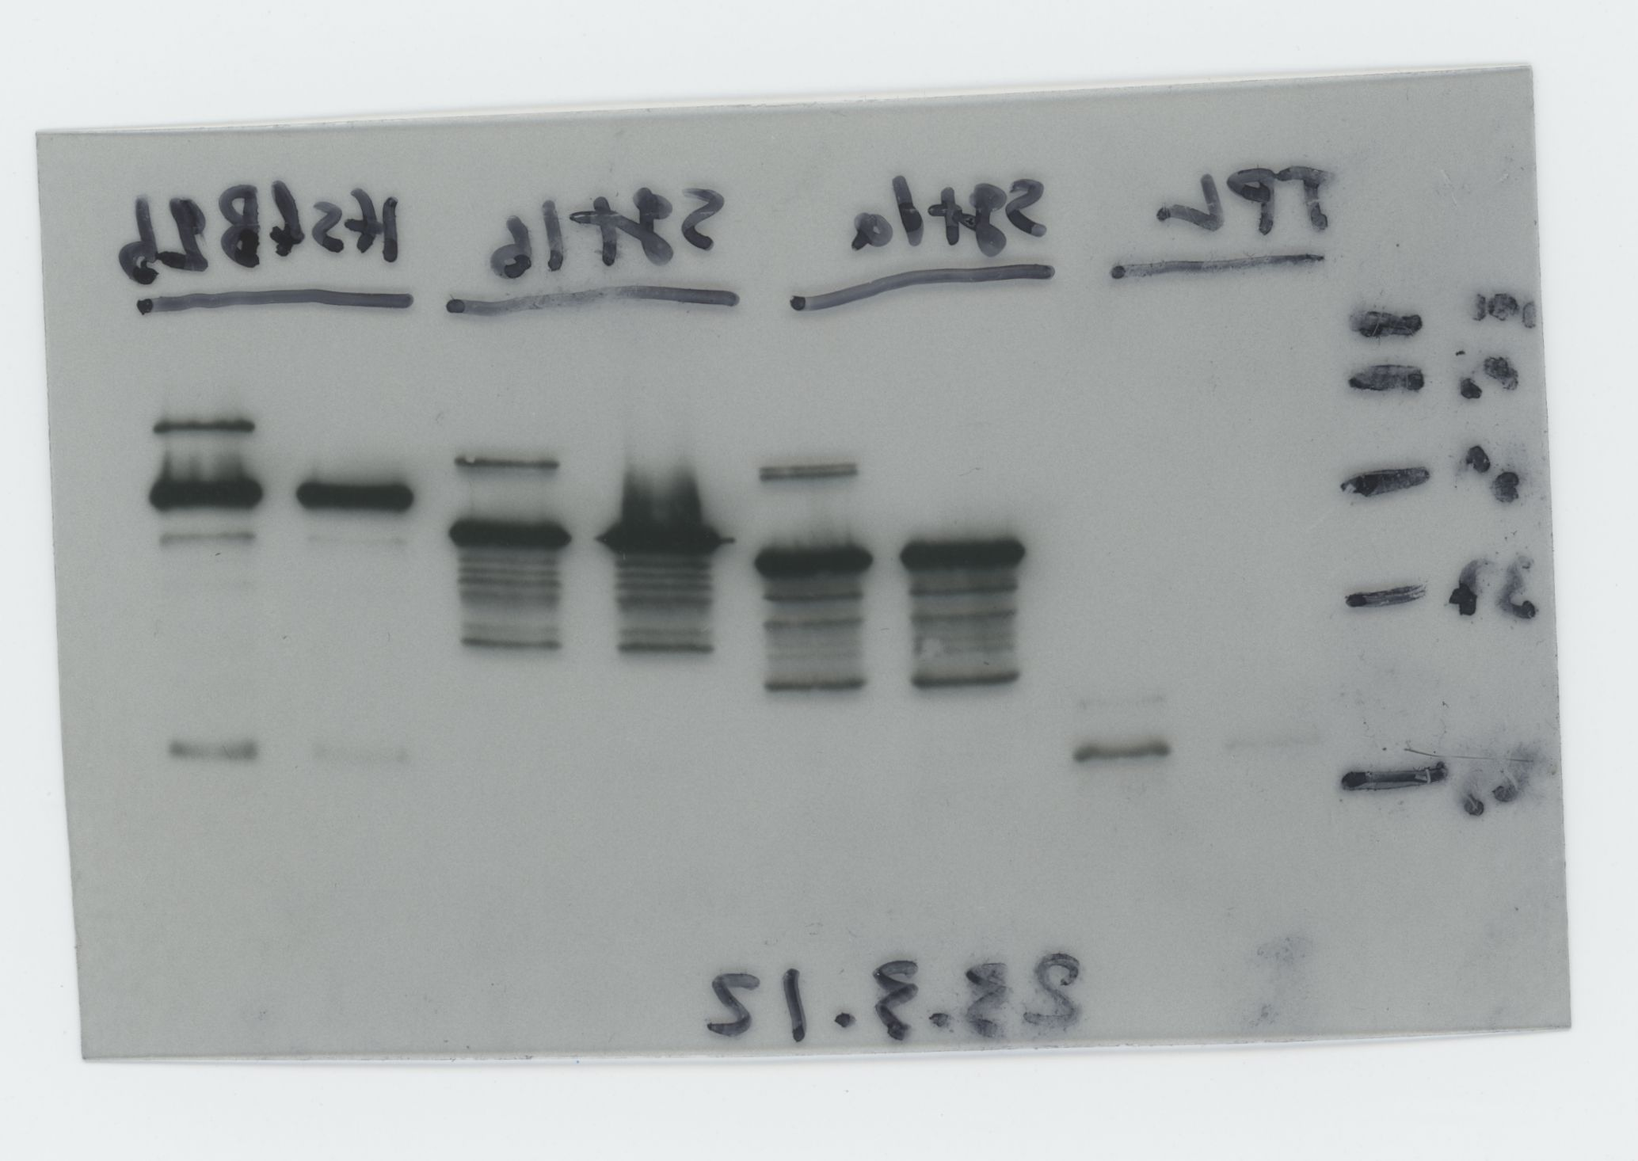
HsfB2b is sumoylated in E. coli system
SUMO1:
AA
GG
Sumoylated T7-TCP15
Unmodified T7-HsfB2b

Slide 3
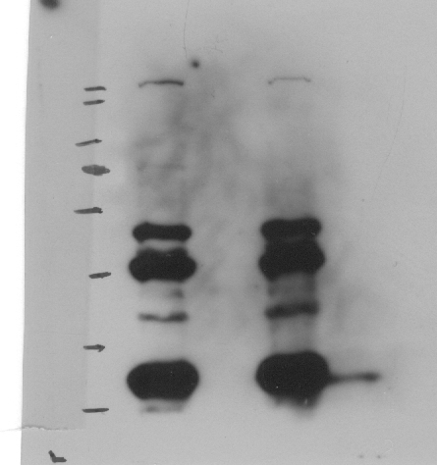
TCP1 is sumoylated in E. coli system
SUMO1:
GG
AA
130
95
Sumoylated T7-TCP1
70
55
Unmodified T7-TCP1
43
34
25

Slide 4
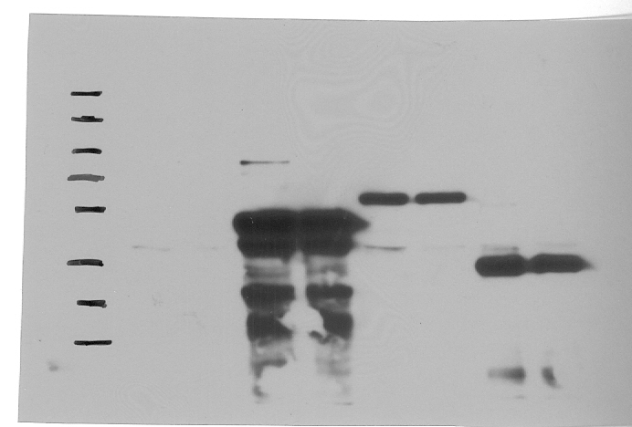
TCP8 is sumoylated in E. coli system
SUMO1:
GG
AA
130
95
Sumoylated T7-TCP8
70
55
Unmodified T7-TCP8
43

Slide 5
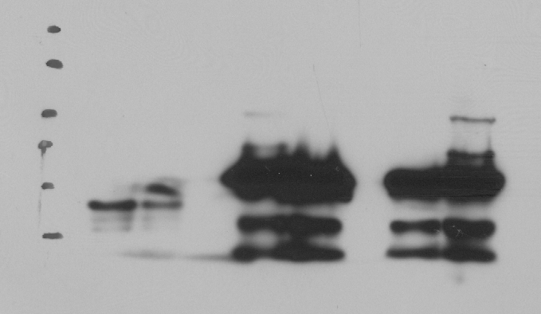
TCP14 is sumoylated in E. coli system
GG
AA
AA
SUMO1:
GG
130
95
Sumoylated T7-TCP14
70
55
Unmodified T7-TCP14
43

Slide 6
TCP15 is sumoylated in E. coli system
GG
SUMO1:
AA
Sumoylated T7-TCP15
Unmodified T7-TCP15
Sumoylated T7-TCP15

