Slide 1
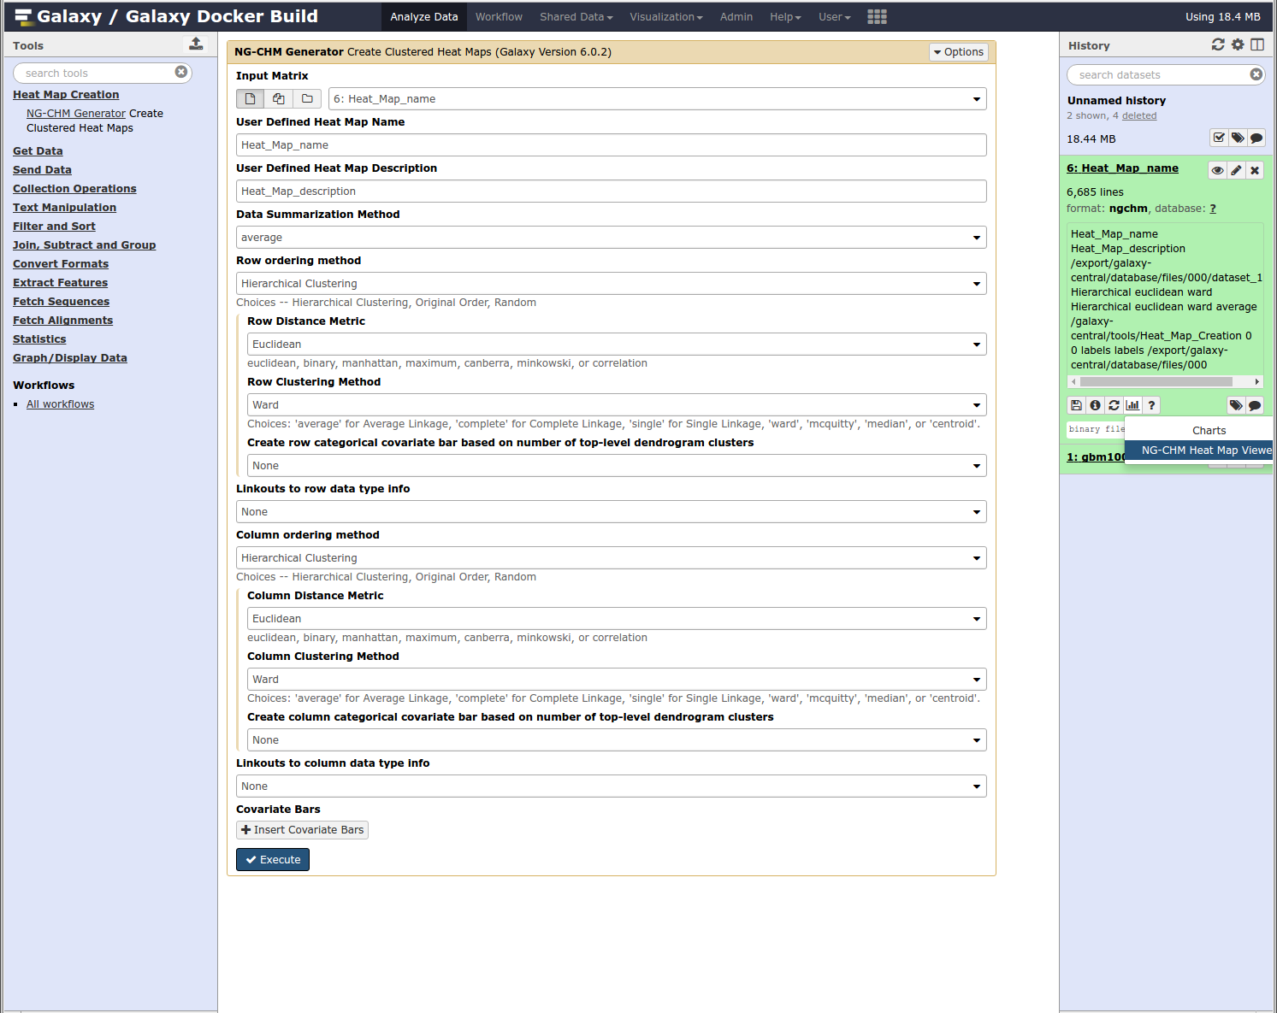
Supplementary Figure S1. Screenshot of the NG-CHM Generator within the Galaxy bioinformatics platform. The central panel shows the Generator input form, which is displayed after NG-CHM Generator is selected from the Tools menu (left panel). After the generator has finished, the NG-CHM visualization tool can be selected from the visualization menu in the job history (right panel).

