Slide 1
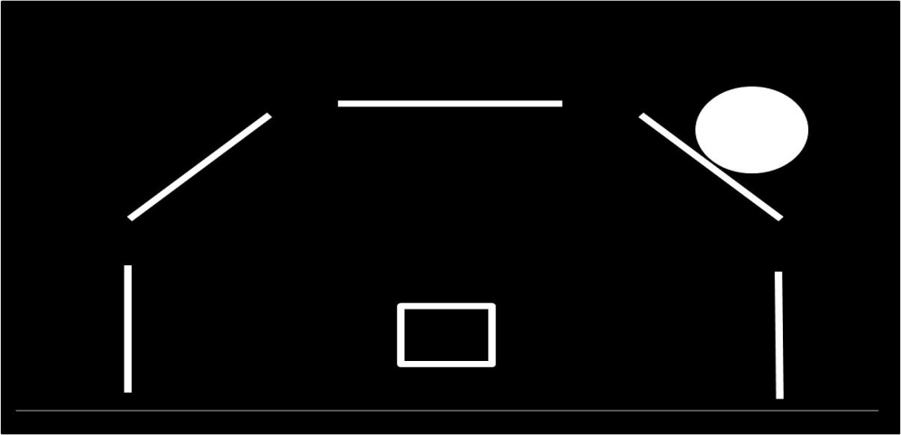
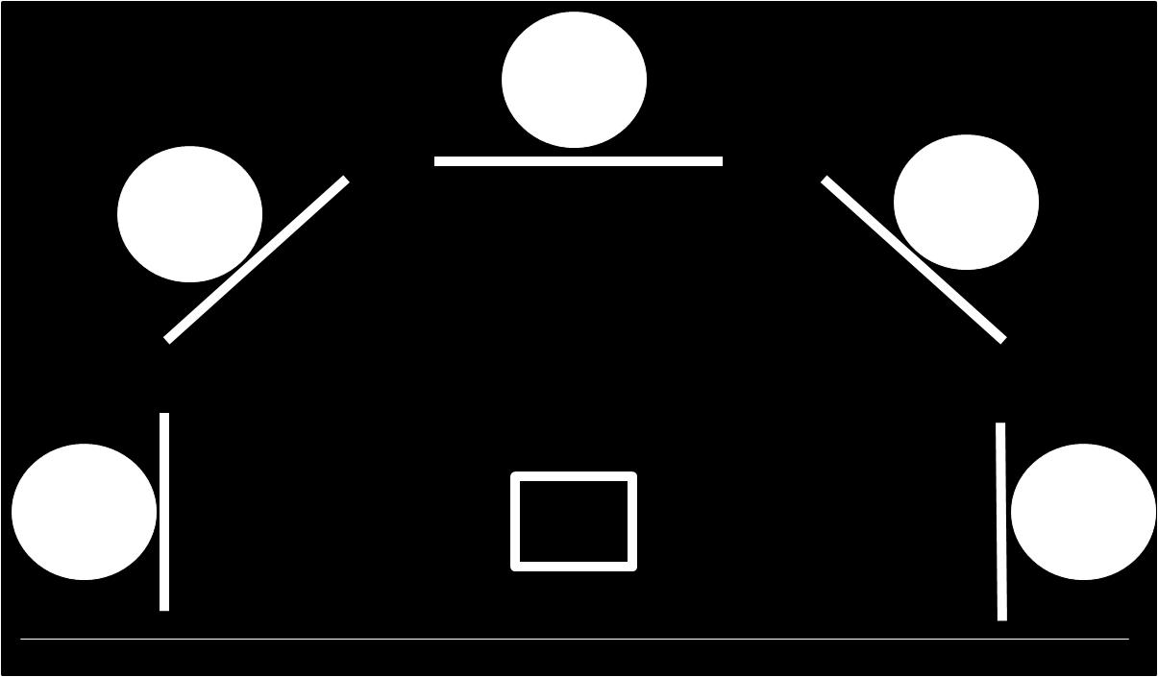
Target “Go” Trial (X5)
Requiring response
Non-target “No-go” Trial (X1)
Requiring inhibition
Hit rate
False alarm rate
D-prime score
Figure S1
A
Target Trial (X5)
Non-target Trial (X1)
A
Target Trial (X5)
Non-target Trial (X1)

