Slide 1
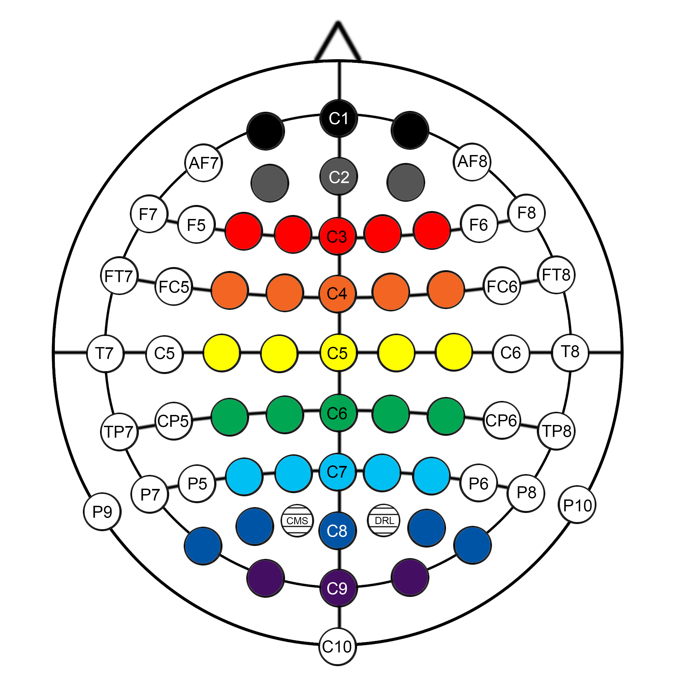
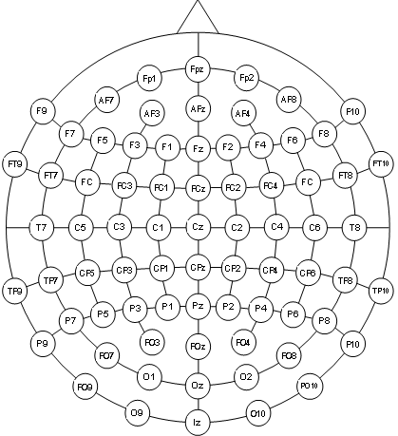
Figure S2
B
B
1
2
1
3
2
4
3
5
4
6
5
7
6
8
7
8

