Slide 1
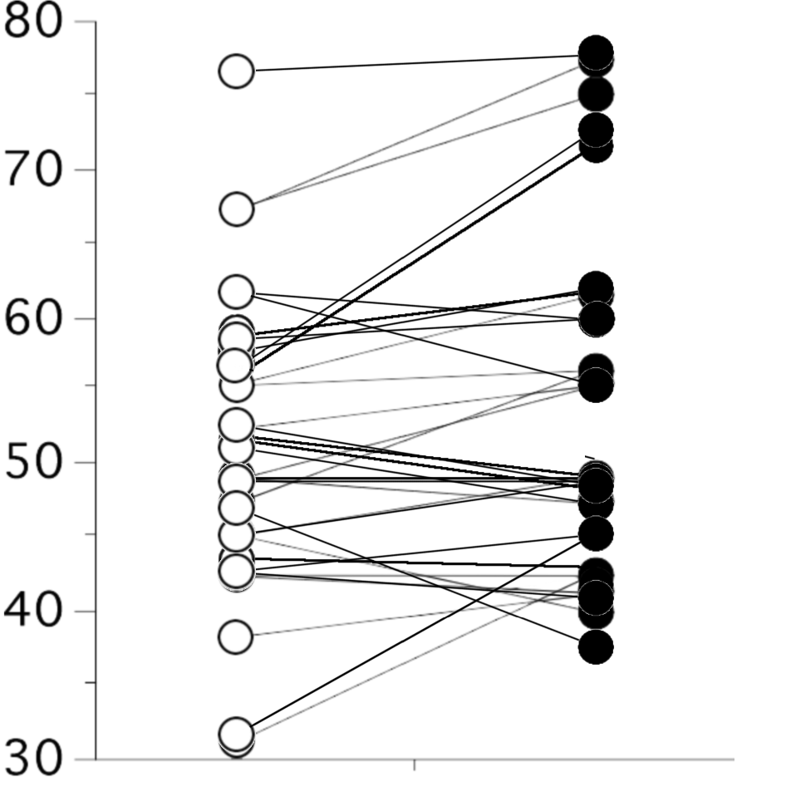
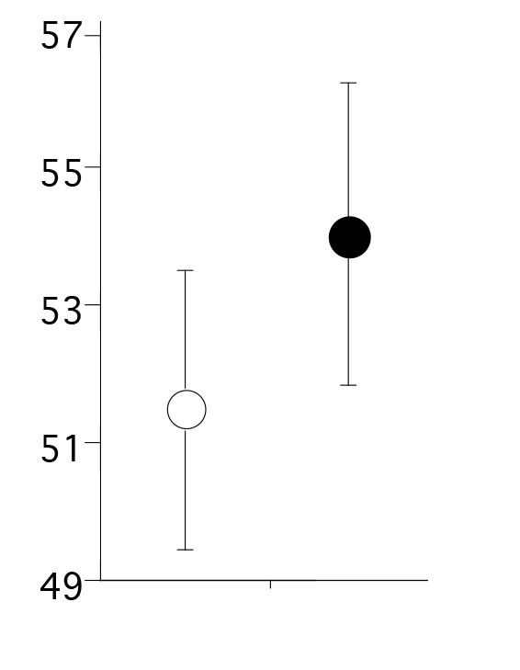
A.
B.
*
PBO
TOL
Mean T-score
Verbal Fluency T-Score
Placebo Tolcapone
Figure S3

