Slide 1
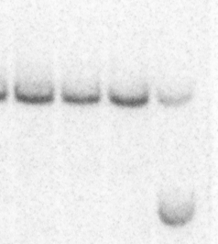
a
NcoI
NcoI
NcoI
Endogenous Cbfb
4
5
6
15,727bp
NcoI
NcoI
BamH1
BamH1
Targeting vector
5
MYH11
pgkNeo
DE
NcoI
NcoI
NcoI
NcoI
NcoI
Targeted Cbfb
4
5
MYH11
pgkNeo
6
DE
7,066bp
Cbfb^{+/mDE}
Cbfb^{+/MYH11}
c
WT
b
1 2 3 4
CBFβ-SMMHC
WT
mDE
CBFβ

Slide 2
Supplementary Figure S1. Cbfb-MYH11 C-terminal DE mutation knockin (Cbfb^{+/mDE}) design. (a) Schematic representation of the targeting strategy. Genomic DNA was cut by NcoI and probed with 0.2C (solid block) and Neo Probe (grey box). DE: the mutations in the D&E helices. (b) Southern blot hybridization of 4 mouse embryonic stem cell lines (No.1-4) with probe 0.2C to show the wildtype band (top) in all 4 lines and the mutated DE knockin band (bottom) only in line No.1, which was used to generate the DE knockin mice. (c) Representative western blot that shows the endogenous CBFβ bands in all BM samples with the indicated genotype, and the CBFβ-SMMHC knockin protein bands (same size with or without the DE mutation) in Cbfb^{+/MYH11} and Cbfb^{+/mDE} BM samples. The graphs on the right show relative knockin vs endogenous CBFß band intensity of Cbfb^{+/mDE} (N=5) and Cbfb^{+/MYH11} (N=4) BM samples.

Slide 3
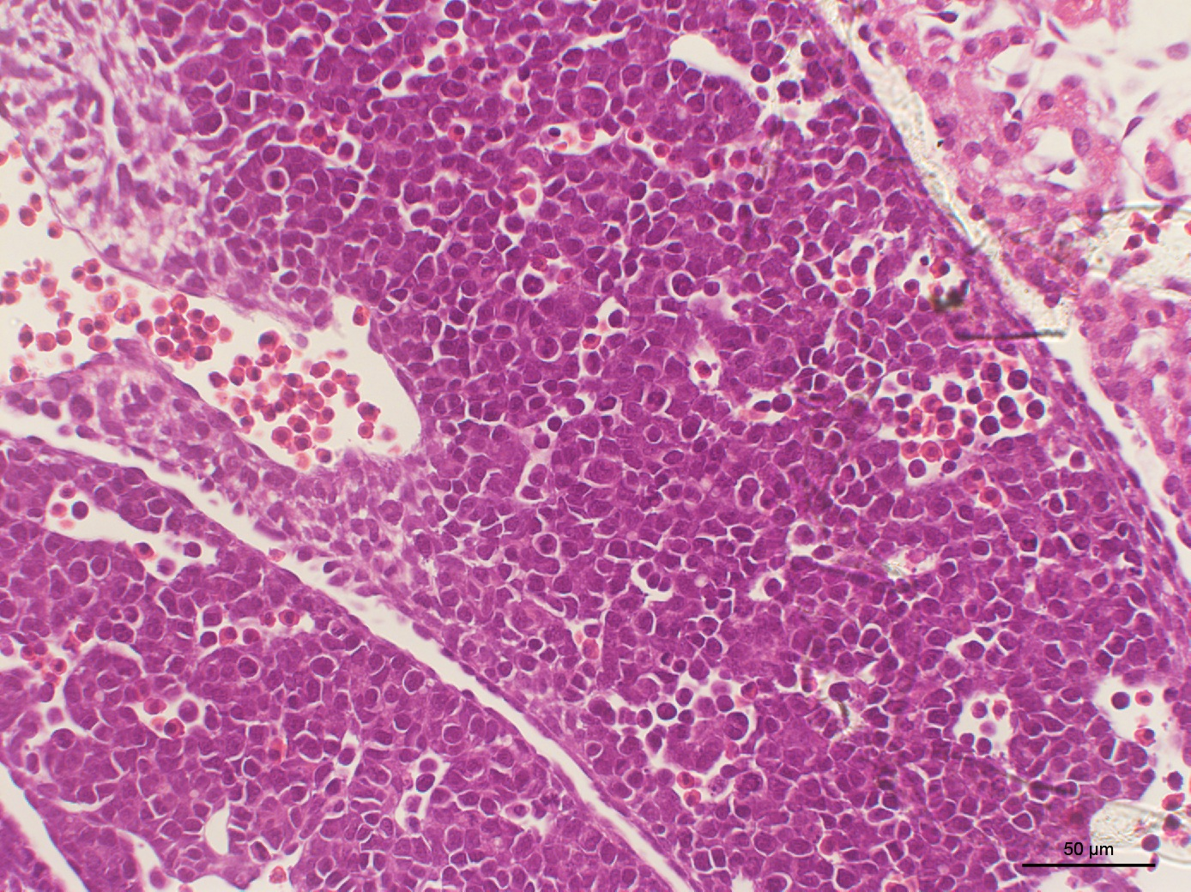
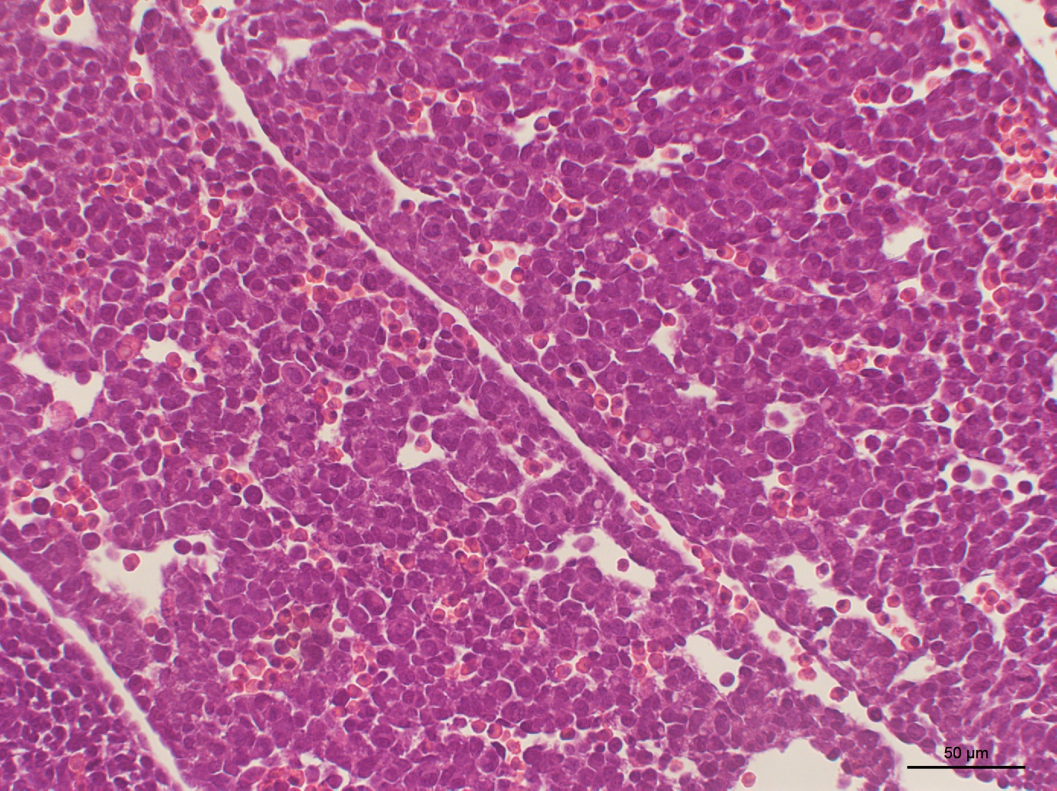
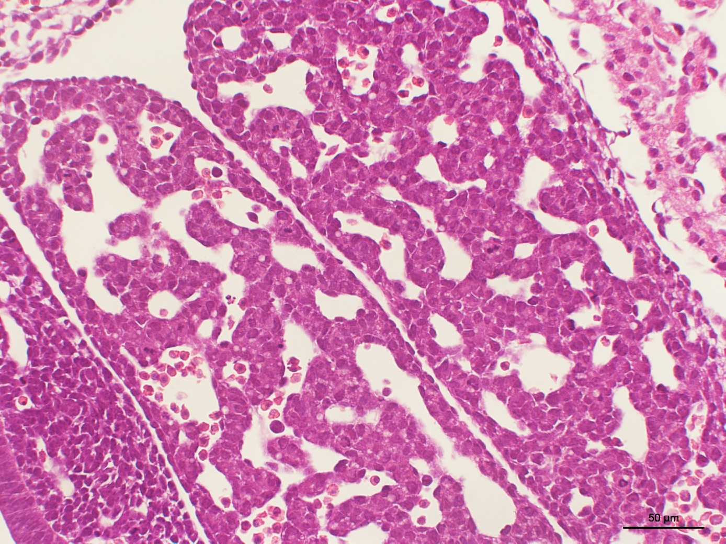
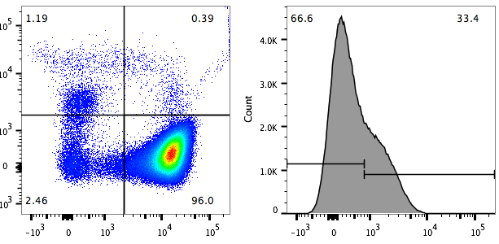
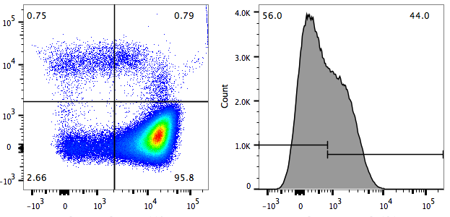
a
b
WT
Cbfb^{+/mDE}
Cbfb^{mDE/mDE}
Colony number / 1x10⁴ cells
c
Cbfb^{+/+}
Cbfb^{mDE/mDE}
C-KIT
C-KIT
Ter119
CD131
Ter119
CD131
d
e
Percentage (%)
Percentage CD131⁺ (%)
Cbfb^{+/+}

Slide 4
Supplementary Figure S2. Embryonic phenotype of Cbfb^{+/mDE} and Cbfb^{mDE/mDE} mice. (a) Fetal liver of E11.5 Cbfb^{mDE/mDE} mice showed decreased cellularity and hematopoietic cells. (b) Colony forming assay using E12.5 fetal liver cells from WT (N=3), Cbfb^{+/mDE} (N=6), and Cbfb^{mDE/mDE} (N=3) mice. No colonies were found on plates with cells from Cbfb^{mDE/mDE} mice. There are no significant differences between WT and Cbfb^{+/mDE} mice for all types of colonies counted. (c) Representative flow data of E10.5 PB from WT and Cbfb^{mDE/mDE} mice. (d) Percentages of each indicated cell surface marker combination for E10.5 PB cells of each indicated genotype. (e) Percentages of CD131⁺ cells in E10.5 PB for each indicated genotype.

Slide 5
P<0.05
P<0.05
Supplementary Figure S3. Summary of FACS analysis of different types of PB cells in aged mice (>12 months). CD19⁺ B cells were decreased and Gr1⁺/Mac1⁺ cells increased in the peripheral blood of Cbfb^{+/mDE} mice 12 months after ENU treatment, as compared to Cbfb^{+/+} mice.

Slide 6
a
b
Cbfb^{+/+}
Cbfb^{+/mDE}
Cbfb^{+/MYH11}
percentage
percentage
Supplementary Figure S4. FACS analysis of adult bone marrow cells. (a) FACS analysis with the indicated lineage markers. Cbfb^{+/mDE} mice were analyzed at the indicated time points (2.5,4.5 and 6 months) while the WT control mice were analyzed at 2.5 months. (b) Comparing bone marrow hematopoietic lineage cells among mice with the indicated genotypes. All lineage cell population in the BM of Cbfb^{+/mDE} mice are comparable to WT control (Cbfb^{+/+}) mice, rather than the Cbfb^{+/MYH11} mice.

Slide 7
**
**
Colony number /1x10⁵ cell
**
**
*
**
Supplementary Figure S5. Colony forming assay with adult Cbfb^{+/+}, Cbfb^{+/mDE} and Cbfb^{+/MYH11} bone marrow (BM) cells. Three mice from each genotype at the age of 8-12 weeks were used for the experiments. Cbfb^{+/mDE} BM cells were similar to WT BM cells but different from Cbfb^{+/MYH11} BM cells. E: BFU-E, G: CFU-G, M: CFU-M, GM: CFU-GM, GEMM: CFU-GEMM, Total: sum of all colonies, G/M: G+M+GM. There is no difference between Cbfb^{+/+} and Cbfb^{+/mDE} BM cells. Cbfb^{+/MYH11} BM cells have significantly higher number of colonies in all categories except BFU-E (E) colonies. *: p <0.05, **: p < 0.01
Notes:
Colony forming assay from adult WT (N=3), Cbfb^{+/mDE} (N=3) and Cbfb^{+/MYH11} (N=3) BM cells.

Slide 8
a
b
Viability
Live cell count (x10⁶)/femur
c
Supplementary Figure S6. Analysis of cell viability and apoptosis.
(a) Viability of Cbfb^{+/mDE} BM cells (shaded bars) at 2.5, 4.5 and 6 months (m) was similar (p > 0.05) to WT mice at 2.5 months (WT 2.5m). (b) Bone marrow (from femur) live cell counts of Cbfb^{+/mDE} mice (shaded bars) were comparable to WT (2.5m) mice (p > 0.05). (c) BM cells were stained with lineage markers (CD3,CD4,CD8,CD19,GR1,MAC1), C-KIT, SCA-1, 7AAD and Annexin V (BD Biosciences). Percentage of 7AAD⁻Annexin V⁺ apoptotic cells and 7AAD⁺ dead cells from Lin⁺ and Lin⁻ cells were compared among different genotypes. Cbfb^{+/mDE} mice had similar apoptosis rates as compared to the WT (Cbfb^{+/+} ) mice except a slight increase in Lin⁺ apoptotic cells. Three mice were used in each group.
P=0.04
Percentages of annexin V/7AAD positive cells
P=0.04

Slide 9
a
b
RUNX1+CBFβ-SMMHC^{mDE}
+/mDE
+/+
Cbfb^{+/MYH11}
CBFβ-SMMHC
CBFβ-SMMHC^{mDE}
RUNX1+CBFβ-SMMHC
RUNX1
RUNX1+CBFβ
Cy
Nu
Cy
Nu
Cy
Nu
CBFβ-SMMHC
Cy\ Nuc
Cy\ Nuc
Cy\ Nuc
Cy\ Nuc
Cy\ Nuc
Cy\ Nuc
CBFβ-SMMHC
CBFβ
60KDa
RUNX1
50KDa
CBFβ
40KDa
RUNX1
Lamin B
β-Actin
β-actin
Lamin B
Supplementary Figure S7. Subcellular localization of RUNX1, CBFβ, and CBFβ-SMMHC fusion proteins in bone marrow cells from adult mice (a) and transfected 293 cells (b). (a) Western blot of bone marrow cells from Cbfb^{+/mDE}, wildtype and Cbfb^{+/MYH11} mice. (b) Western blot of 293 cells transfected with the constructs as indicated. Cy: cytoplasmic protein; Nu: nuclear protein. Lamin B and β-actin were detected as controls for nuclear and cytoplasmic fractions, respectively.

Slide 10
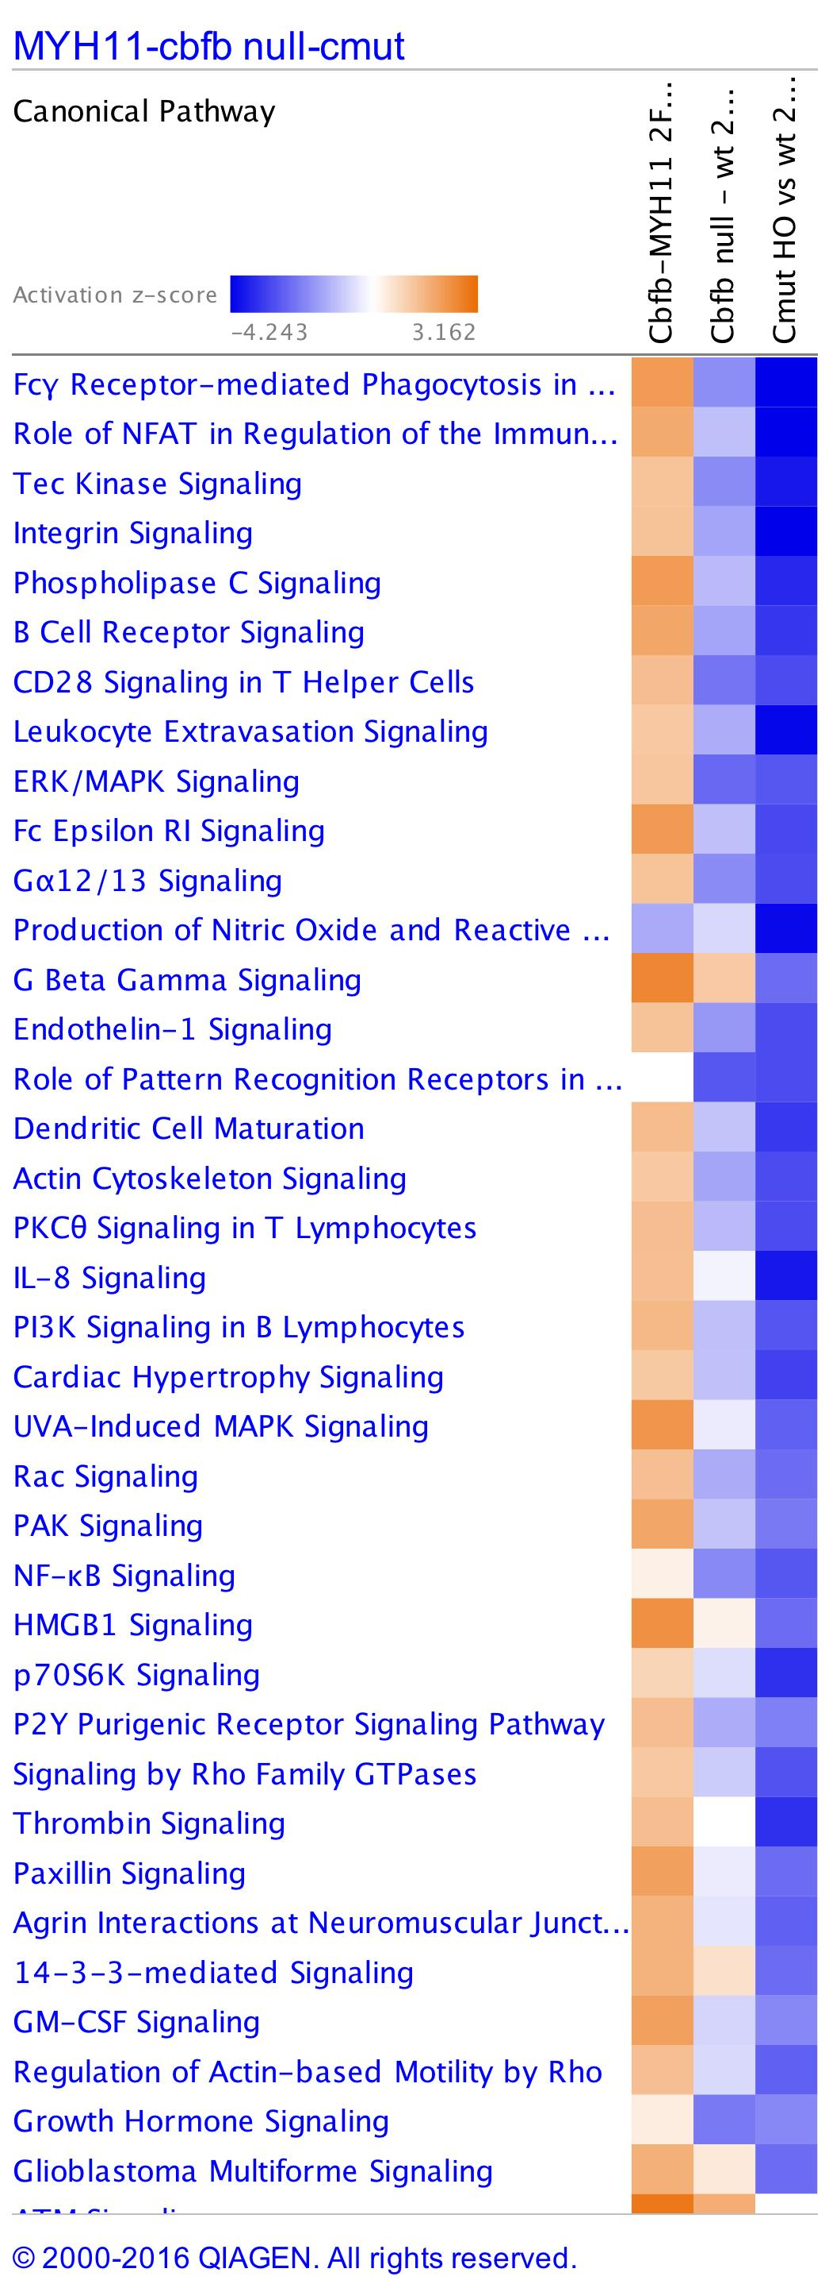
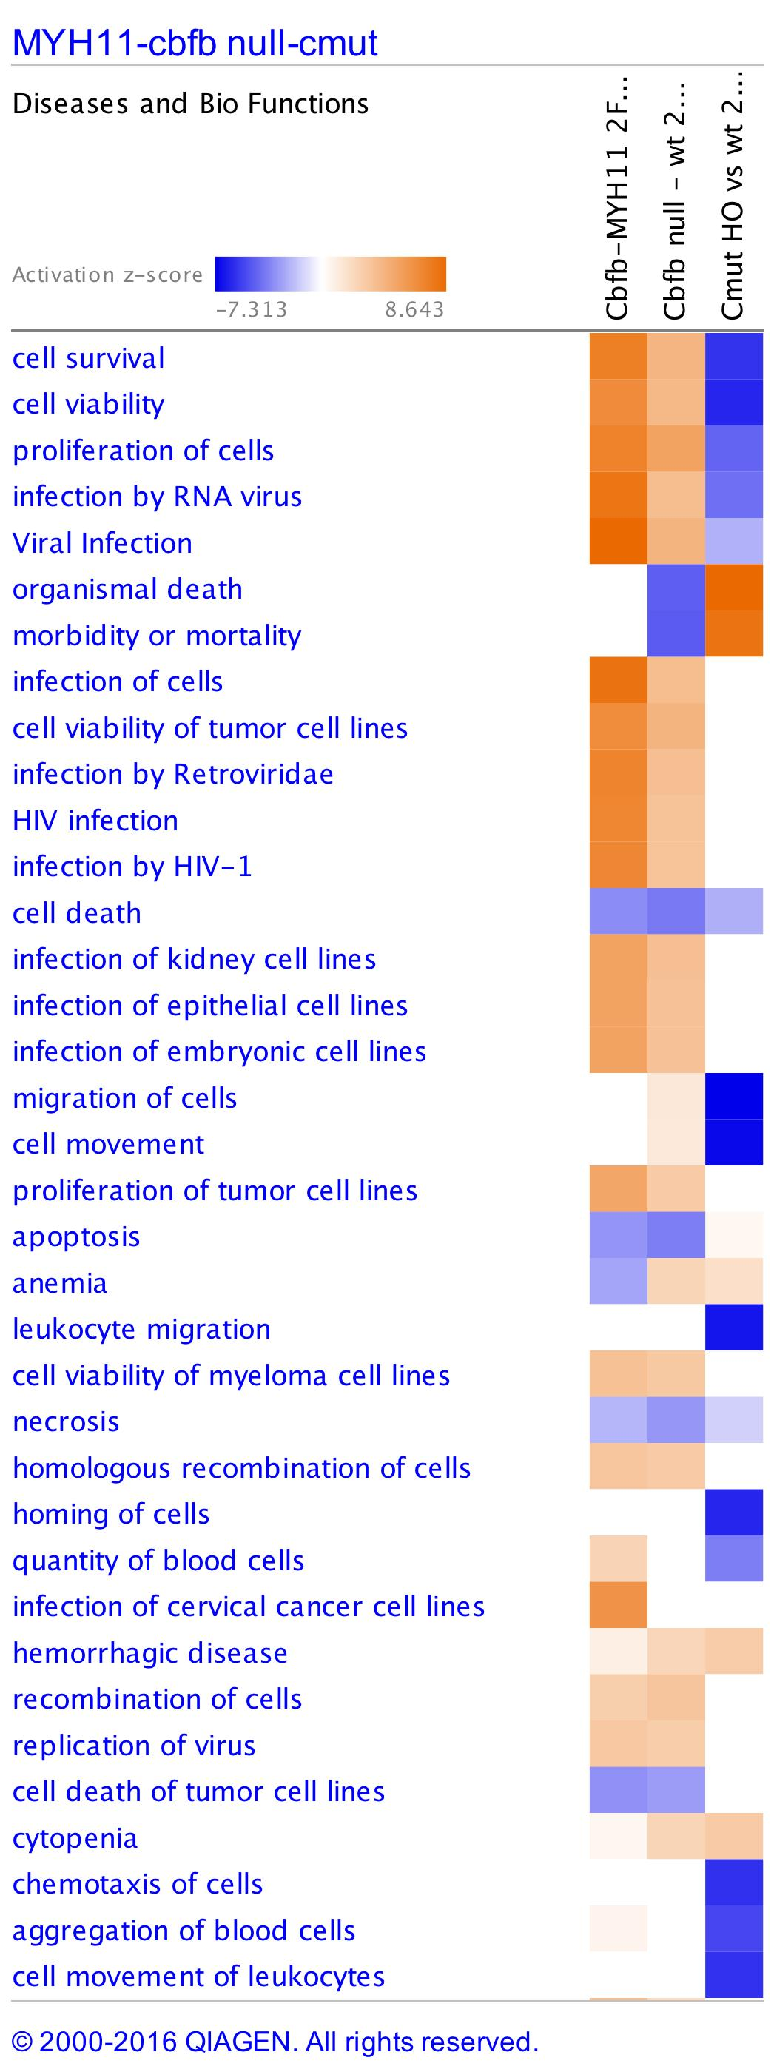
a
b
Cbfb^{+/MYH11}
Cbfb^{-/-}
Cbfb^{mDE/mDE}
Cbfb^{+/MYH11}
Cbfb^{-/-}
Cbfb^{mDE/mDE}
Supplementary Figure S8. Pathway analyses of microarray data from PB cells of Cbfb^{mDE/mDE} and Cbfb^{+/MYH11} embryos at E12.0. (a) Canonical pathway analysis of microarray data by IPA showed that genes in the indicated pathways were mostly downregulated in Cbfb^{mDE/mDE} embryos while they were mostly upregulated in Cbfb^{+/MYH11}. (b) Disease and biological function analysis. Blue color indicates pathway inhibition and orange color indicates activated pathways.

Slide 11
a
b
P<0.05
p=0.001
Differentially Expressed/total genes (%)
Total expressed gene numbers (FPKM≥10)
Genotype
Genotype
Supplementary Figure S9. Numbers of differentially expressed and total expressed genes by RNA-Seq analysis. (a) Ratio of differentially expressed genes/ total expressed genes (average of three samples). (b) Total expressed gene numbers from two sets of RNA-Seq samples. RSEM was used to obtain RNA-Seq count and to estimate the transcript abundance level. Genes were considered expressed if the average FPKM was ≥ 10.
Notes:
6B: induction of oncogene Cbfb-MYH11 made an significant increase of total expressed genes compare to Cbfb-mDE and wt controls.
6C: percentage of differentially expressed genes in Cbfb-MYH11 and Cbfb-mDE mouse BM cells.
Expressed genes are filtered geneset for genes with RSEM count >= 10.

