Slide 1
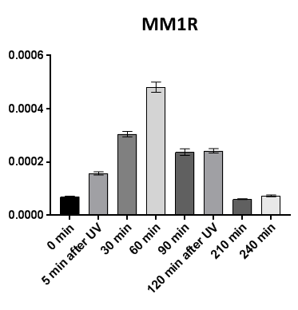
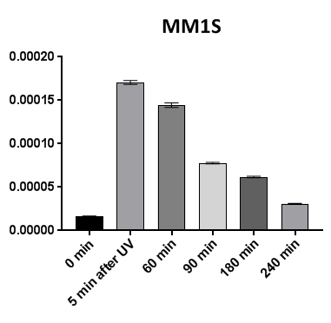
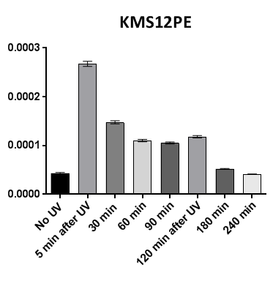
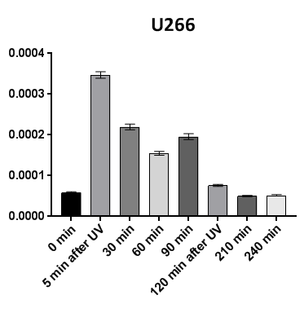
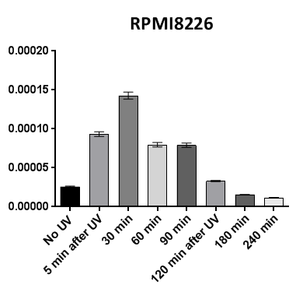
Figure S1: NER efficiency over the time
DDB2 proteoprobe signal
after UV exposure (A.F.U.)
DDB2 proteoprobe signal
after UV exposure (A.F.U.)
DDB2 proteoprobe signal
after UV exposure (A.F.U.)
DDB2 proteoprobe signal
after UV exposure (A.F.U.)
DDB2 proteoprobe signal
after UV exposure (A.F.U.)

Slide 2
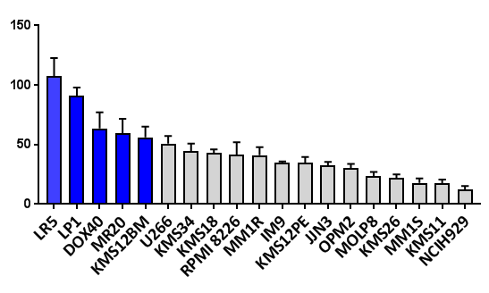
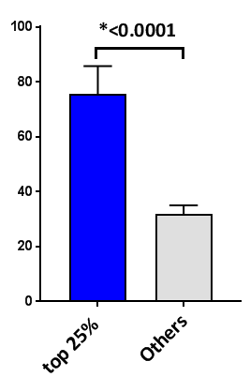
Figure S2: NER phenotype and melphalan sensitivity
A
B
C
Remaining DDB2 proteoprobe signal
120 mins after UV exposure
IC50 melphalan (μM)
IC50 melphalan (μM)

Slide 3
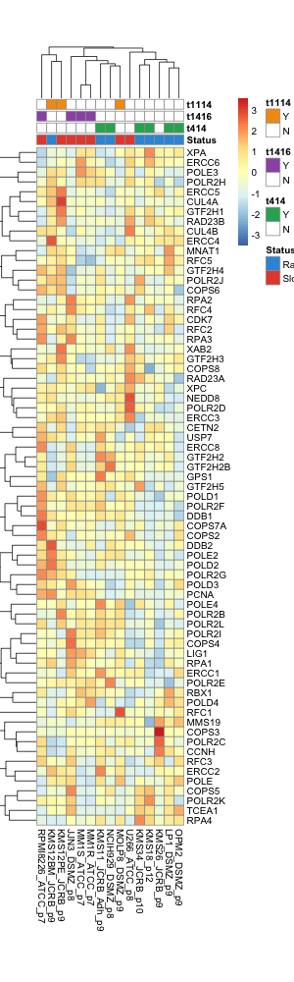
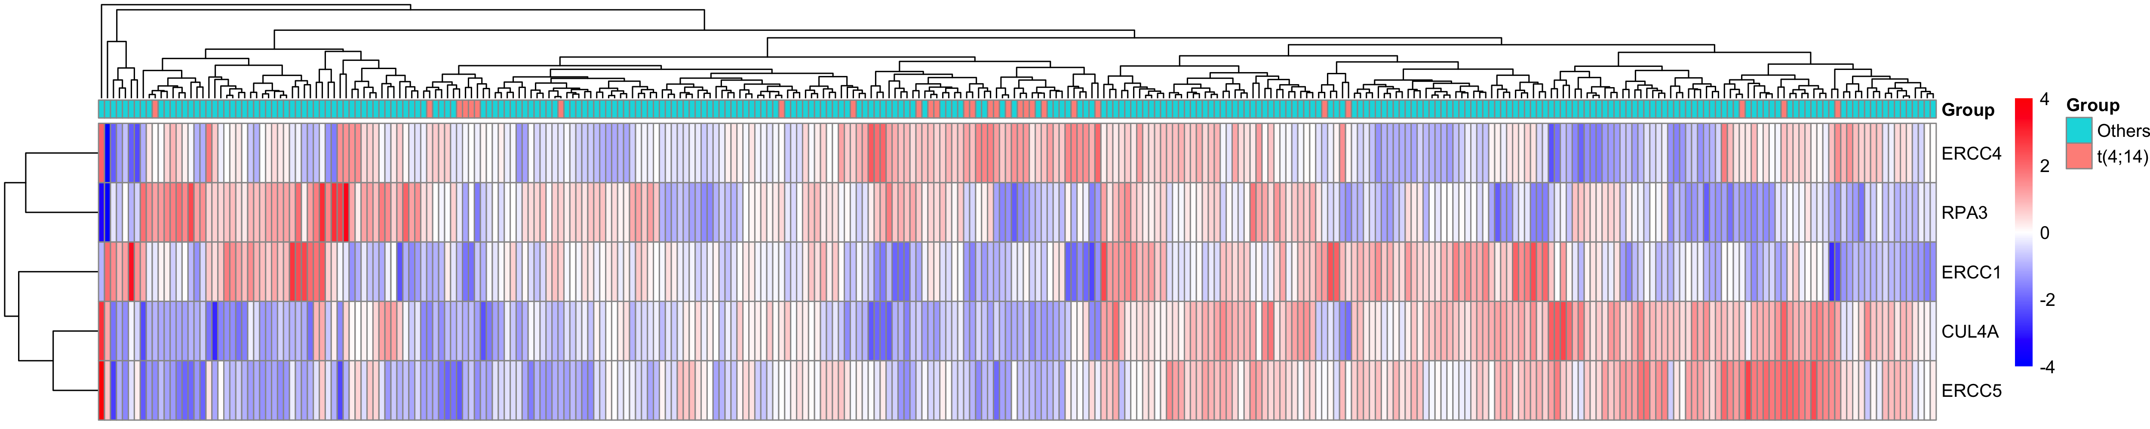
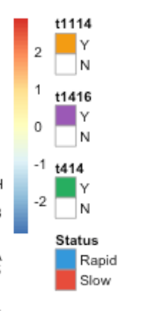
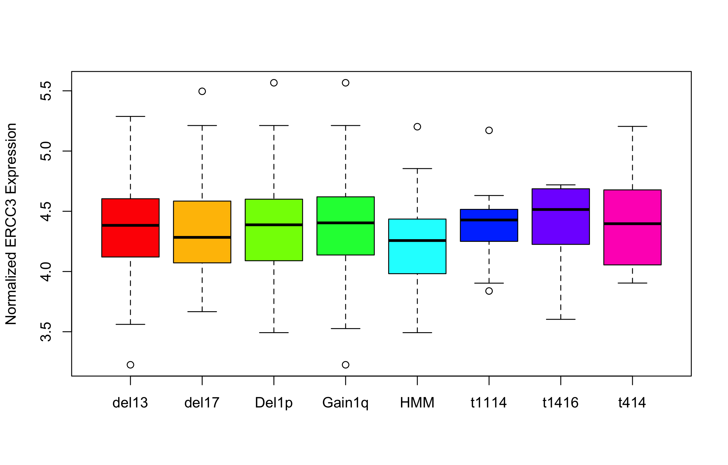
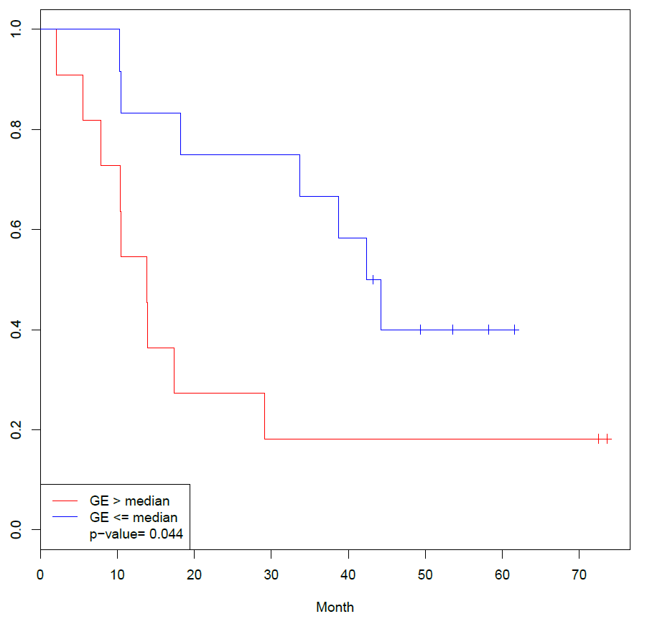
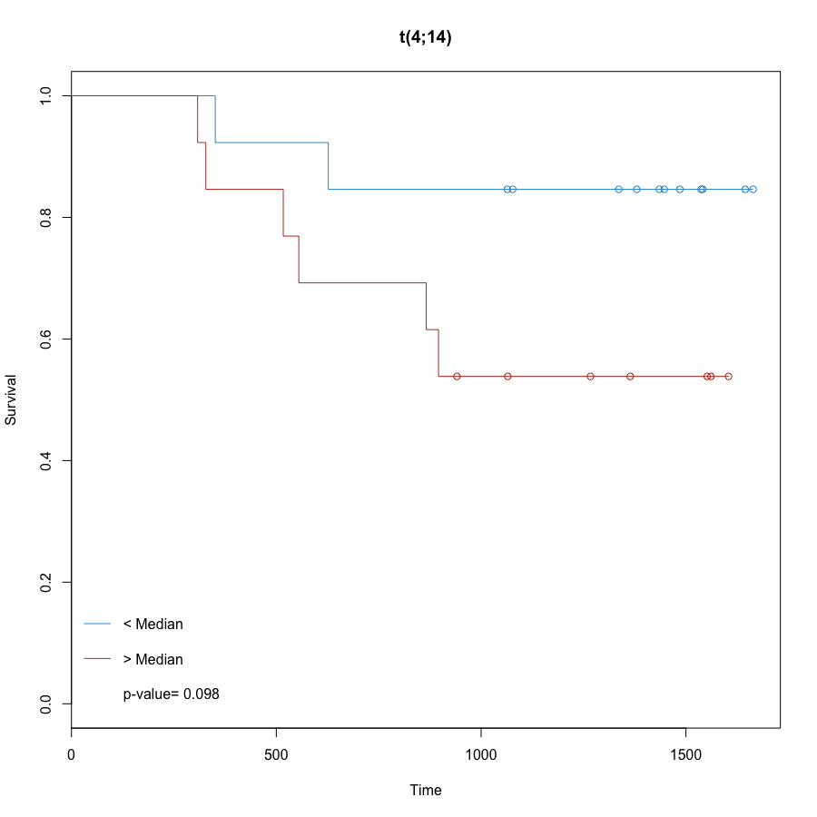
Figure S3
A
B
C
D
IFM 2005-01
IFM-DFCI 2009
Overall survival
Overall survival

Slide 4
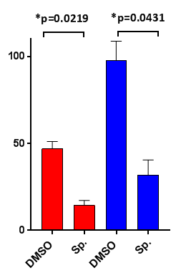
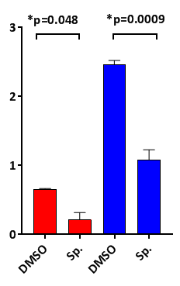
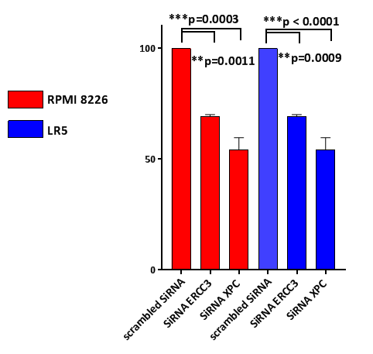


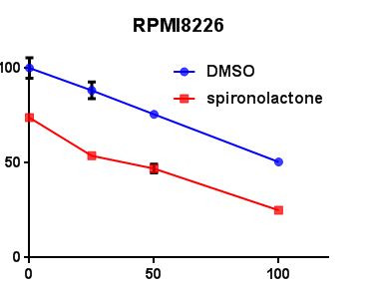
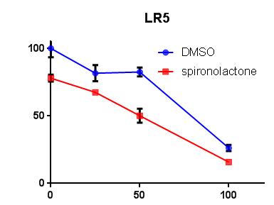
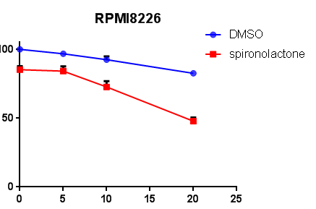
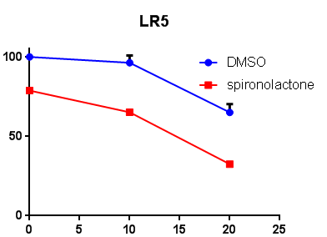
Figure S4: spironolactone increases sensitivity to alkylating agents
A
D
24h
3h
Time
- | - | - | +
+ | - | - | -
- | + | + | +
PYR-41
DMSO
IC50 melflufen (μM)
Sp.
IC50 melphalan (μM)
XPB
GAPDH
LR5
B
% cell viability
% cell viability
Bendamustine (μM)
Bendamustine (μM)
C
% cell viability
% cell viability
4-hydroperoxycyclophosphamide
(μM)
4-hydroperoxycyclophosphamide
(μM)

Slide 5
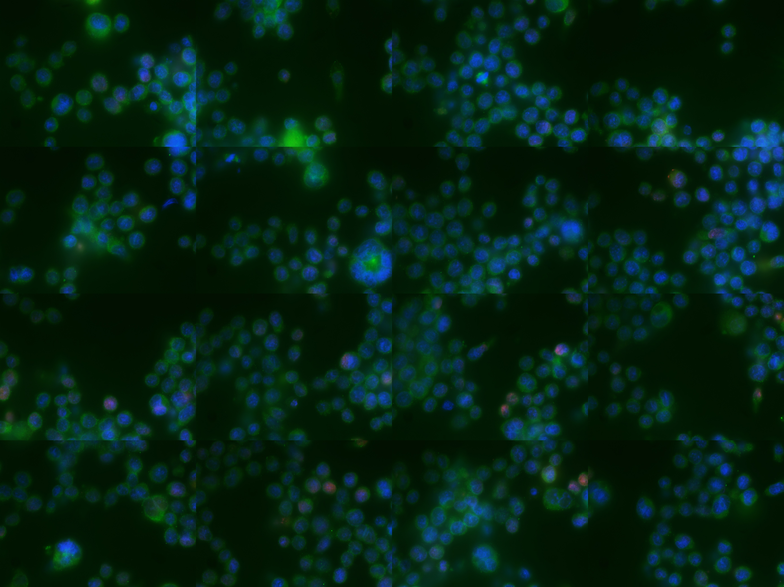
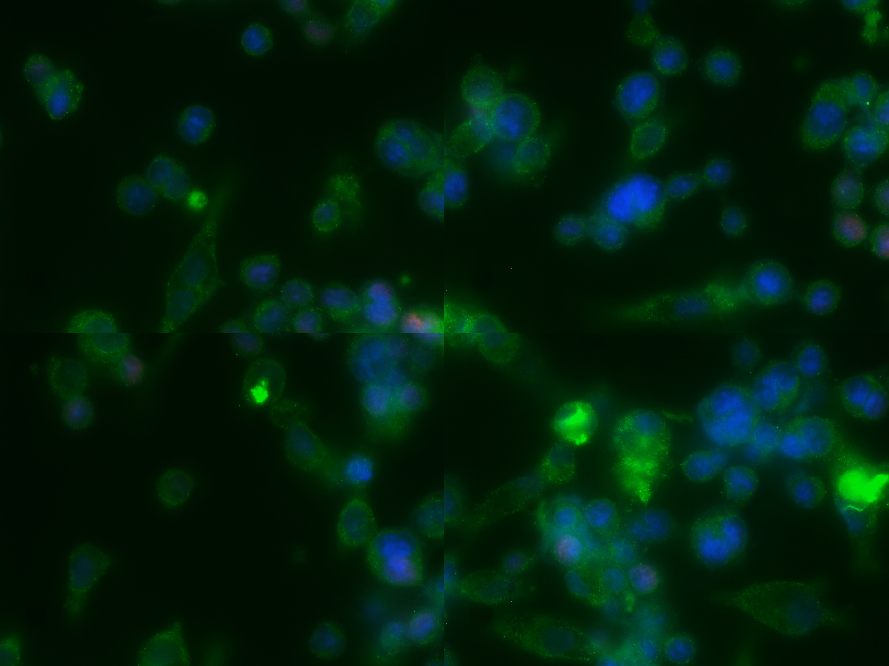
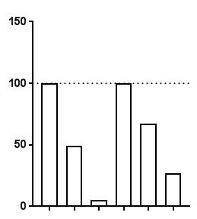
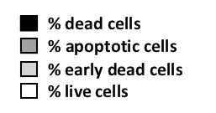
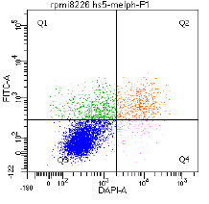
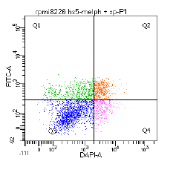
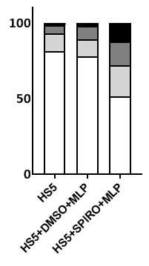
Figure S5: impact of stromal cells on NER
A
B
Merged*
Merged*
RPMI8226
MM1S
RPMI8226
+
HS5
RPMI8226
Remaining DDB2 proteoprobe signal
Remaining DDB2 proteoprobe signal
MM1S
MM1S
+
HS5
*Merged: dapi, alpha-tubulin, DDB2 proteoprobe
C
D
MM1S
RPMI8226
% cell viability
stroma cells
Melphalan
Sp.
+ | + | + | + | + | +
- | + | + | - | + | +
- | - | + | - | - | +
RPMI8226/HS5
Melphalan/DMSO
RPMI8226/HS5
Melphalan/spironolactone

Slide 6
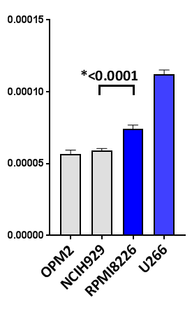
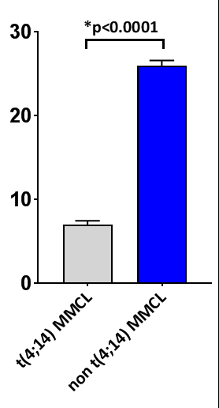
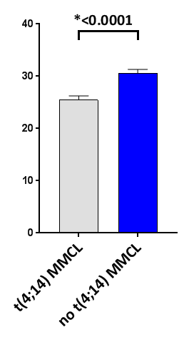
Figure S6
A
B
C
DDB2 proteoprobe signal after
fixation and UV exposure
Remaining DDB2 proteoprobe signal
120 mins after UV exposure
DDB2 proteoprobe signal 5min.after UV exposure

Slide 7
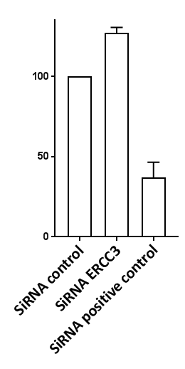
Figure S7: ERCC3 knockdown does not affect homologous recombination in FLO-1 cell line (eosophageal adenocarcinoma cell line).
Normalized HR activity

Slide 8
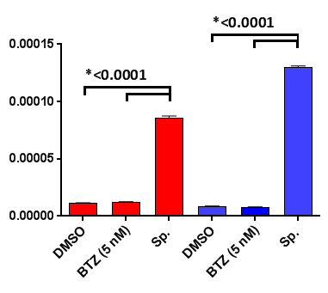
Figure S8: Bortezomib (BTZ) doesn’t inhibit NER
DDB2 proteoprobe signal 150 minutes after UV

