Slide 1
Supplemental Figure 2
A
La Sota cDNA
CMV pro
Xba I
Not I
PCR
pCI-neo
GCCACC
NP
GCCACC
P
GCCACC
L
Kozaka sequence
Xba I Not I digest
Xba I Not I digest
GCCACC
NP
GCCACC
P
GCCACC
L
CMV pro
Xba I
Not I
pCI-NP-K
pCI-P-K
pCI-L-K

Slide 2
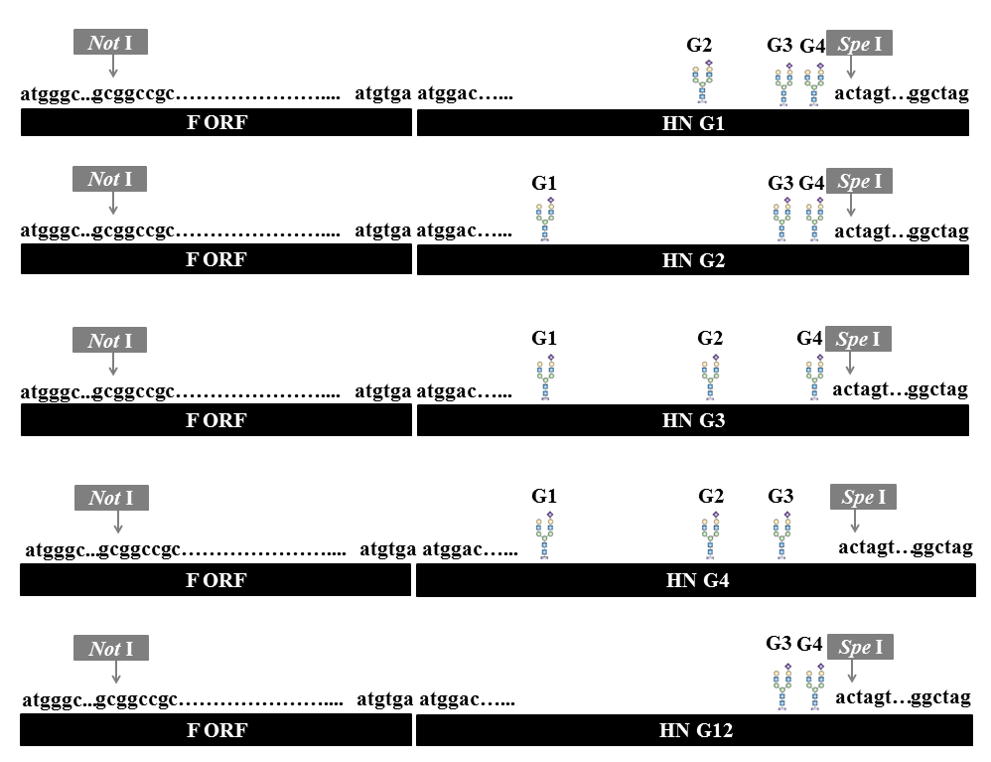
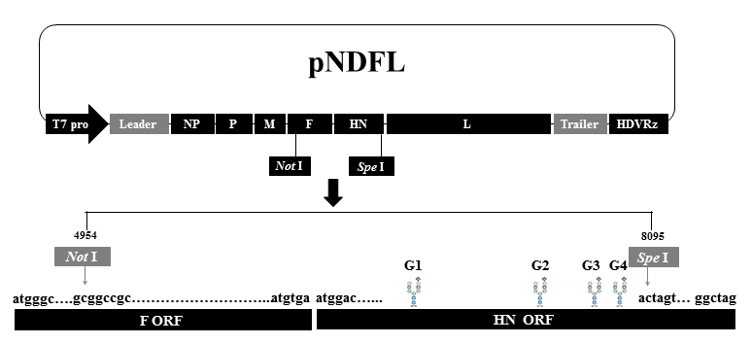
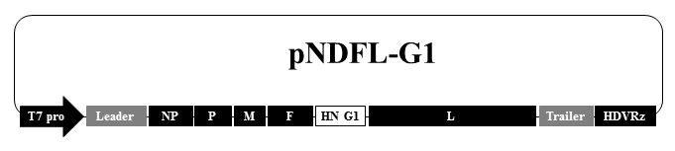
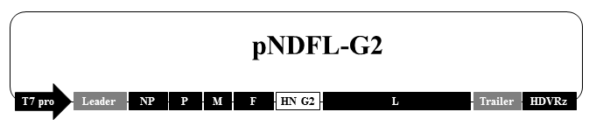
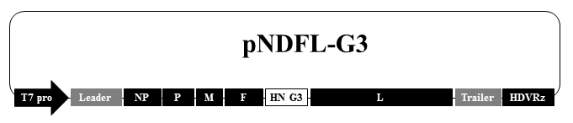
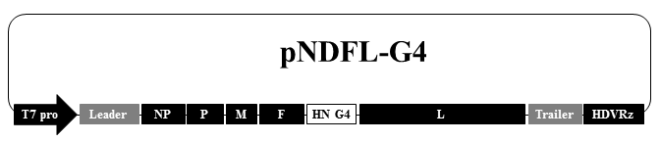
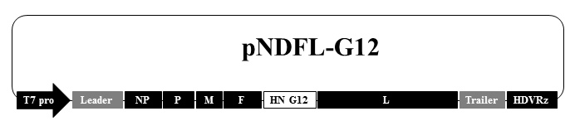
B
Not I Spe I digest
Not I Spe I digest

