Slide 1
Liu et al. manuscript
Supplemental Tables/Figures

Slide 2
Supplemental Table 1:
Cell Lines | CXCR4 % positive ± SEM
Ramos | 99 ± 1.7
OPM-2 | 71 ± 1.6
MV4-11 | 80 ± 9.0
TF-1 | 3 ± 0.5
PF-06747143 Binding to hematological tumor cell lines by flow cytometry

Slide 3
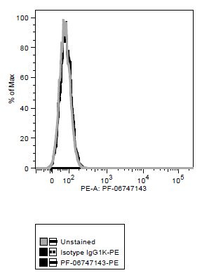
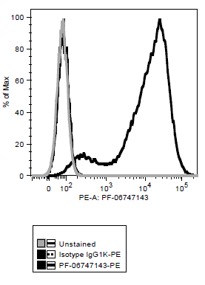
Supplemental Figure 1
A. CHO-Parental B. CHO-hCXCR4

Slide 4
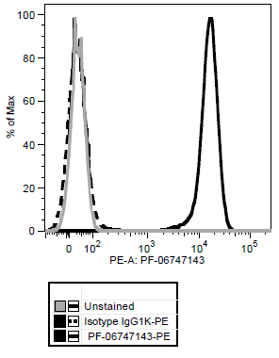
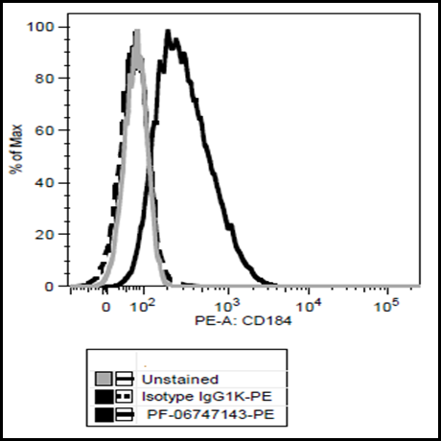
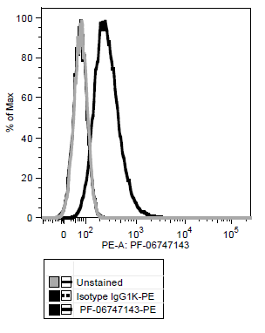
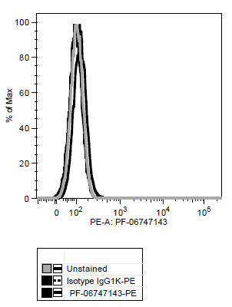
Supplemental Figure 2
A
Ramos (PF-06747143)
B
Ramos (CD184- 12G5 clone)
C
OPM-2 (PF-06747143)
D
MV4-11 (PF-06747143)
E
TF-1 (PF-06747143)

Slide 5
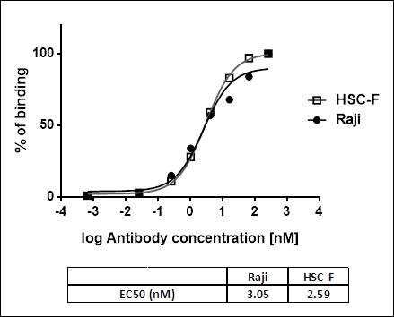
Supplemental Figure 3

Slide 6
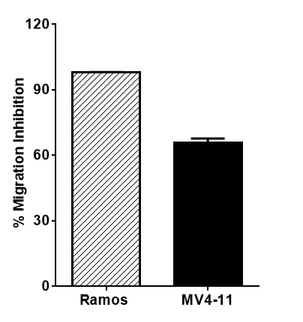
Supplemental Figure 4

Slide 7
Supplemental Figure 5

