Slide 1
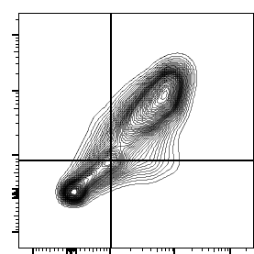
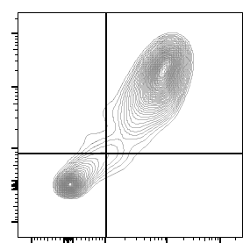
Supplemental Figure 1
A)
Day5
PAM3
M-CSF
6.1
67.9
2.1
78.8
CD163
19.4
6.5
17.9
1.3
CD206
B)
100
B)
***
***
100
CD163⁻
80
CD163⁺
***
80
***
60
% 25F9⁺ cells
60
40
% Macrophage
40
***
20
*
20
0
0
Day 0
No Rx
PAM3
M-CSF
Day 0
No Rx
PAM3
M-CSF
Day 5
Day 5

