Slide 1
Supplementary Table 1: antibodies used for flow cytometry
Analyze of hematopoietic cells:
Target protein | label | Clone | Laboratory
CD45 | Horizon V450 | 30F11 | BD Pharmingen
CD11c | Biotin-PE-Texas Red | N418 | eBiosciences
CD11b | APC-Cy7 | M1/70 | BD Pharmingen
anti-MHC-II IA/IE | Alexa 700 | M5:114 | eBiosciences
CD115 | PE-YG | AFS98 | eBiosciences
mPDCA | APC | JF05-1C2.4.1 | Miltenyi
Gr1 | PerCy5.5 | RB6-8C5 | BD Pharmingen
CD8a | PE-Cy5 | 53-6.7 | eBiosciences
CD3 | Biotin-PE-Texas red | 145-2C11 | BD Pharmingen
CD4 | FITC | RM4-5 | eBiosciences
CD44 | PE-Cy5 | IM7 | eBiosciences
FR4 | APC | 12A5 | BD Pharmingen
CD62-L | Alexa 700 | MEL-14 | BD Pharmingen
NK1.1 | biotin-streptavidine-PC5 | PK136 | eBiosciences
Analyze of adipose tissue stromal vascular fraction (SVF) cells:
Target protein | label | Clone | Laboratory
CD45 | Horizon V450 | 30F11 | BD Pharmingen
CD11c | Biotin-PE-Texas Red | N418 | eBiosciences
CD11b | APC-Cy7 | M1/70 | BD Pharmingen
anti-MHC-II IA/IE | Alexa 700 | M5:114 | eBiosciences
F4/80 | PE-Cy5 | BM8 | eBiosciences
Mgl1 (CD301) | Biotin-PE-Texas Red | ER-MP23 | Serotec

Slide 2
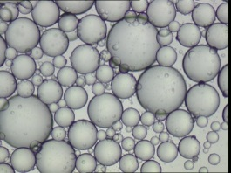
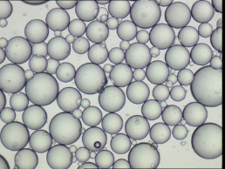
A
Adipocyte size
WT
P<0.001
Adipocyte size (µm)
***
CX3CR1^{-/-}
WT
CX3CR1^{-/-}
B
OGTT
C
Food intake
p=0.01
Control
**
*
CX3CR1 ^{-/-}
Glucose (mg/dL)
g of food/mice/day
D
WT
CX3CR1^{-/-}
*
WT donor
CX3CR1^{-/-} donor
Adipose tissue weight (g)
Total WAT
SC WAT
perigonadal WAT
Supplemental Figure 1: Food intake, OGTT and adipocyte size in female mice CX3CR1^{-/-} and adipose tissue weights in female transplanted with BM of CX3CR1^{-/-} mice
(A) Adipocyte size in female mice CX3CR1^{-/-} and their controls C57Bl/6 fed a HFD (60%fat) for 30 weeks (n=5 mice/genotype) (B) Oral Glucose Tolerance Test (OGTT) in female mice CX3CR1^{-/-} and their controls C57Bl/6 fed a HFD (60%fat) for 26 weeks (n=5 mice/genotype) (C) Food intake (g of food per mice and per day) in female mice CX3CR1^{-/-} and their controls C57Bl/6 fed a HFD (60%fat) (n=6 mice/genotype) (D): AT weights of recipient mice of CX3CR1^{-/-} BM or WT BM after 22 weeks of HFD with 60%Kcal from fat. *, p<0.05. **, p<0.01. ***, p<0.001. Data are expressed as means ±SD.

Slide 3
A
B
C
r²=0.24
p=0.03
r²=0.53
p=0.0032
r²=0.41
p<0.0001
Bodyweight (g)
Bodyweight (g)
Bodyweight (g)
Gr1^{low} monocytes (%CD45)
Gr1^{low} monocytes (%CD45)
Gr1^{low} monocytes (%CD45)
Supplemental Figure 2: Correlation between the rate of Gr1^{low} monocytes and bodyweight in mice totally deficient for CX3CR1 or deficient for CX3CR1 in the hematopoietic compartment
A: Correlation between BW and the rate of circulating Gr1^{low} monocytes (%CD45) in mice deficient for CX3CR1 in the hematopoietic compartment (recipients of CX3CR1^{-/-} BM) and their controls (recipients of WT BM) fed a HFD (n=18 mice).
B: Correlation between BW and the rate of circulating Gr1^{low} monocytes (%CD45) in mice totally deficient for CX3CR1 (CX3CR1^{-/-} mice) and their controls fed a HFD (n=14 mice).
C: Correlation between BW and the rate of circulating Gr1^{low} monocytes (%CD45) in all mice deficient for CX3CR1 (totally or in the hematopoietic compartment) and their controls fed a HFD (n=32 mice).

Slide 4
Bodyweight (g)
r=0.2
p=0.1
Gr1^{high} monocytes (%CD45)
Supplemental Figure 3: Correlation between bodyweight and the rate of circulating Gr1^{high} monocytes (% CD45) in mice deficient for CX3CR1 (CX3CR1^{-/-} and recipients of CX3CR1^{-/-} BM) and their controls (respectively C57Bl/6 and controls BM) fed a HFD (r=0.2, p=0.1, n=31 mice).

Slide 5
A
B
***
WT donor
Adipocyte size (µm)
CD11c-hBcl2 donor
Adipose tissue weight (g)
WT
donor
CD11c-hBcl2
donor
Total WAT
SC WAT
perigonadal WAT
Supplemental Figure 4: Adipose tissue weights of mice transplanted with CX3CR1^{-/-} BM or CD11c-hBcl2 BM and adipocyte size of mice transplanted with CD11c-hBcl2 BM
(A): AT weights of recipient mice of CX3CR1^{-/-} BM or WT BM after 22 weeks of HFD with 60%Kcal from fat. (B): AT weights of recipient mice of CD11c-hBcl2 BM or WT BM after 22 weeks of HFD with 60%Kcal from fat. (C): Adipocyte size in recipient mice of CD11c-hBcl2 BM fed a HFD for 12 weeks; *** p<0.001. WAT= white adipose tissue, SC= subcuteanous.

Slide 6
A
B
C
D
E
Control
CX3CR1 ^{-/-}
Supplemental Figure 5: Other circulating cells in CX3CR1^{-/-} mice (CD4 T cells, activated CD4 T cells, NK cells, dendritic cells and neutrophils)
(A) The frequency of T lymphocytes (CD3⁺, CD4⁺) was determined by flow cytometry in C57Bl/6 (white histograms) or CX3CR1^{-/-} mice (black histograms) fed a HFD containing 60 % kcal from fat for 30 weeks, as in Figure 1. **, p<0.01. n =9 mice in C57Bl/6 and n= 12 CX3CR1 ^{-/-}. (B) The frequency of activated T lymphocytes (CD3⁺, CD4⁺,CD62⁻ and CD44^{high}) was determined in the same mice than in A. (C) The frequency of circulating dendritic cells (CD11c^{high}, CMH-II⁺, and CD115⁻) was determined in the same mice than in A. (D) The frequency of circulating NK cells (NK1.1⁺, CD45⁺)) was determined in the same mice than in A. (E) The frequency of circulating neutrophils (CD11b⁺, Gr1^{high} and CD115⁻) was determined in the same mice than in A. Plots show the mean values (±SD).

Slide 7
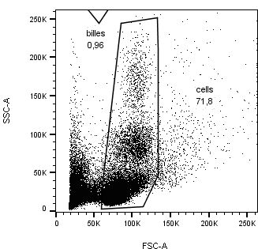
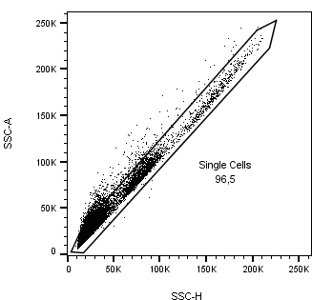
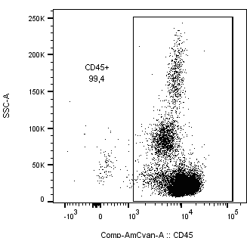
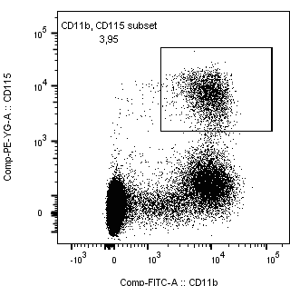
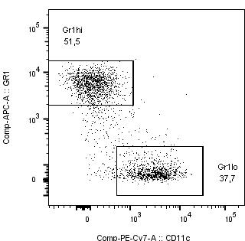
Supplemental Figure 6: Gating strategy to isolate the subpopulation of Gr1^{high} and Gr1^{low} monocytes in the blood of female mice upon HFD diet.

