Slide 1




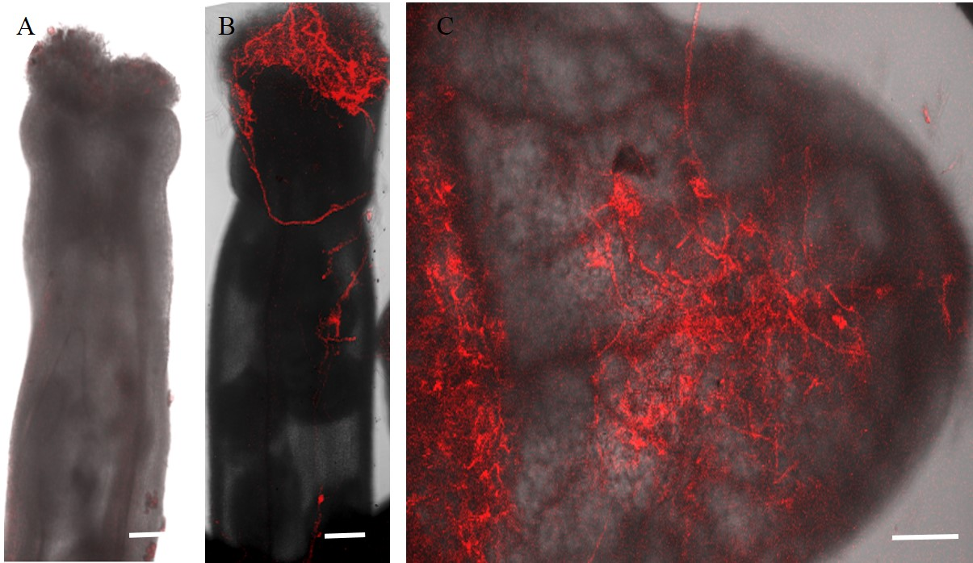
A
TREATMENT
infected
EMASCULATION
F. graminearum infection
24h.
96h.
3DAI
CONTROLS
untreated
B
C
D

