Slide 1
Supplemental Figure 1: CD8α:MyD88 design, expression, and function. A) Schematic representation of the domains for each construct used in this study. EC, extracellular domain of CD8α; TM, transmembrane domain of CD8α; DD, death domain of MyD88; ID, intermediate domain of MyD88. B) Western blot assessing the levels of MyD88 in T cells. C) Transduction efficiency of constructs on primary murine T cells as determined by the frequency of GFP-expressing T cells. D) MyD88 expression on GFP⁺ T cells co-cultured with peptide-pulsed splenocytes was visualized on the Amnis Imagestream Mark II Imaging Flow Cytometer (EMD Millipore). E) Proliferation of pmel T cells co-cultured with splenocytes pulsed with 1.2 ng/mL gp100₂₅₋₃₃ peptide at 72 hours gated on CD8⁺GFP⁺ cells. F) Proliferation of wild type (WT; top panel) and IRAK4 kinase dead (IRAK4KD; bottom panel) T cells stimulated with plate-bound anti-CD3 for 72 hours.
Supplemental Figure 2: CD8α:MyD88 expression increases IFNγ production and induces the differential expression of co-stimulatory and co-inhibitory molecules on T cells. Pmel T cells were engineered to express the empty vector control, CD8αΔIC or CD8α:MyD88. A) The intracellular levels of IFNγ in response to stimulation with splenocytes pulsed with 1.2 ng/mL gp100₂₅₋₃₃ were evaluated 48 hrs later. B) The fold change of the median fluorescence intensity (MFI) of CD8αΔIC and CD8α:MyD88 T cells, as evaluated by flow cytometry, over control vector T cells from three independent experiments is displayed in a waterfall plot. The expression of the most highly up- and downregulated proteins from the flow cytometry screen as average fold change from three independent experiments is shown.
Supplemental Figure 3. Changes in cytokines and chemokines induced by CD8α:MyD88 expression in T cells following stimulation with tumor cells. A) Expression of MHC class I on B16-F1 cells cultured in the presence (solid line) or absence (dashed line) of 500 ng/mL of IFN-y. Shaded histogram represents unstained control. B) Pmel T cells engineered to express the indicated vectors were co-cultured with irradiated B16-F1 tumor cells and supernatant was collected at 48 hours for Luminex analysis. CXCL10 levels were above the limit of detection in 2 of 3 samples in the CD8α:MyD88 B16 co-culture experiment, therefore standard error could not be calculated. CXCL9, CXCL1, CXCL2, and VEGF were not detected in splenocyte co-cultures. Values and error bars represent mean ± s.e.m. * p ≤ 0.05, ** p ≤ 0.01, *** p≤ 0.001; one-way ANOVA with Tukey’s Multiple Comparison Test; n=3 experimental replicates; representative of at least two independent experiments.
Supplemental Figure 4: Changes in cytokine and chemokine expression in vivo following transfer of CD8α:MyD88 T cells. A and B). B16-F1 tumor cells were injected into C57BL6 mice (n=5) and allowed to establish until they reached a size of ~50mm². Mice were treated with a sublethal dose of irradiation and 6x10⁶ T cells were transferred one day later. Transduction efficiency of CD8α:MyD88 T cells was 50%. (A) Tumor and B) serum samples from mice one week after adoptive T cell transfer were analyzed by Luminex analysis. Values and error bars represent mean ± s.e.m. Each data point represents one mouse.

Slide 2
Supplemental Figure 5: CD8α:MyD88 T cells alter the tumor microenvironment and delay tumor progression. Mice bearing an established B16-F1 tumor (~50mm²) were exposed to a sublethal dose of irradiation (550 rads) followed by transfer of the CD8α:MyD88 or vector control pmel T cells (6x10⁶) by intraveneous injection one day later. A) Average tumor volume, C) tumor volumes for individual mice (n=8) and B) survival are shown. Values and error bars represent mean ± s.e.m. ** p ≤ 0.01, *** p≤ 0.001. Survival was evaluated using the exact log-rank (Mantel-Cox) test and the tumor volumes samples were analyzed by one-way ANOVA.
Supplemental Figure 6: CD8α:MyD88 T cells alter the tumor microenvironment and delay tumor progression. A and B) Mice bearing an established B16-F1 tumor (~50mm²) were exposed to a sublethal dose of irradiation (550 rads) followed by transfer of T cells engineered to express CD8α:MyD88 or vector control pmel T cells (6x10⁶) by intravenous injection one day later and injected intraperitoneally with anti-41BB antibody (3H3 clone; 200ug) on days 1 and 3 days after T cell transfer (A) or with anti-PD-L1 (10F.9G2 clone; 200ug) or isotype control antibody one day after T cell transfer. Tumor sizes are the average of 4 to 6 mice per group. Values and error bars represent mean ± s.e.m. *** p ≤ 0.001 from days 23 onward. Tumor growth (volume) was analyzed by a mixed model repeated measures with AR(1) covariance structure (yielding smallest BIC), followed by Sidak-adjusted comparisons at each time.

Slide 3
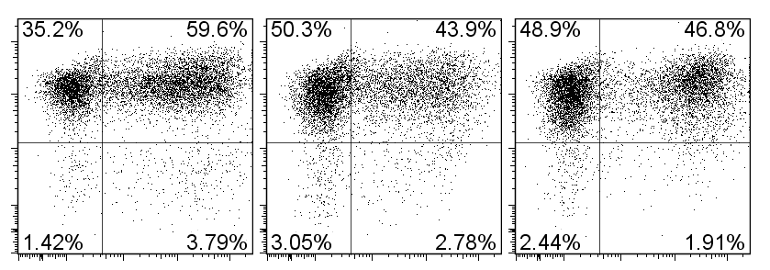
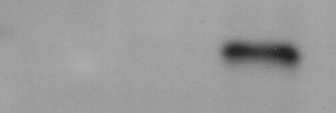
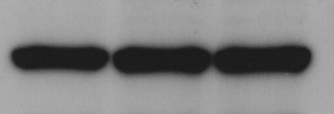
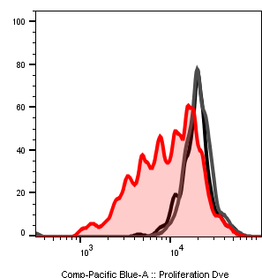
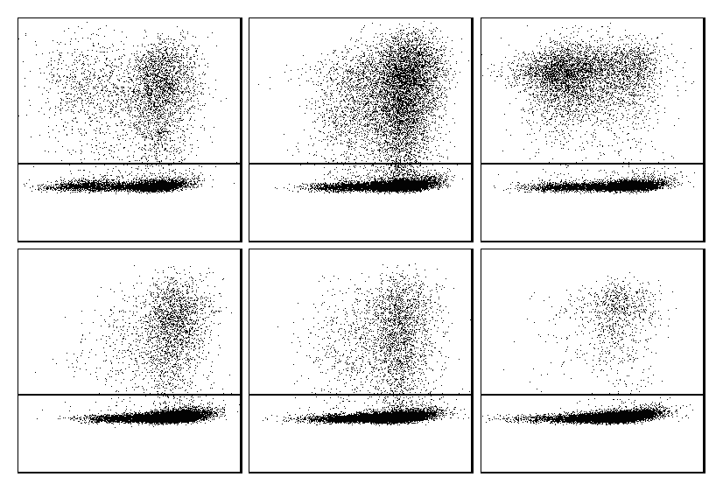
A
CD8α:MyD88
EC
TM
DD
ID
IRES
GFP
CD8α
MyD88
CD8αΔIC
EC
TM
IRES
GFP
Vector Control
CD8α
IRES
GFP
B
C
Vector Control
CD8α:MyD88
Vector Control
CD8αΔIC
CD8α:MyD88
CD8αΔIC
CD8α
hMyD88
β Actin
GFP
D
Brightfield
GFP
MyD88
Overlay
APC
T cell
E
F
Vector Control
CD8αΔIC
CD8α:MyD88
Vector Control
MFI 9,125
MFI 13,535
MFI 3,528
CD8αΔIC
CD8α:MyD88
WT
MFI 7,868
MFI 12,424
MFI 10,786
GFP
MFI 14,175
MFI 12,058
MFI 9,051
IRAK4 KD
MFI 13,480
MFI 11,296
MFI 8,583
Proliferation Dye
Supplemental Figure 1: CD8α:MyD88 design, expression, and function. A) Schematic representation of the domains for each construct used in this study. EC, extracellular domain of CD8α; TM, transmembrane domain of CD8α; DD, death domain of MyD88; ID, intermediate domain of MyD88. B) Western blot assessing the levels of MyD88 in T cells. C) Transduction efficiency of constructs on primary murine T cells as determined by the frequency of GFP-expressing T cells. D) MyD88 expression on GFP⁺ T cells co-cultured with peptide-pulsed splenocytes was visualized on the Amnis Imagestream Mark II Imaging Flow Cytometer (EMD Millipore). E) Proliferation of pmel T cells co-cultured with splenocytes pulsed with 1.2 ng/mL gp100₂₅₋₃₃ peptide at 72 hours gated on CD8⁺GFP⁺ cells. F) Proliferation of wild type (WT; top panel) and IRAK4 kinase dead (IRAK4KD; bottom panel) T cells stimulated with plate-bound anti-CD3 for 72 hours.

Slide 4
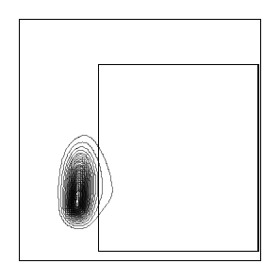

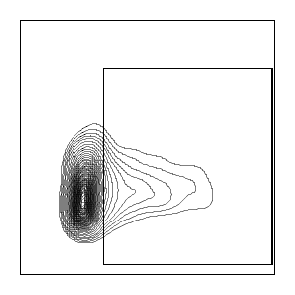
A
Vector Control
CD8α:ΔIC
CD8α:MyD88
3.67%
4.53%
13.2%
FSC-H
IFNγ
B
Supplemental Figure 2: CD8α:MyD88 expression increases IFNγ production and induces the differential expression of co-stimulatory and co-inhibitory molecules on T cells.

Slide 5
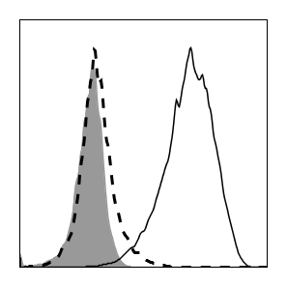
A
B16-F1
No IFN-y
IFN-y
Unstained
MHC I
B
CXCL1
CXCL2
CCL4
CXCL10
***
**
***
***
*
***
GM-CSF
IL-3
LIF
VEGF
***
***
***
***
***
***
Supplemental Figure 3. Changes in cytokines and chemokines induced by CD8α:MyD88 expression in T cells following stimulation with tumor cells.

Slide 6
A
B
Supplemental Figure 4: Changes in cytokine and chemokine expression in vivo following transfer of CD8α:MyD88 T cells.

Slide 7
A
B
***
**
C
Untreated
Vec Control
CD8α:MyD88
Days post tumor challenge
Supplemental Figure 5: CD8α:MyD88 T cells alter the tumor microenvironment and delay tumor progression.

Slide 8
A
Untreated
***
***
Vector control
Vector control + 4-1BB Ab
n.s.
CD8α:MyD88
CD8α:MyD88 + 4-1BB Ab
B
Untreated
Vector control
CD8α:MyD88
Vector control + Isotype Ab
CD8α:MyD88 + Isotype Ab
Vector control + PD-L1 Ab
CD8α:MyD88 + PD-L1 Ab
Supplemental Figure 6: Checkpoint blockade with anti-PD-L1 or costimulation with anti-4-1BB antibodies do not increase antitumor activity of pmel CD8α:MyD88 T cells.

