Slide 1
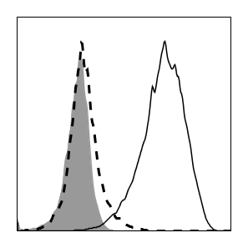
A
B16-F1
No IFN-y
IFN-y
Unstained
MHC I
B
CXCL1
CXCL2
CCL4
CXCL10
***
**
***
***
*
***
GM-CSF
IL-3
LIF
VEGF
***
***
***
***
***
***
Supplemental Figure 3. Changes in cytokines and chemokines induced by CD8α:MyD88 expression in T cells following stimulation with tumor cells. A) Expression of MHC class I on B16-F1 cells cultured in the presence (solid line) or absence (dashed line) of 500 ng/mL of IFN-y. Shaded histogram represents unstained control. B) Pmel T cells engineered to express the indicated vectors were co-cultured with irradiated B16-F1 tumor cells and supernatant was collected at 48 hours for Luminex analysis. CXCL10 levels were above the limit of detection in 2 of 3 samples in the CD8α:MyD88 B16 co-culture experiment, therefore standard error could not be calculated. CXCL9, CXCL1, CXCL2, and VEGF were not detected in splenocyte co-cultures. Values and error bars represent mean ± s.e.m. * p ≤ 0.05, ** p ≤ 0.01, *** p≤ 0.001; one-way ANOVA with Tukey’s Multiple Comparison Test; n=3 experimental replicates; representative of at least two independent experiments.

