Slide 1
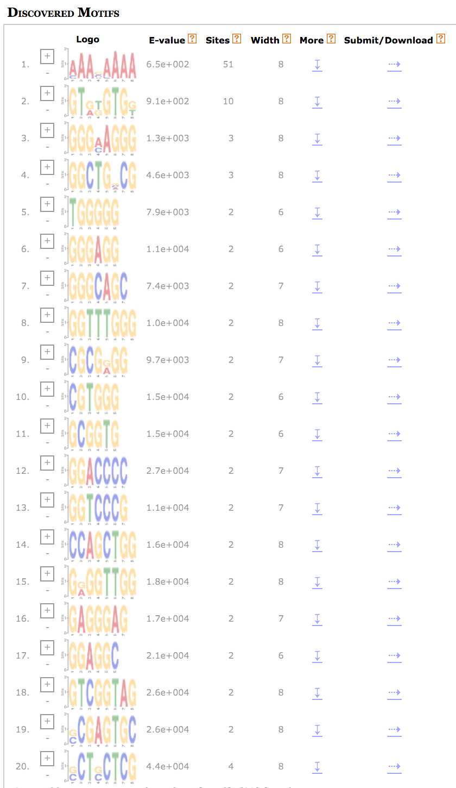
Figure S1 MEME ANALYSIS USING PROMOTER REGION OF 51 NRRS GENE

Slide 2
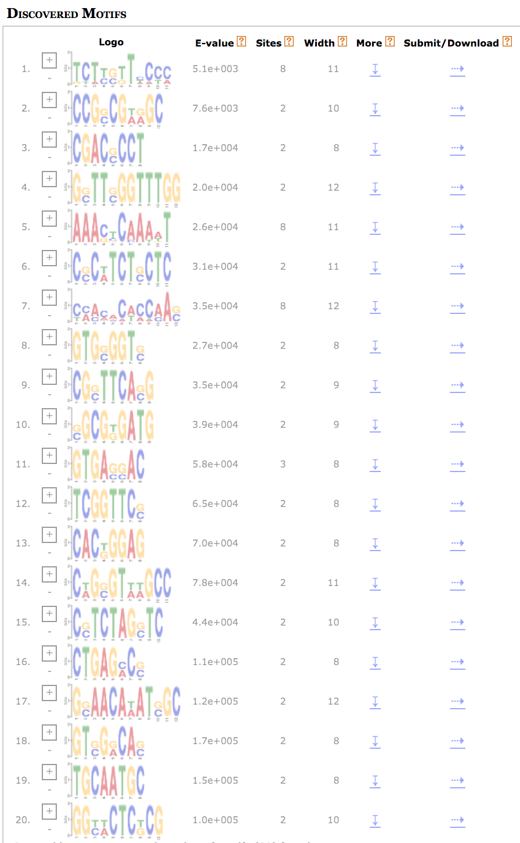
MEME ANALYSIS USING PROMOTER REGION OF 51 RANDOM GENES

Slide 3
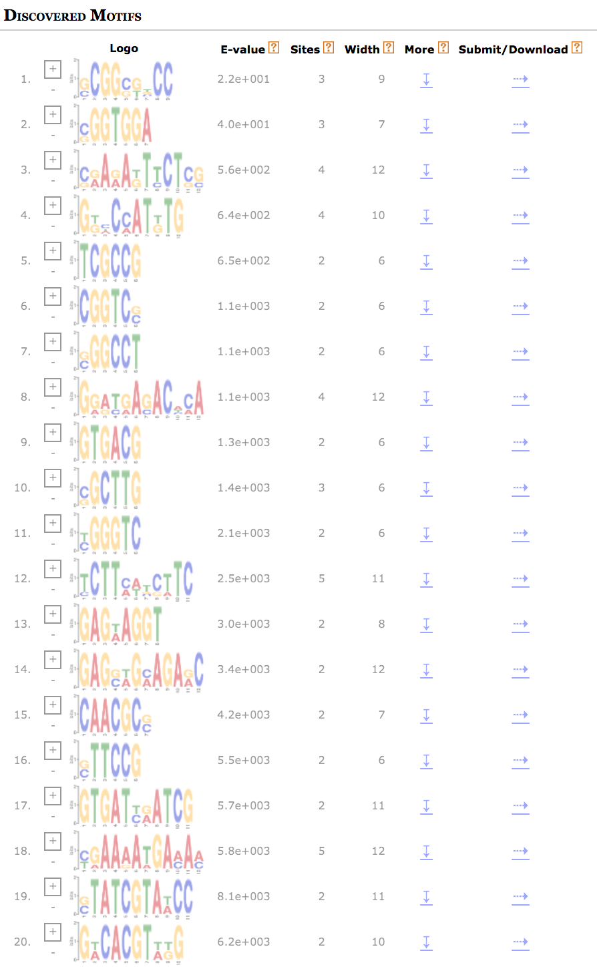
MEME ANALYSIS USING PROMOTER REGION OF 7 RANDOM GENES

