Slide 1
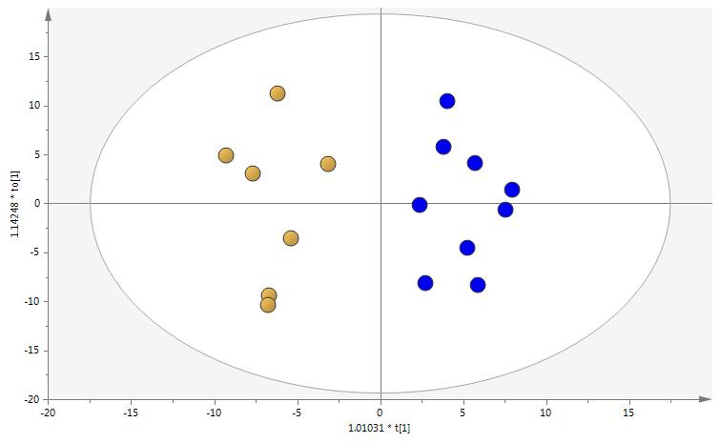
Supplementary Figure S3
A
B

