Slide 1
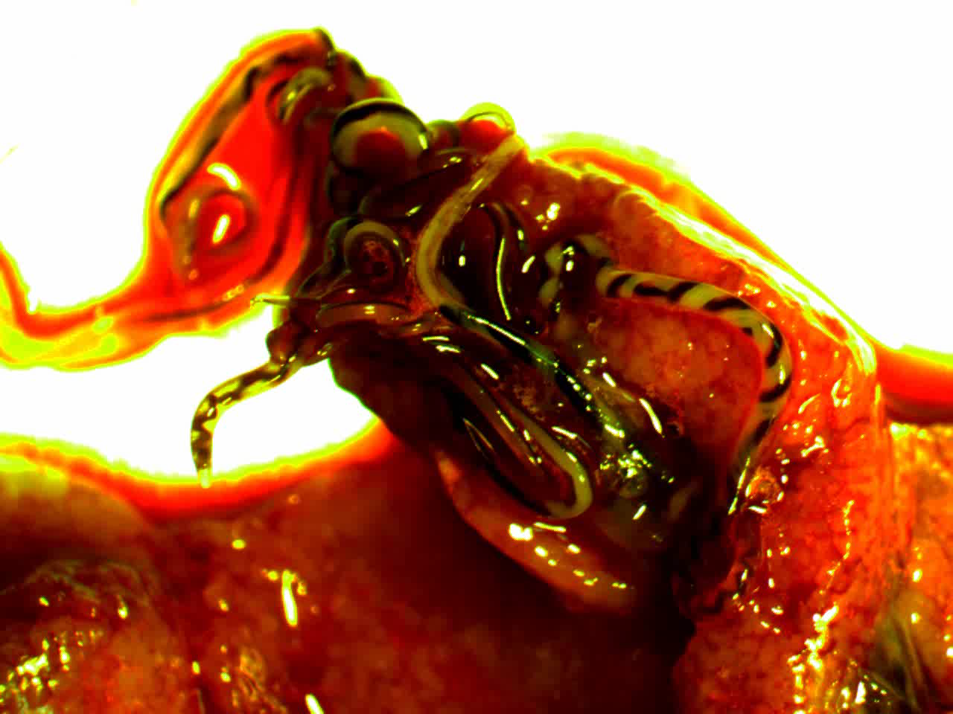
Adult Angiostrongylus cantonensis emerging from a ruptured pulmonary artery of a rat.
Video credit: Jarvi Lab, University of Hawaii at Hilo

