Slide 1












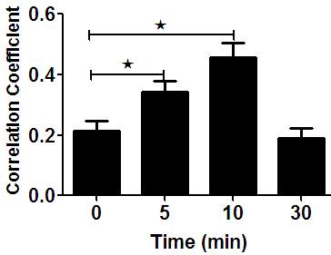
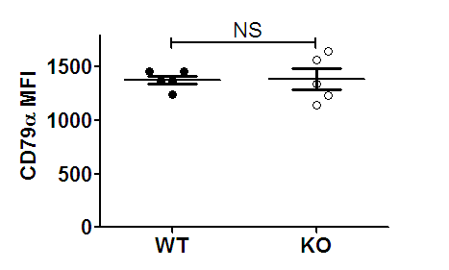
Fig.S1
A
CD79a pMst1 overlay
0 min
5 min
10 min
30 min
B
C

Slide 2
Fig.S1 The recruitment of Mst1 to CD79α aggregates in B cells stimulated by sAg. To mimic sAg, splenic B cells were incubated with anti-CD79α for 10 min at 4°C to label the CD79α . Then, the cells were either incubated with F(ab)₂′–anti-Ig or with the medium alone (0 min) as a control at 37°C for varying lengths of time. After fixation and permeabilization, the cells were stained for pMst1 and analyzed using confocal microscopy (CFm) (A). Images were quantitatively analyzed to determine the correlation coefficients between the CD79α and pMst1 (B). Flow cytometry analysis of the MFI of CD79α in WT and Mst1 KO B cells (C). Shown are representative images and mean values (±SD) from three independent experiments where over 50 cells were individually analyzed using NIS-Elements AR 3.2 software. Scale bars, 2.5 μm. ∗, p <0.01.

Slide 3
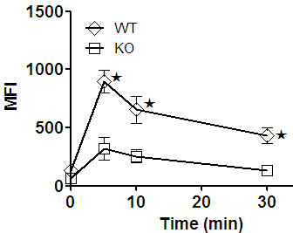
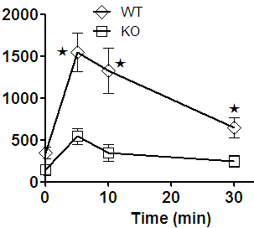
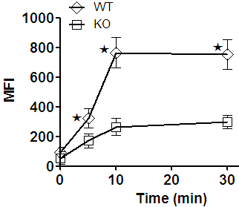
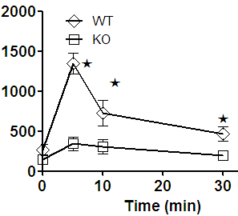
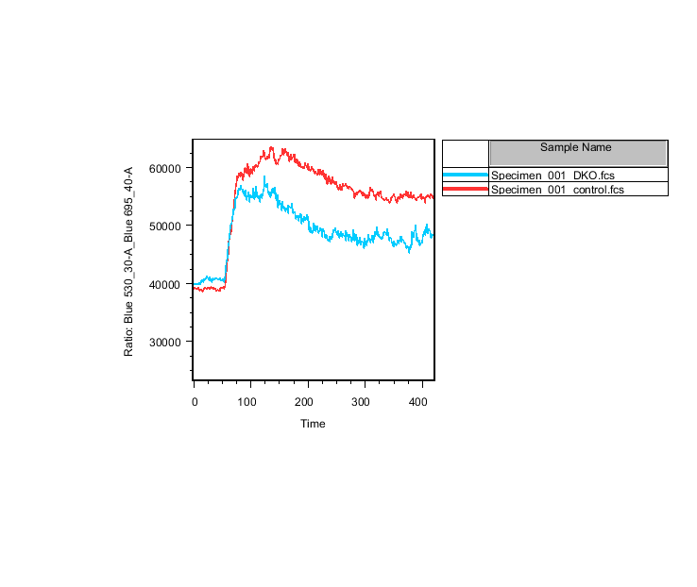
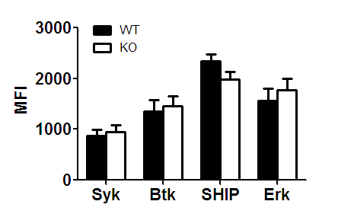
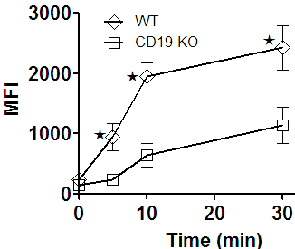
Fig.S2
A
B
pSyk
pBtk
C
D
pSHIP
pErk
E
F
Fluo 4/Fura Red
WT
KO
G
Time (S)
pSHIP

Slide 4
Fig.S2 BCR signaling is reduced in Mst1 KO or CD19 KO B cells. B cells from WT and Mst1 KO or CD19 KO mice were stained with anti-B220 antibody at 4℃ for 30 minutes. And then cells incubated with soluble Fab′–anti-IgG+M plus streptavidin at 37°C for indicated times. Cells were fixed, permeablized and stained with anti-pSyk (A), anti-pBtk (B), anti-pSHIP (C) ,anti-pErk (D) , antibodies for the total proteins above described (F) and anti-pSHIP antibodies in CD19 KO mice (G) . Then samples were analyzed by flow cytometry. Ca²⁺ flux analysis of splenic B cells activated with soluble mB-Fab′–anti-Ig plus streptavidin using flow cytometry (E). Shown are the average MFI (±SD) from three independent experiments. *p < 0.01.

Slide 5
































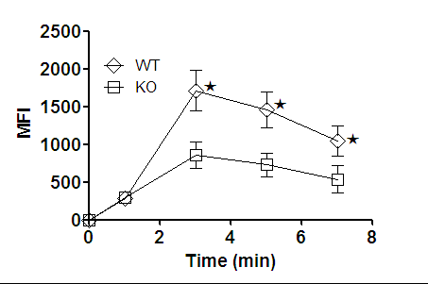
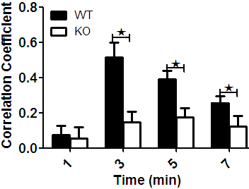
Fig.S3
A
WT
B
Mst1 KO
IRM CD19 BCR overlay
IRM CD19 BCR overlay
1 min
3 min
5 min
7 min
C
D

Slide 6
Fig.S3 CD19 recruitment is decreased in Mst1 KO B cells. Splenic B cells from WT and Mst1 KO mice were incubated with AF546-mB-Fab′–anti-Ig tethered to lipid bilayers at 37°C for indicated times. Cells were fixed, permeabilized, and stained for CD19 using a specific mAb and AF488-conjugated secondary Ab. Cells were analyzed using TIRFm ( A and B). The MFI of CD19 staining in the B-cell contact zone was quantified (C). Shown are representative images and TIRFM analysis of the spatial relationship of BCR with CD19 in the contact zone of splenic B cells incubated with membrane-tethered Fab′–anti-Ig. The correlation coefficients between BCR and CD19 staining were determined using NIS-Elements AR 3.2 software (D).

Slide 7
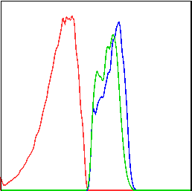
Fig.S4
5346
4987
678
WT
KO-CD19 Ov
KO
Cells
CD19

Slide 8
Fig.S4 Overexpression of CD19 recovers the level of CD19 in Mst1 KO B cells. WT Bone marrow cells were transduced with GFP tagged retroviral vector only (WT). Mst1 KO bone marrow B cells were transduced with GFP tagged retroviral vector expressing with (KO-CD19 Ov) or without CD19 (KO) then transferred into CD45.1 mice recipients together with CD45.1 WT bone marrow B cells. After 8 weeks reconstitution, CD45.2⁺ GFP⁺ donor derived splenic B cells were stained with CD19 antibody to check the surface expression of CD19 after bone marrow reconstitution.

