Slide 1
Supplementary Figure 1
A
C
SWATH
DDA Peptides
SWATH Peptides
B
D
Q-value | median CV | mean CV | Mean R² | Mean slope | Number of peptides identified per run
1.00E-01 | 21.54 | 28.59 | 0.880 | 0.901 | 12360
1.00E-02 | 16.22 | 19.48 | 0.957 | 0.940 | 8888
1.00E-03 | 13.72 | 16.03 | 0.974 | 0.950 | 6642
1.00E-04 | 12.02 | 13.88 | 0.981 | 0.958 | 4910
1.00E-05 | 10.43 | 11.87 | 0.986 | 0.965 | 3464
1.00E-06 | 8.98 | 10.40 | 0.989 | 0.971 | 2310
1.00E-07 | 7.57 | 8.70 | 0.992 | 0.977 | 1304
1.00E-08 | 4.64 | 5.68 | 0.993 | 0.970 | 315
DDA LF | 8.74 | 13.04 | 0.910 | 0.962 | 6165

Slide 2
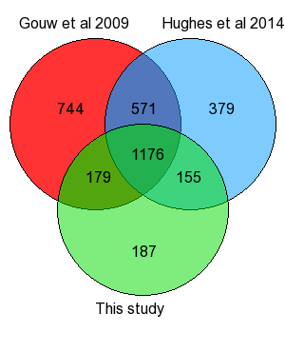
Supplementary Figure 2

Slide 3
Supplementary Figure 3
DDA LFQ
SWATH
Coefficient of variations (%)
20
10
Timepoints

Slide 4
Supplementary Figure 4
DDA LFQ
SWATH

Slide 5
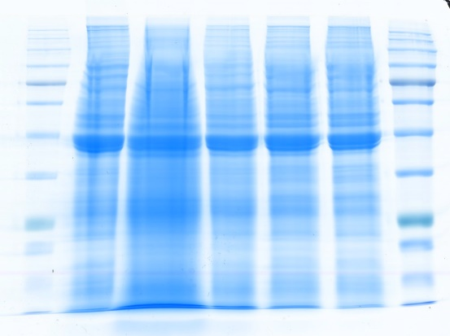
Supplementary Figure 5
0-4.5h
4.5-9h
9-13.5h
13.5-18h
18-22.5h

Slide 6
Supplementary Figure 6
Skyline

Slide 7
Supplementary Figure 7

Slide 8
Supplementary Figure 8
p=0.039
p=0.064
p=0.047

