Slide 1
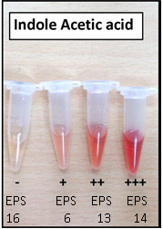
Figure S1: Indole-3-acetic acid production by sugarcane and wheat isolates

Slide 2
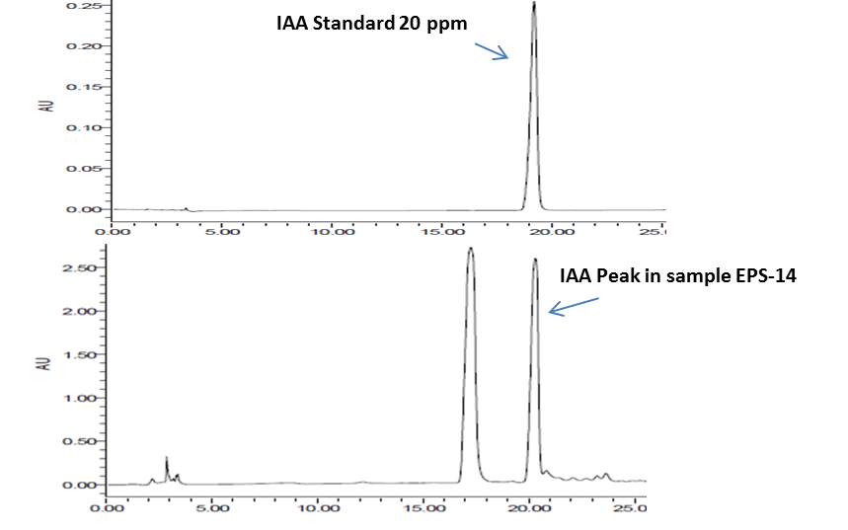
A
B
Figure S2: (A) Indole-3-acetic acid 20 ppm standard , (B) IAA production by EPS-14

Slide 3
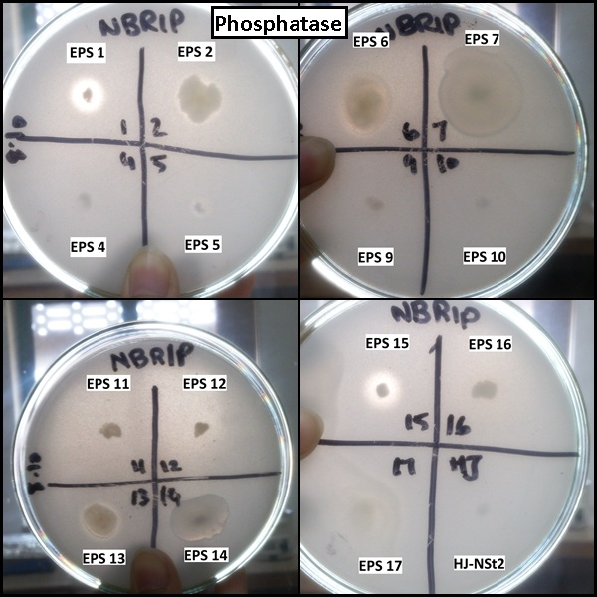
Figure S3: Solubilization of inorganic phosphate by wheat and sugarcane isolates on NBRIP agar plates

Slide 4
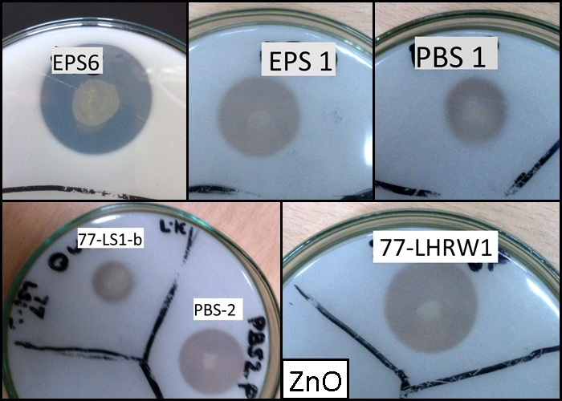
Figure S4: Solubilization of ZnO by wheat and sugarcane isolates

Slide 5
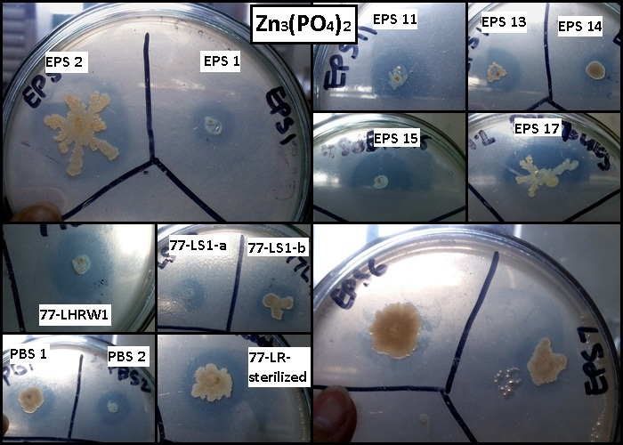
Figure S5: Solubilization of Zn₃(PO₄)₂ by wheat and sugarcane isolates

Slide 6
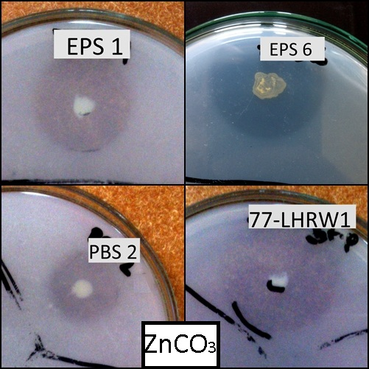
Figure S6: Solubilization of ZnCO₃ by wheat and sugarcane isolates

Slide 7
Table S1: Zinc solubilizing ability of bacterial isolates on three zinc complex media
Sr. No. | Bacterial strain | Isolate | ZnCO₃ | ZnO | Zn₃(PO₄)₂
1. | Pseudomonas fragi | EPS 1 | 0.9 cm | 0.8 cm | 0.3 cm
2. | Pantoea sp. | EPS 2 | - | - | 0.5 cm
3. | In progress | EPS 4 | - | - | -
4. | Acinetobacter johnsonii | EPS 5 | - | - | 0.3 cm
5. | Pantoea dispersa | EPS 6 | 1.1 cm | 1 cm | 0.4 cm
6. | Kosakonia oryzae | EPS 7 | - | - | 0.2 cm
7. | In progress | EPS 9 | - | - | -
8. | A. johnsonii | EPS 10 | - | - | -
9. | A. johnsonii | EPS 11 | - | - | 0.5 cm
10. | In progress | EPS 12 | - | - | 0.4 cm
11. | Pantoea vagans | EPS 13 | 1 cm | - | 0.5 cm
12. | Enterobacter cloacae / E. asburiae | EPS 14 | - | - | 0.3 cm
13. | Pseudomonas fragi | EPS 15 | - | - | 1 cm
14. | Bacillus pumilus | EPS 16 | - | - | 0.6 cm
15. | Pantoea agglomerans | EPS 17 | - | - | 0.6 cm
16. | Enterobacter cloacae | PBS 1 | 0.6 cm | 0.3 cm | 0.2 cm
17. | E. cloacae | PBS 2 | 1 cm | 1cm | 0.5 cm
18. | Caulobacter sp. | QS2 | - | - | 0.1 cm
19. | E. cloacae | Qst-W1 | - | - | 0.2 cm
20. | E. cloacae | LHR sterilized | - | - | 0.3 cm
21. | E. cloacae | LHST IN W1 | - | - | 0.2 cm
22. | Rhizobium sp. | LHRW1 | 1.8 cm | 1 cm | 0.6 cm
23. | Klebsiella oxytoca | LHRW2 | - | - | -
24. | K. oxytoca | LS1-a | - | - | 0.3 cm
25. | Enterobacter sp. / Pantoea sp. | LS1-b | - | 0.4 cm | 0.1 cm
Sr. No. 1 to 15: Wheat isolates Sr. No. 16 to 25: Sugarcane isolates

Slide 8
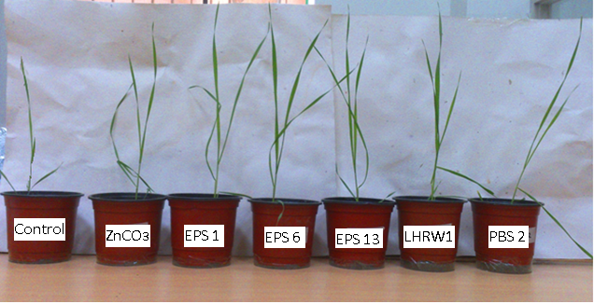
Figure S7: Comparison of control and inoculated plants after one month of growth showing effect of bacterial inoculations on wheat growth

Slide 9
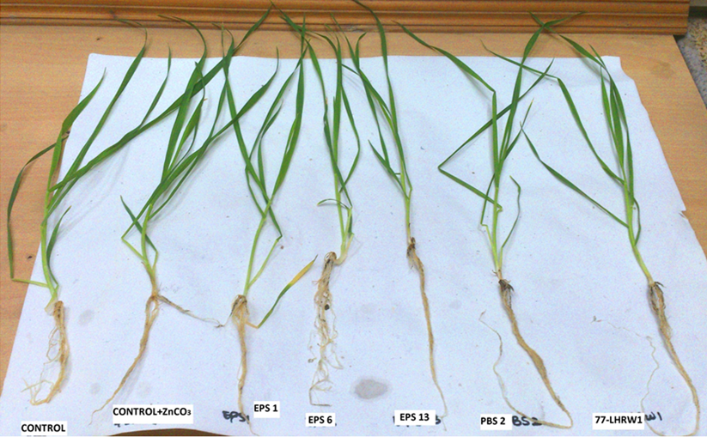
Figure S8: Comparison of control and inoculated plants after one month of growth showing effect of bacterial inoculations on wheat shoots and roots

