Slide 1
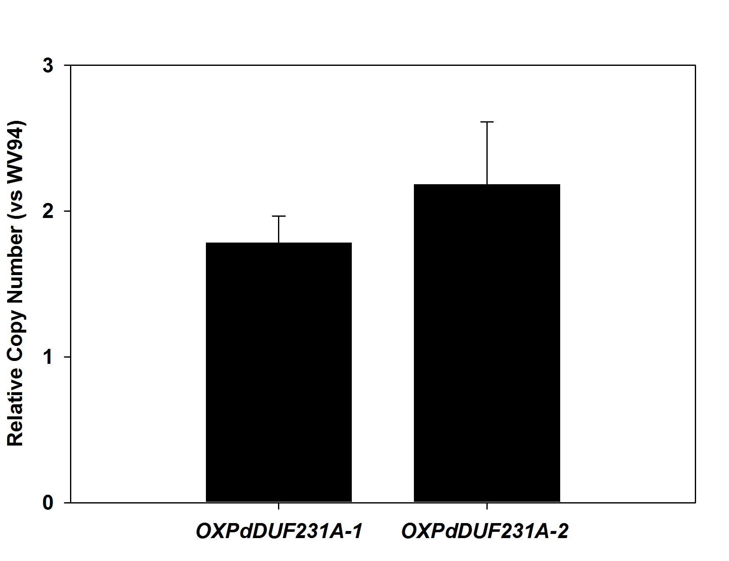
2.2 ± 0.4
1.8 ± 0.2

