Slide 1

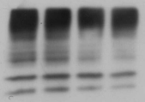


Additional file 1.
PC3
U373MG
MLN4924
- | + | - | +
NEDD8
ubiquitin
Modified PTMs
SUMO-1
Tubulin

