Slide 1
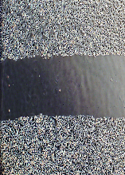
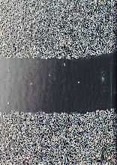
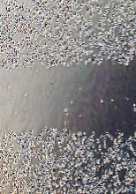
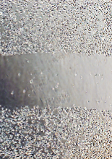
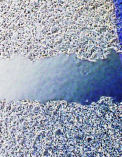
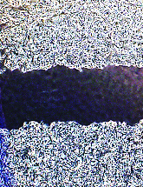
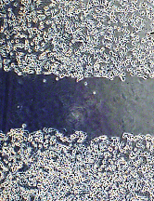
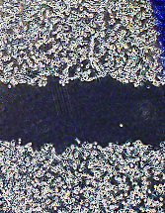
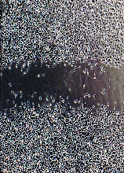
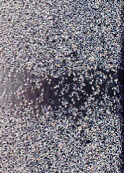
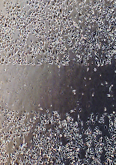
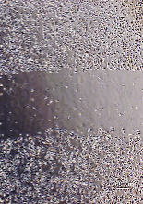
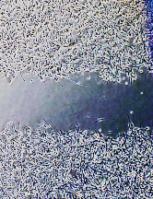
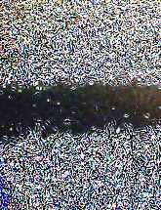
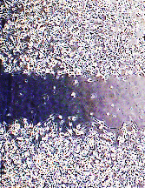
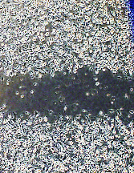

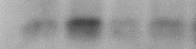
Additional file 3
A
si-Con
si-Cav1^{#1}
B
si-Con
si-Cav1^{#2}
Veh
MLN
Veh
MLN
Veh
MLN
Veh
MLN
0 hr
0 hr
PC3
U373MG
24 hr
24 hr
Migration area
(fold change)
Migration area
(fold change)
n.s
Veh
MLN
Veh
MLN
Veh
MLN
Veh
MLN
si-Con
si-Cav1^{#1}
si-Con
si-Cav1^{#2}
pY14-Cav1
pY14-Cav1
Cav1
Cav1
Tubulin
Tubulin
pY14-Cav1
pY14-Cav1
n.s
Cav1
n.s
Cav1
n.s
n.s
n.s
Veh
MLN
Veh
MLN
Veh
MLN
Veh
MLN
si-Con
si-Cav1^{#1}
si-Con
si-Cav1^{#2}

