Slide 1
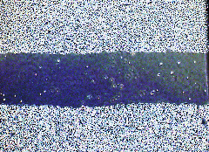
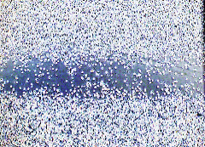
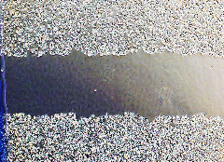
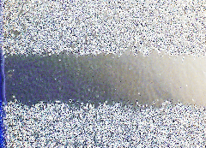
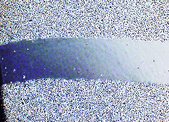
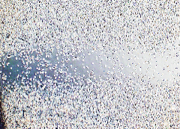
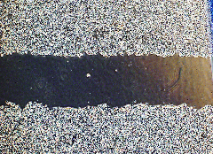
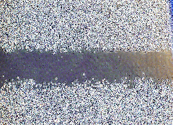
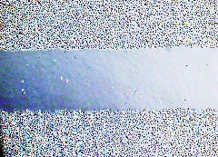
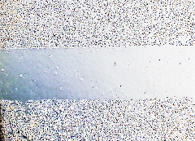
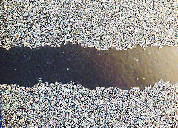
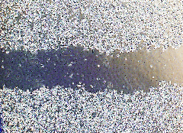
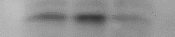
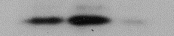
Additional file 4
A
PC3
B
U373MG
0 hr
24 hr
0 hr
24 hr
Con
si-N8^{#2}
si-N8^{#2}
+PP2
n.s
*
*
*
Migration area
(fold change)
Migration area
(fold change)
si-Con
-
PP2
si-Con
-
PP2
si-N8^{#2}
si-N8^{#2}
pY14-Cav1
pY14-Cav1
Cav1
Cav1
N8
N8
Tubulin
Tubulin
pY14-Cav1
*
*
pY14-Cav1
*
*
si-Con
-
PP2
si-Con
-
PP2
si-N8^{#2}
si-N8^{#2}

