Slide 1
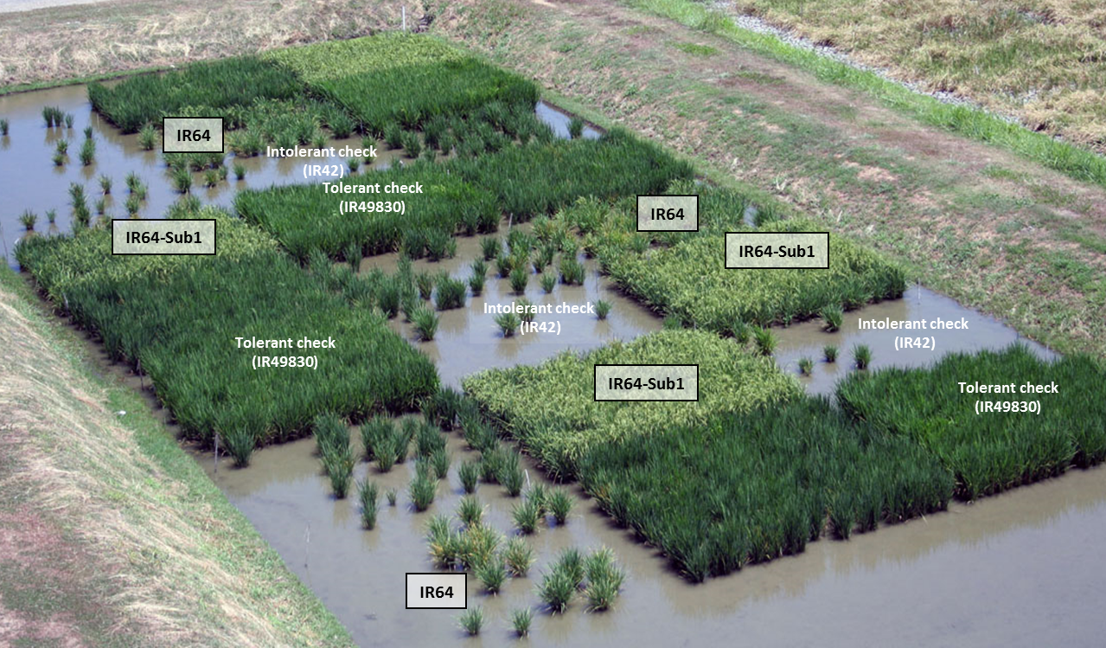
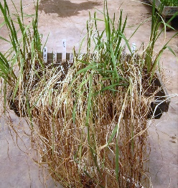
a
SUB1 QTL
SUB1C
SUB1B
SUB1A-1
Tolerant
e.g., FR13A, IR64-Sub1
SUB1C
SUB1B
SUB1A-2
Intermediate tolerant
e.g., IR64
SUB1C
SUB1B
Intolerant
e.g., Nipponbare
Chromosome 9
c
b
tolerant
susceptible
IR64-
Sub1 IR64
node
(leaf base)
internode
Supplementary Figure 1

