Slide 1
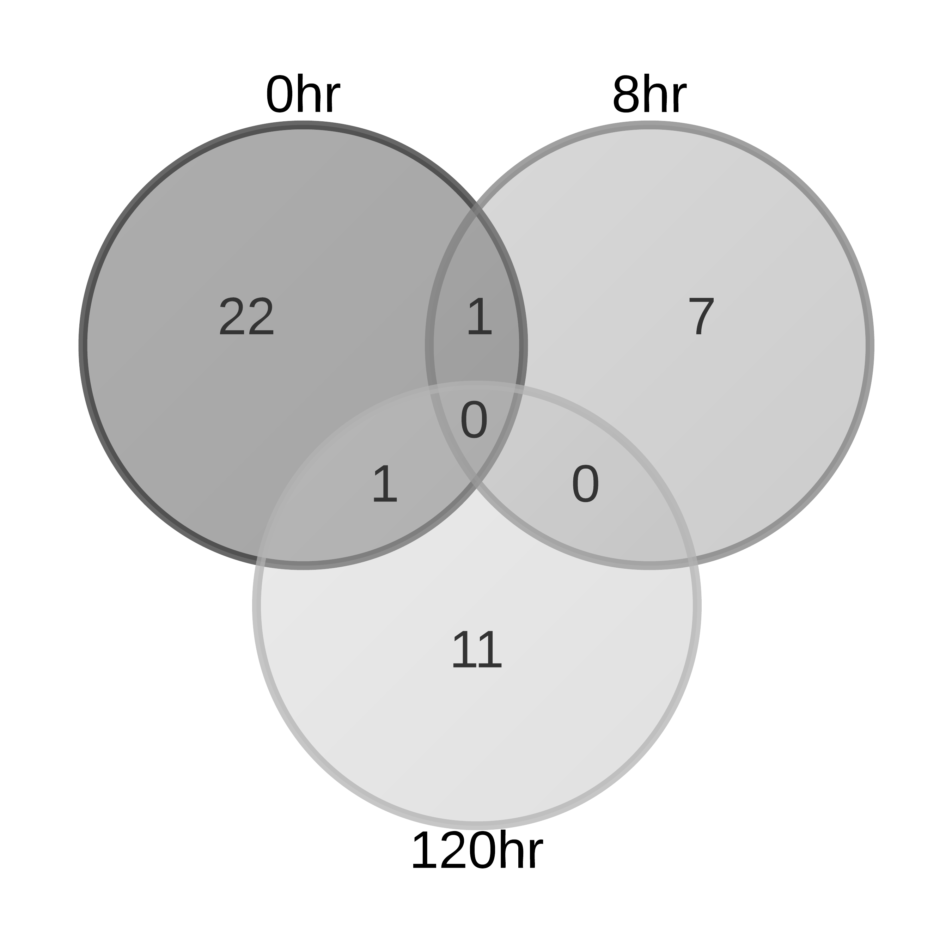


S1 Fig. Overlap of DE probesets within each brain region as a function of time.
A. AMY
B. NAC
C. PFC

