Slide 1
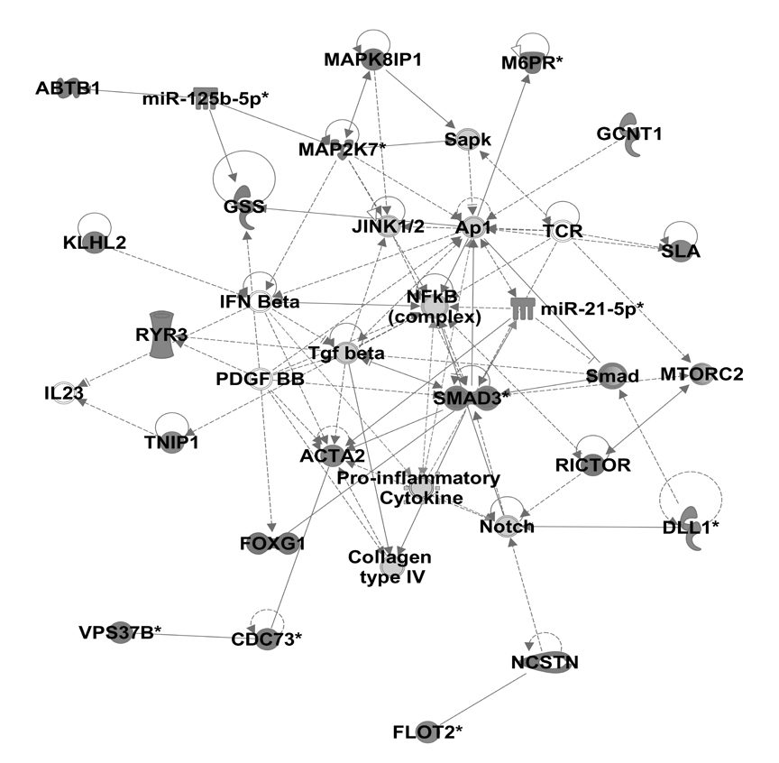
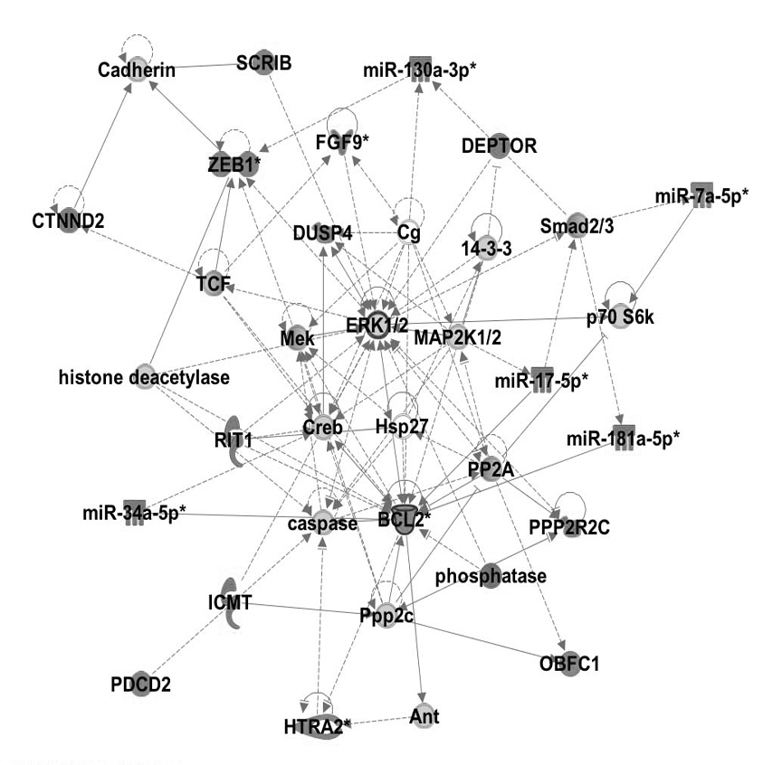
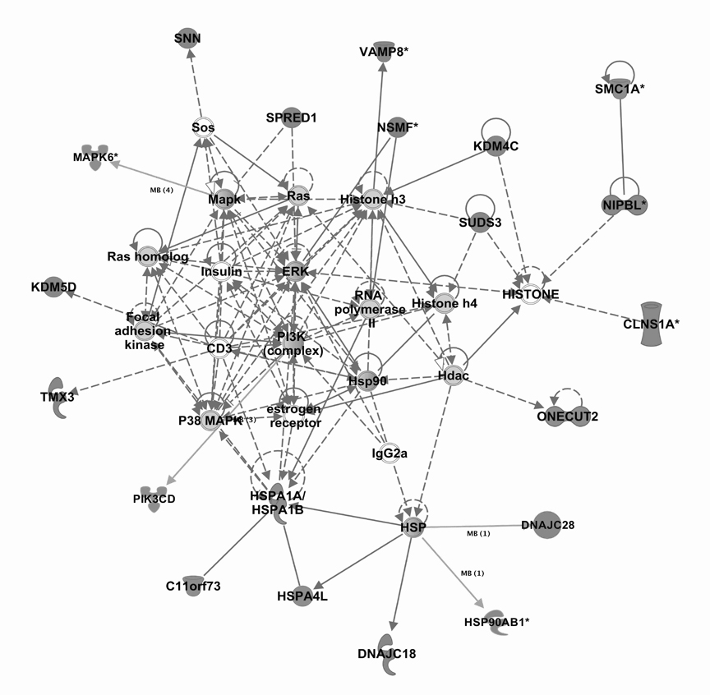
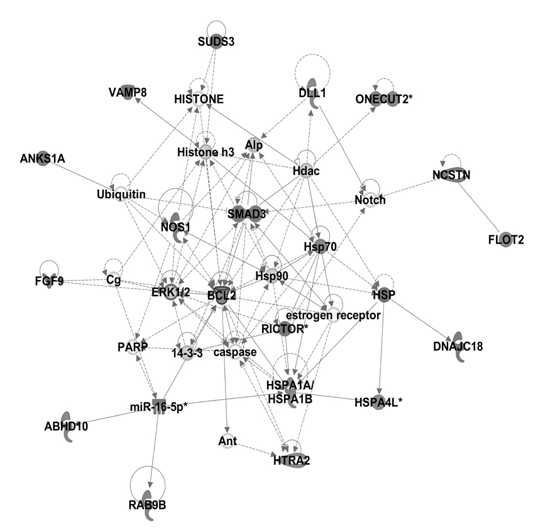
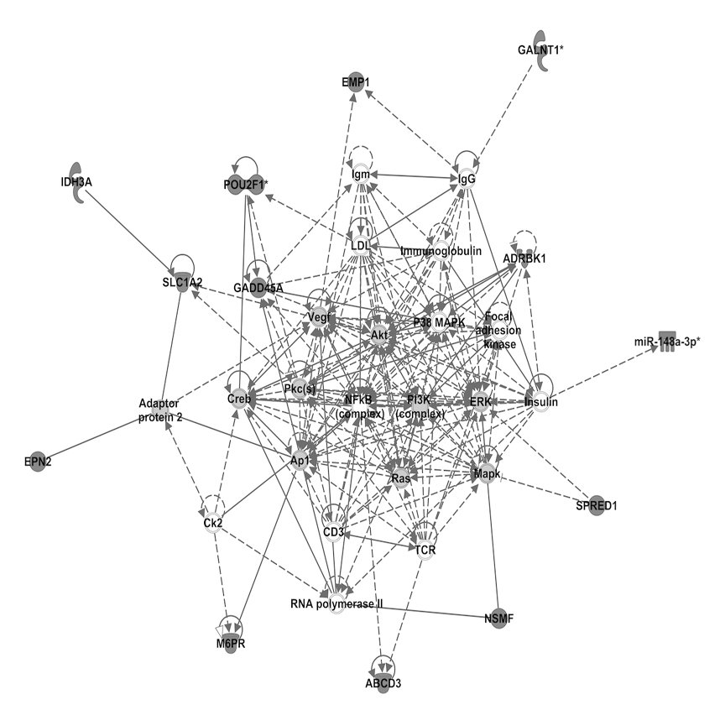
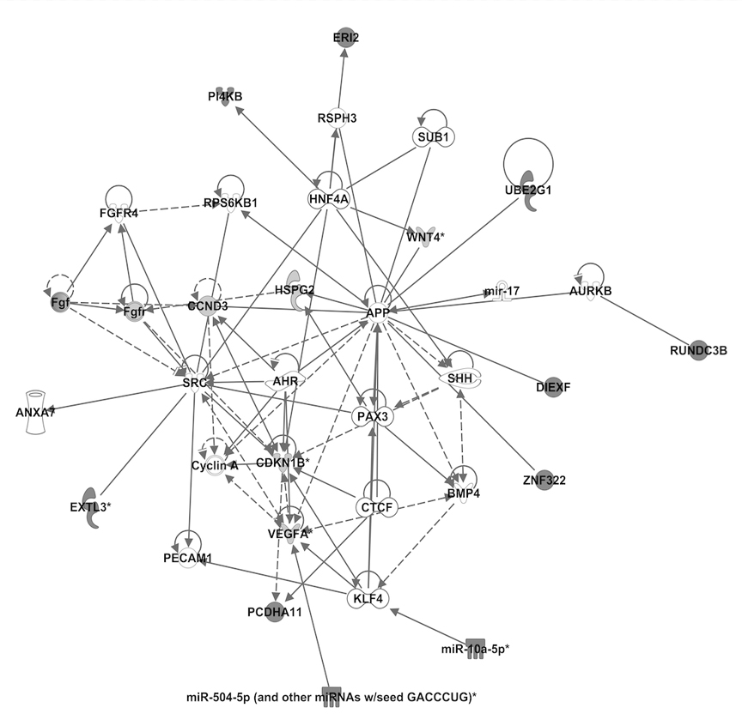
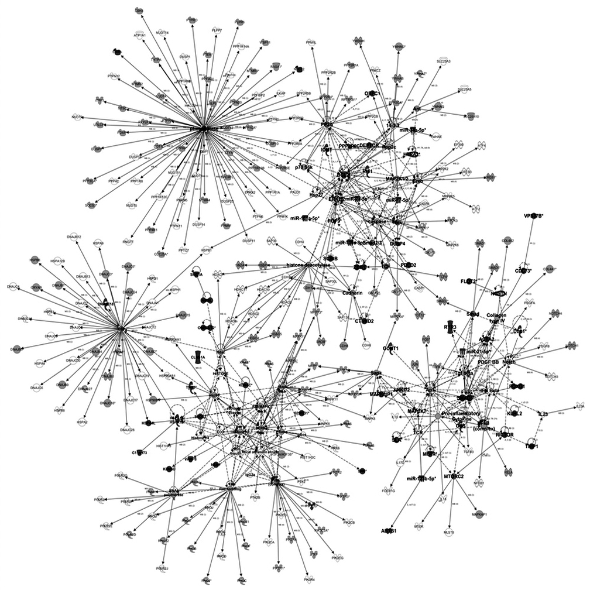
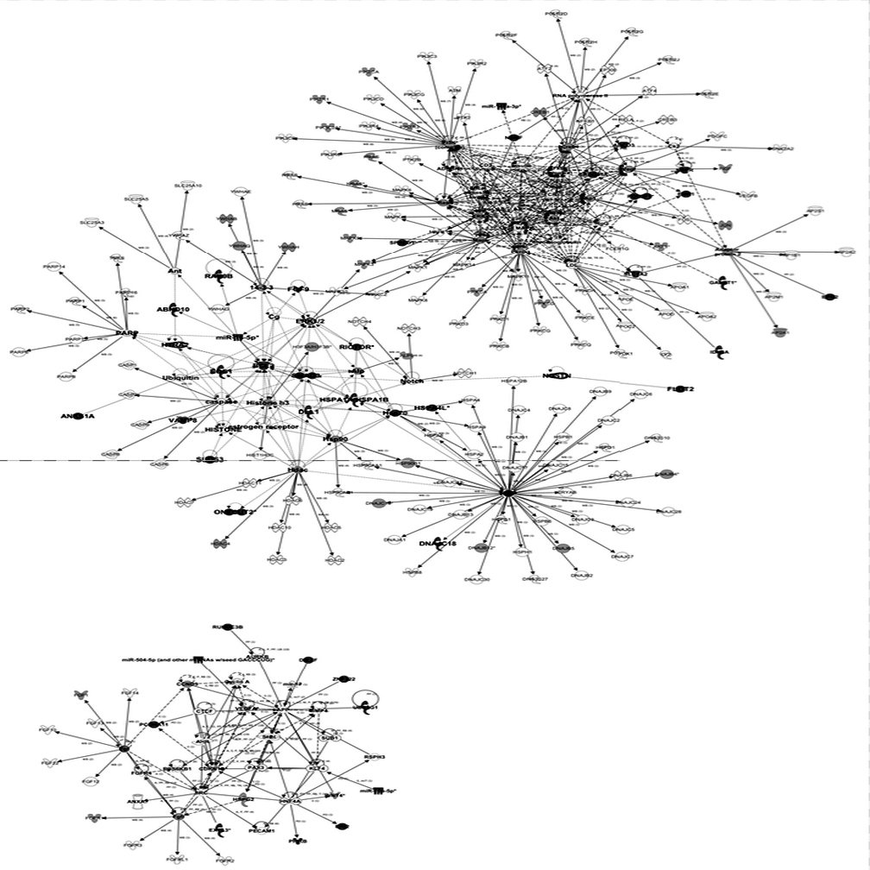
S3 Fig. Temporal miRNA regulation of target genes. To investigate the potential time-dependent relationship of miRNA gene regulation, focused datasets were created from differentially expressed miRNAs (0 and 8h only) and their differentially expressed target mRNAs (120h). For each of these miRNA-mRNA datasets, genes from the top three IPA-derived networks were merged and genes common to the merged networks were identified. This enabled us to focus on a key list of genes (”critical network genes”) whose expression is modulated by miRNAs during withdrawal and remains dysregulated during protracted withdrawal, a period of time associated with drug relapse.
0h DE miR / 120h DE targets
8h DE miR / 120h DE targets
Network 1
Network 2
Network 3
Network 1
Network 2
Network 3
Merge top 3 networks from each dataset
Identify common genes
Select 120h DE genes
Table 5

