Slide 1
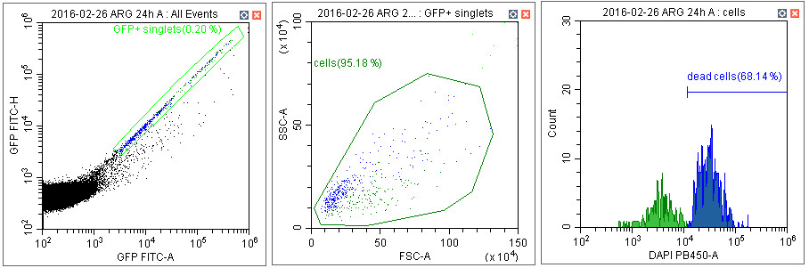
a
b
c
Addional file 1: Figure S1. Gating strategy. a Gating on single GFP+ cells on GFP-A/GFP-H dotplot. b Gating on Leishmania cells on FSC-A/SSC-A dotplot. c Analysis of DAPI fluorescence on histogram – enumeration of % DAPI+ (i.e. dead) Leishmania cells.

Slide 2
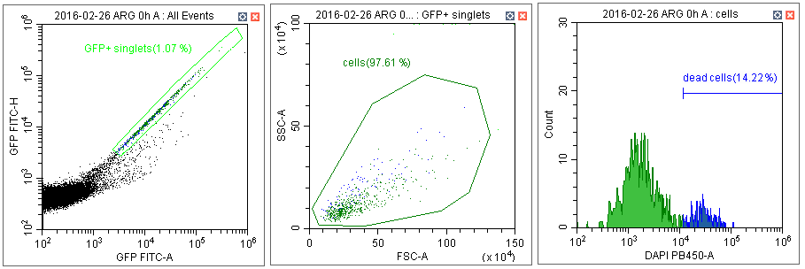
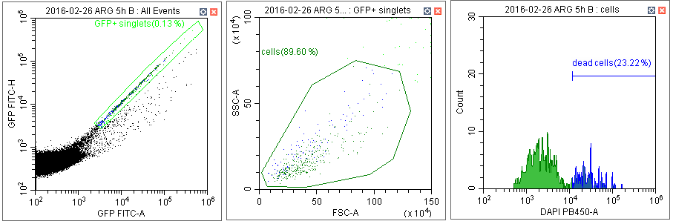
0h
AMA
5h
AMA/
PROMA
24h
PROMA
Addional file 1: Figure S2. Leishmania donovani amastigotes (0 h AMA), parasites within amastigote-promastigote transition (5 h AMA/PROMA) and promastigotes (24 h PROMA) were incubated in a microtiter plate for 2 h with midguts of P. argentipes dissected at 24 h post-blood meal. Analysis of dead Leishmania was performed using flow cytometry. Percentage of dead cells was assessed on histogram of DAPI fluorescence on gated single GFP-positive Leishmania.

Slide 3
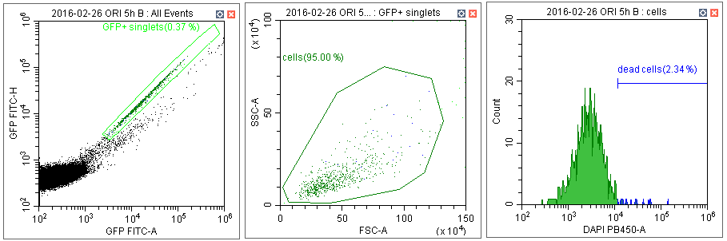
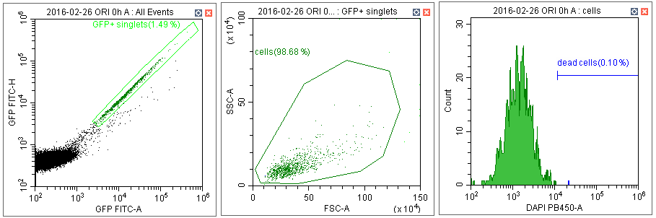
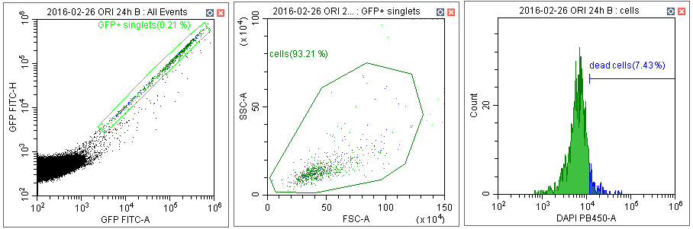
0h
AMA
5h
AMA/
PROMA
24h
PROMA
Addional file 1: Figure S3. Leishmania donovani amastigotes (0 h AMA), parasites within amastigote-promastigote transition (5 h AMA/PROMA) and promastigotes (24 h PROMA) were incubated in a microtiter plate for 2 h with midguts of P. orientalis dissected at 24 h post-blood meal. Analysis of dead Leishmania was performed using flow cytometry. Percentage of dead cells was assessed on histogram of DAPI fluorescence on gated single GFP-positive Leishmania.

Slide 4
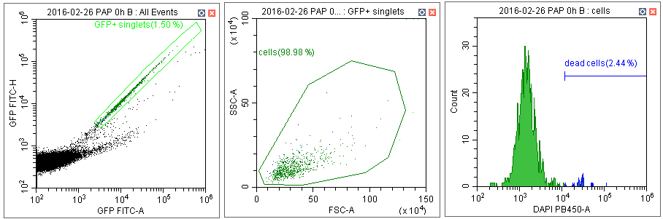
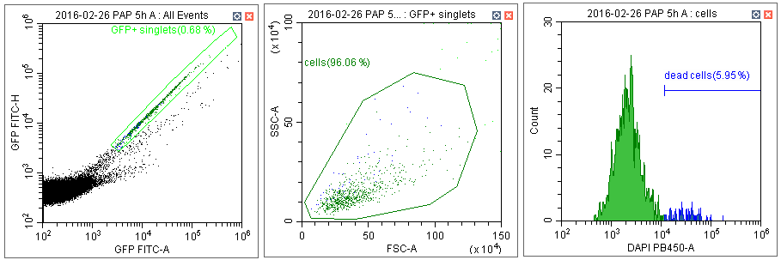
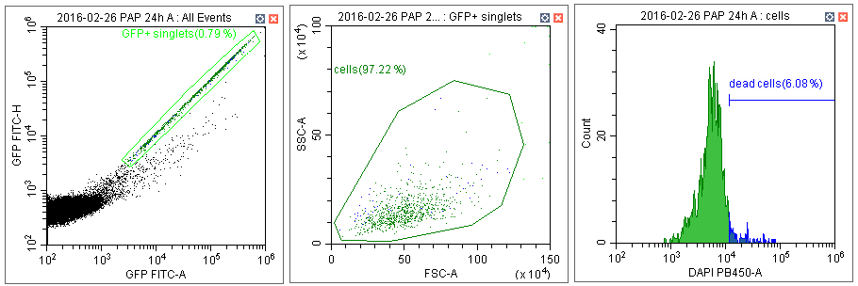
0h
AMA
5h
AMA/
PROMA
24h
PROMA
Addional file 1: Figure S4. Leishmania donovani amastigotes (0 h AMA), parasites within amastigote-promastigote transition (5 h AMA/PROMA) and promastigotes (24 h PROMA) were incubated in a microtiter plate for 2 h with midguts of P. papatasi dissected at 24 h post-blood meal. Analysis of dead Leishmania was performed using flow cytometry. Percentage of dead cells was assessed on histogram of DAPI fluorescence on gated single GFP-positive Leishmania.

Slide 5
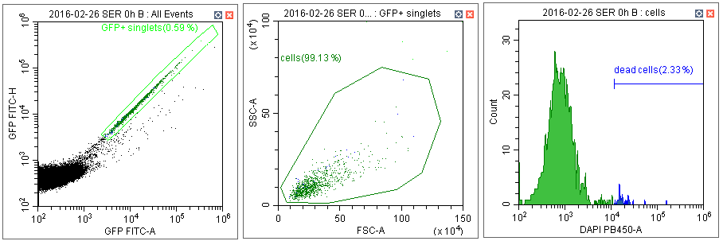
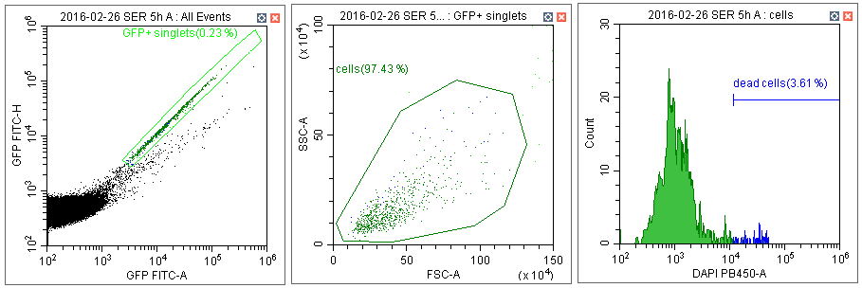
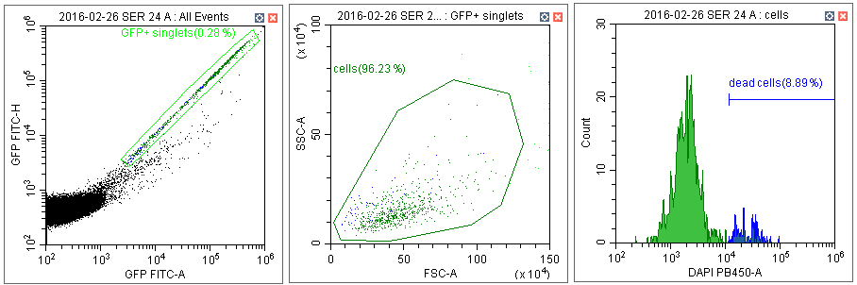
0h
AMA
5h
AMA/
PROMA
24h
PROMA
Addional file 1: Figure S5. Leishmania donovani amastigotes (0 h AMA), parasites within amastigote-promastigote transition (5 h AMA/PROMA) and promastigotes (24 h PROMA) were incubated in a microtiter plate for 2 h with midguts of S. schwetzi dissected at 24 h post-blood meal. Analysis of dead Leishmania was performed using flow cytometry. Percentage of dead cells was assessed on histogram of DAPI fluorescence on gated single GFP-positive Leishmania.

Slide 6
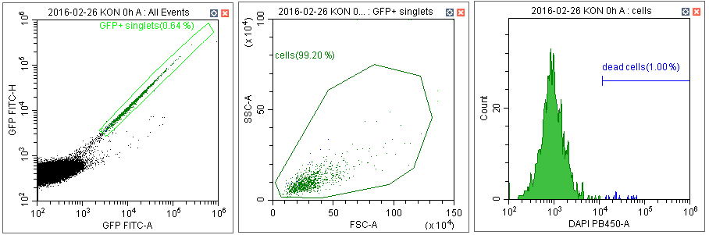
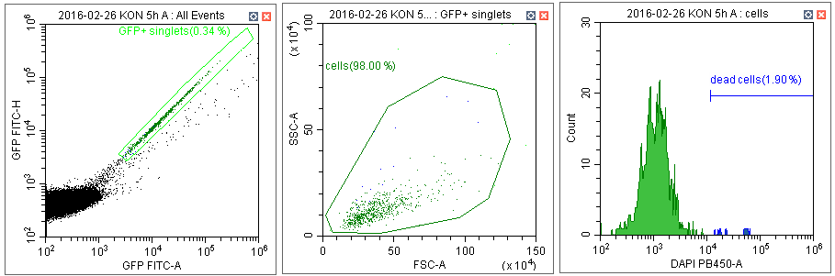
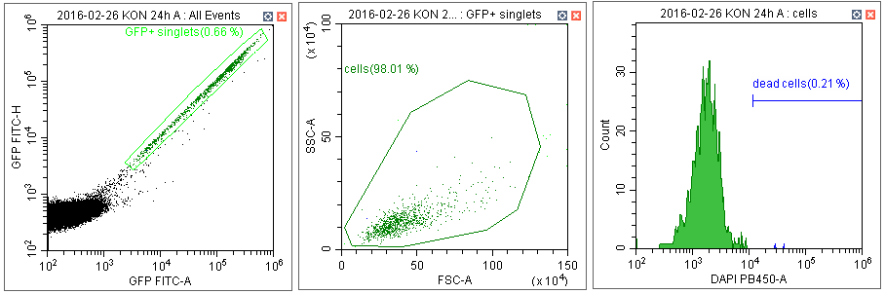
0h
AMA
5h
AMA/
PROMA
24h
PROMA
Addional file 1: Figure S6. Negative control; Leishmania donovani amastigotes (0 h AMA), parasites within amastigote-promastigote transition (5 h AMA/PROMA) and promastigotes (24 h PROMA) were incubated in a microtiter plate for 2 h with saline. Analysis of dead Leishmania was performed using flow cytometry. Percentage of dead cells was assessed on histogram of DAPI fluorescence on gated single GFP-positive Leishmania.

Slide 7
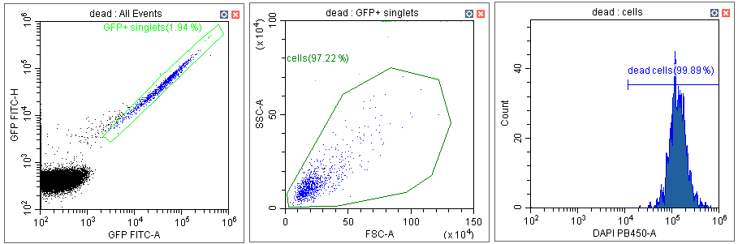
Addional file 1: Figure S7. Positive control; parasites killed by 1% formaldehyde and permeabilised by 0.5% Triton X-100. Percentage of dead cells was assessed on histogram of DAPI fluorescence on gated single GFP-positive Leishmania.

