Slide 1
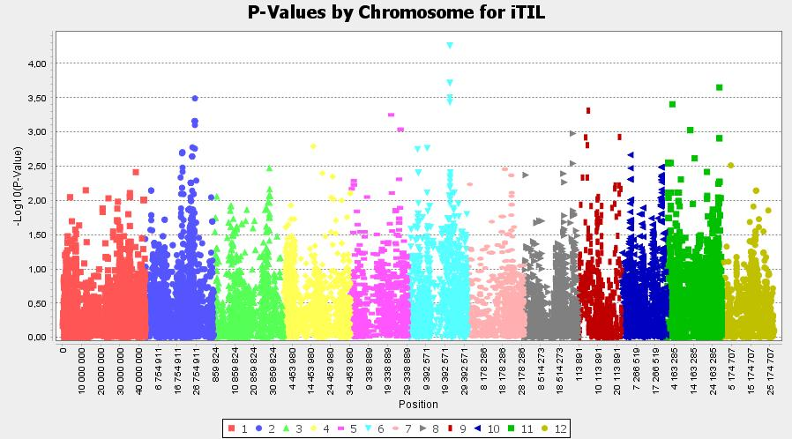
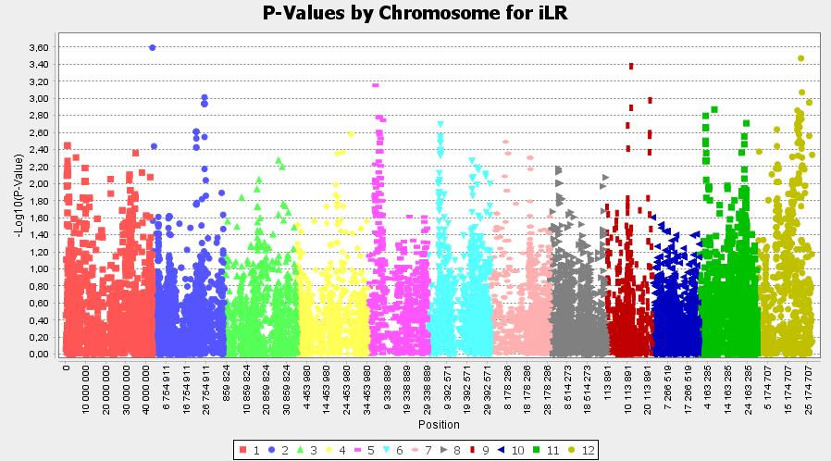
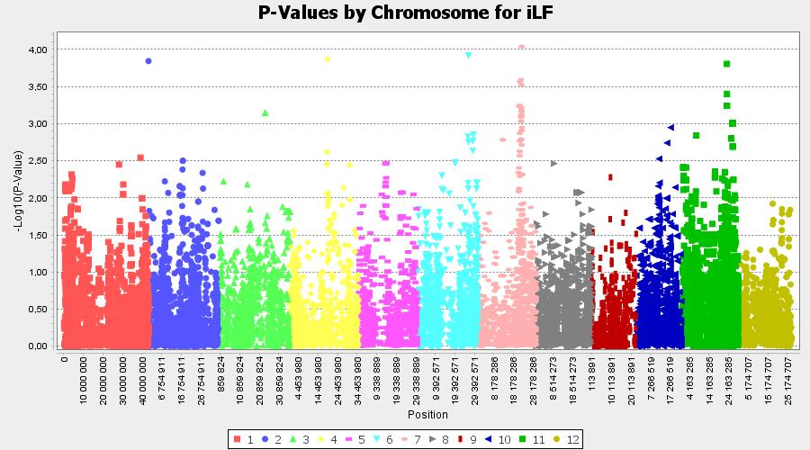
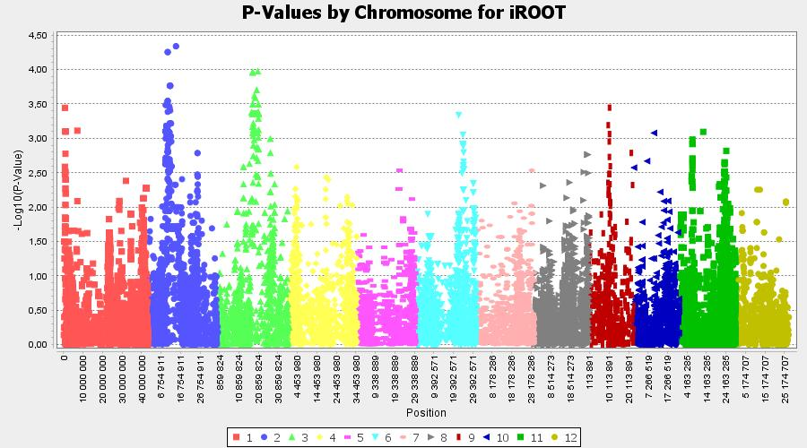
S4 Fig: Manhattan plots for the 8 growth traits analyzed with the conventional method
iTIL: relative number of tillers; iLF: relative maximum leaf length; iLR: relative maximum root length, iROOT: relative root dry weight;

Slide 2
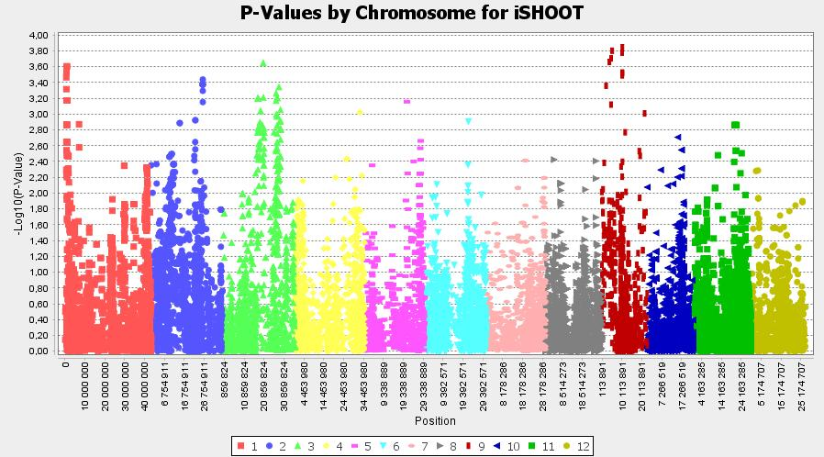
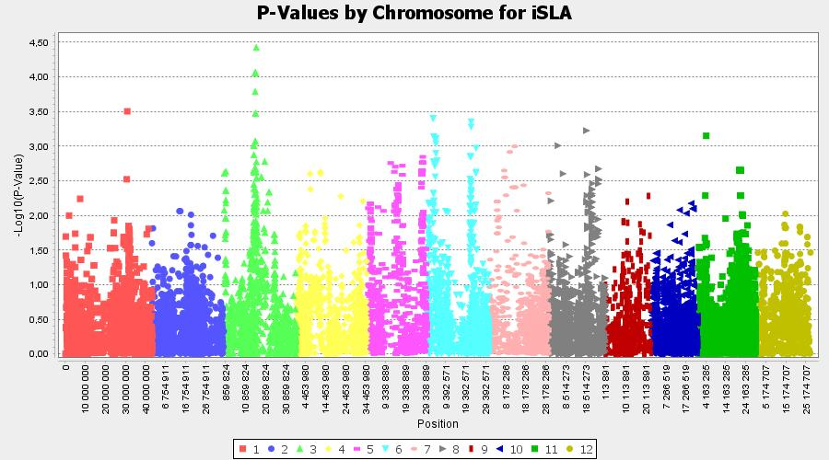
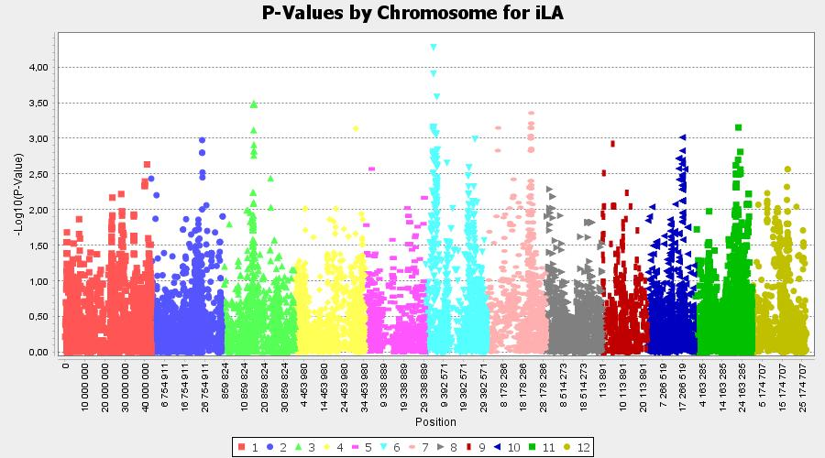
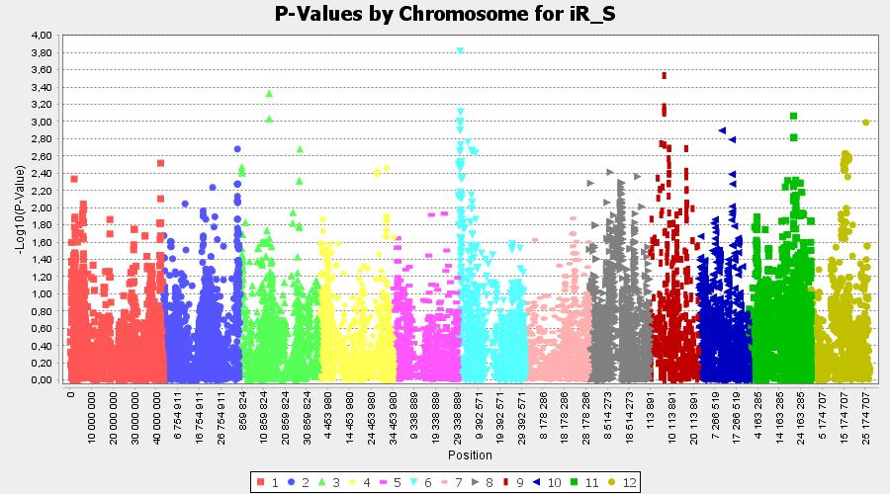
S4 Fig: Manhattan plots for the 8 growth traits analyzed with the conventional method
iSHOOT: relative shoot dry weight; iR/S: relative root-to-shoot ratio; iLA: relative leaf area; iSLA: relative specific leaf area

