Slide 1
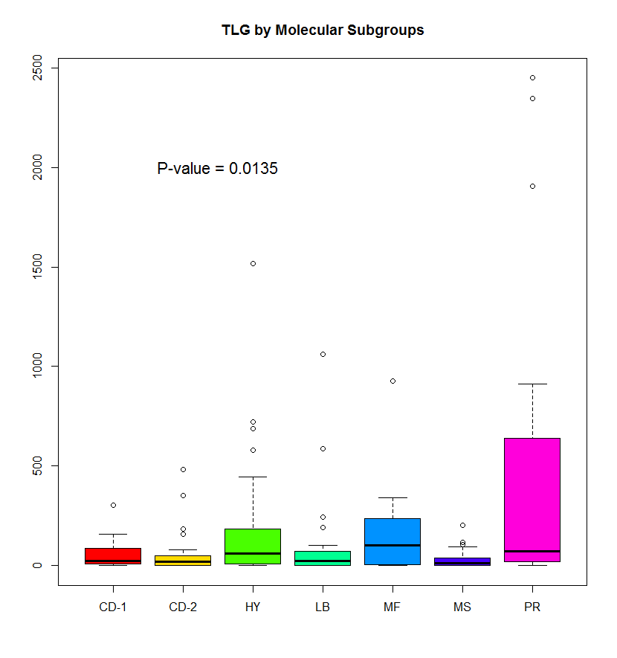
Supplementary Figure 1A:
The distribution of TLG by molecular
subgroup. The table below shows the
percentages and numbers of patients
in each group. The Kruskal-Wallis p-value
= 0.0135 indicates there is some difference
in TLG among the subgroups
 | PR | MS | MF | LB | HY | CD-1 | CD-2
Low TLG (TLG < 205) | 64% (16/25) | 100% (23/23) | 67% (10/15) | 90% (26/29) | 78% (39/50) | 92% (11/12) | 91% (20/22)
High TLG (205 < TLG < 620) | 8% (2/25) | 0% (0/23) | 27% (4/15) | 7% (2/29) | 16% (8/50) | 8% (1/12) | 9% (2/22)
Very High TLG (TLG > 620) | 28% (7/25) | 0% (0/23) | 7% (1/15) | 3% (1/29) | 6% (3/50) | 0% (0/12) | 0% (0/21)

Slide 2
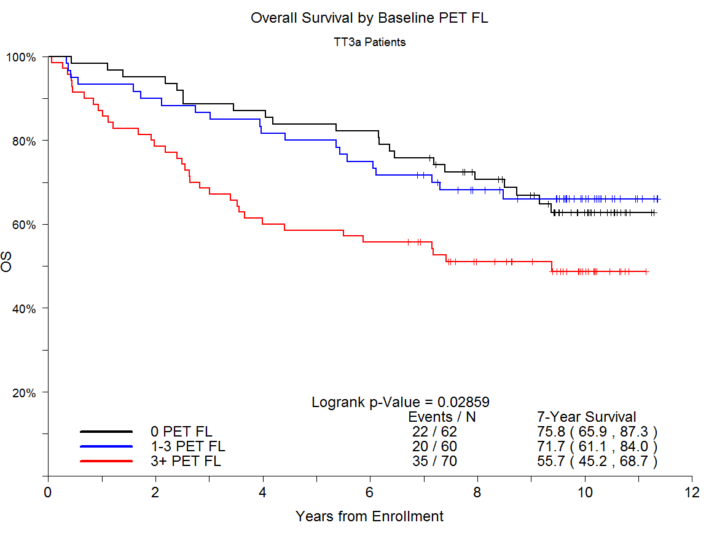
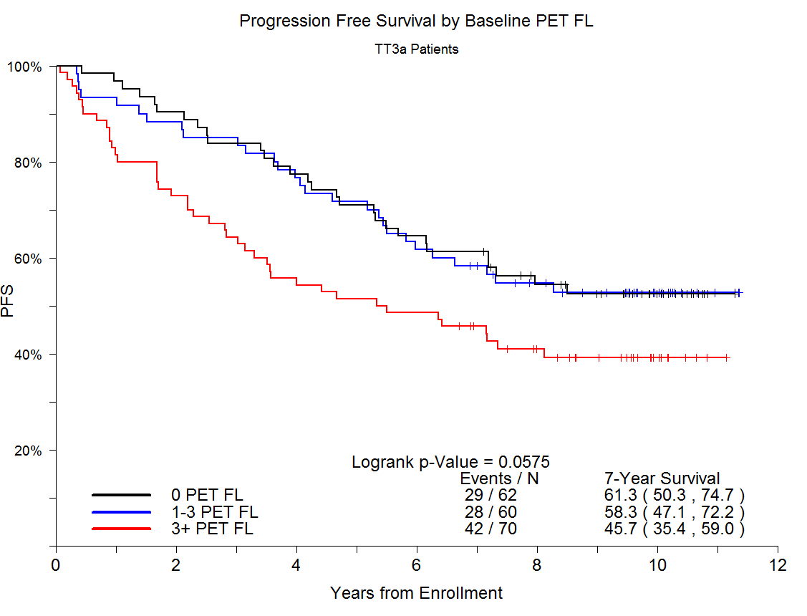
Supplementary Figure 1B: PFS (left) and OS (right) for Baseline PET Focal Lesions

Slide 3
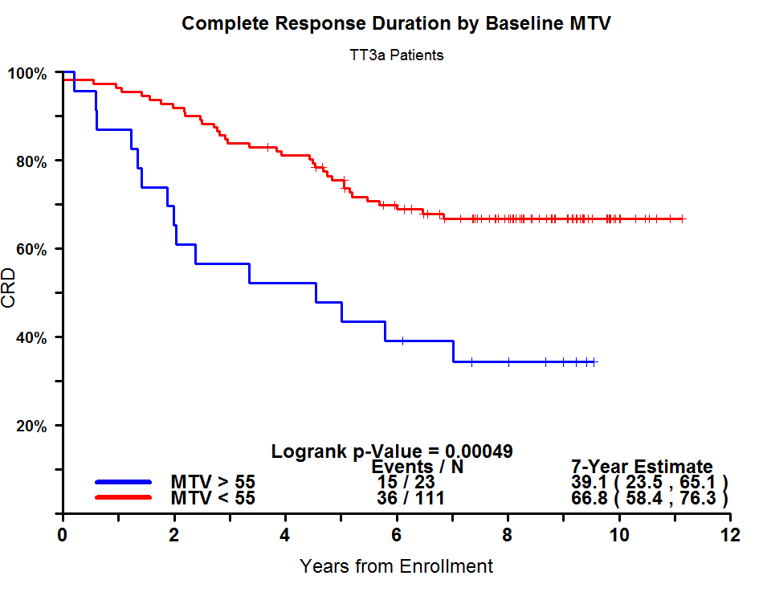
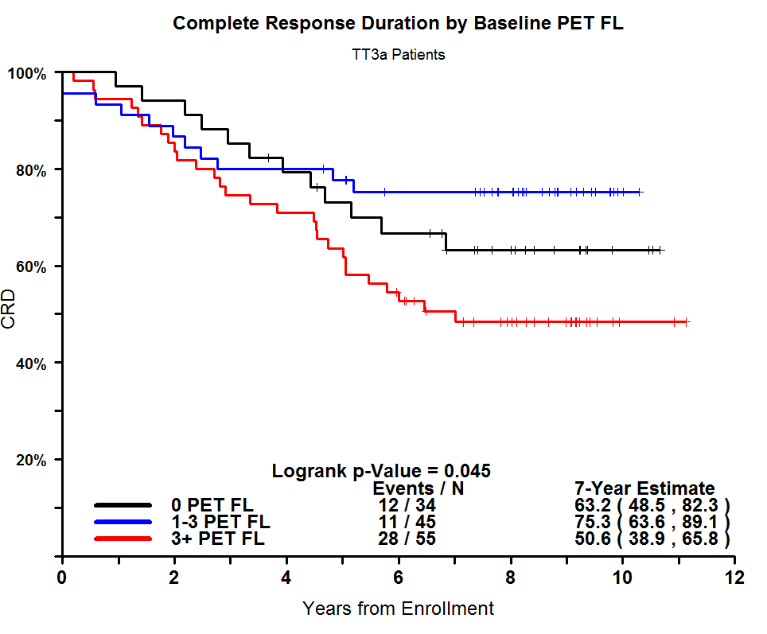
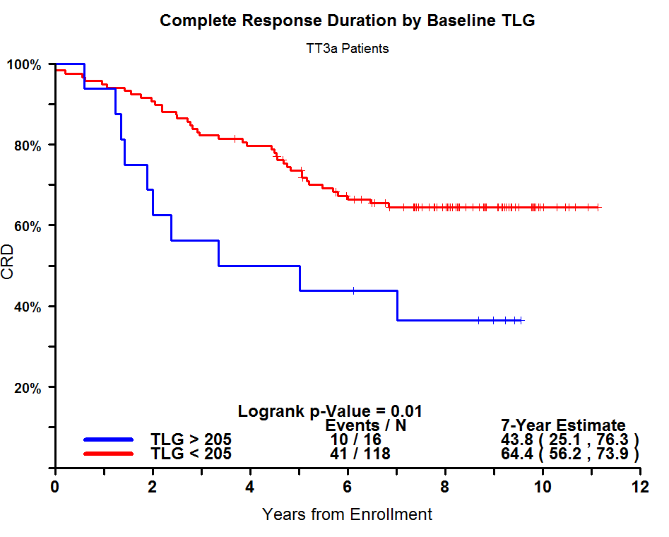
Supplementary Figure 1C: Complete Response Duration for Baseline PET FL, TLG, and MTV.

Slide 4
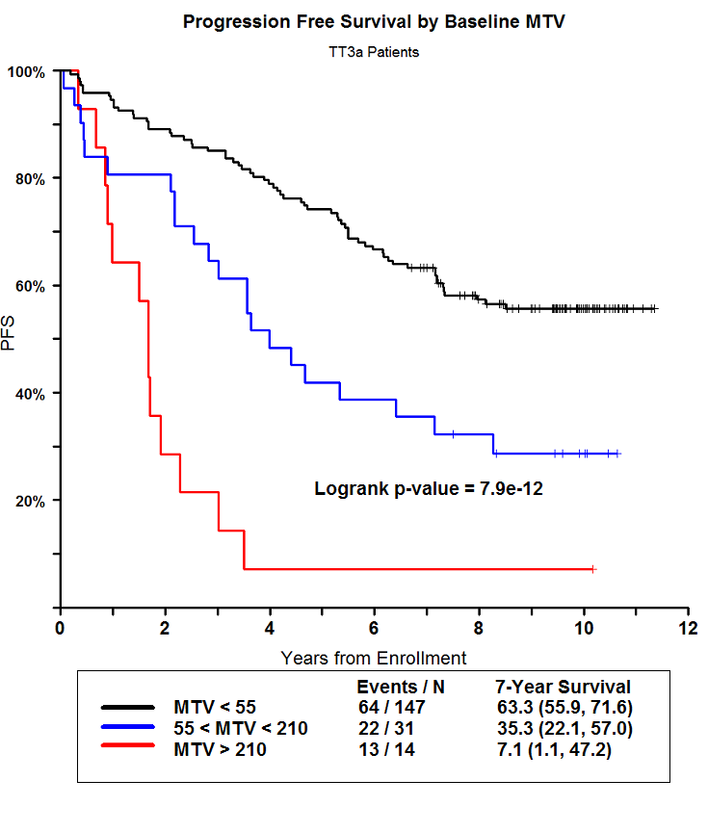
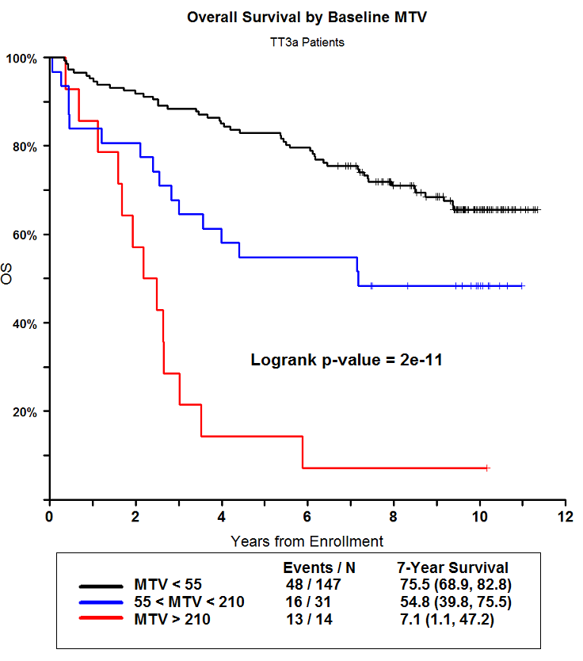
Supplementary Figure 1D: PFS (left) and OS (right) for Baseline MTV

Slide 5
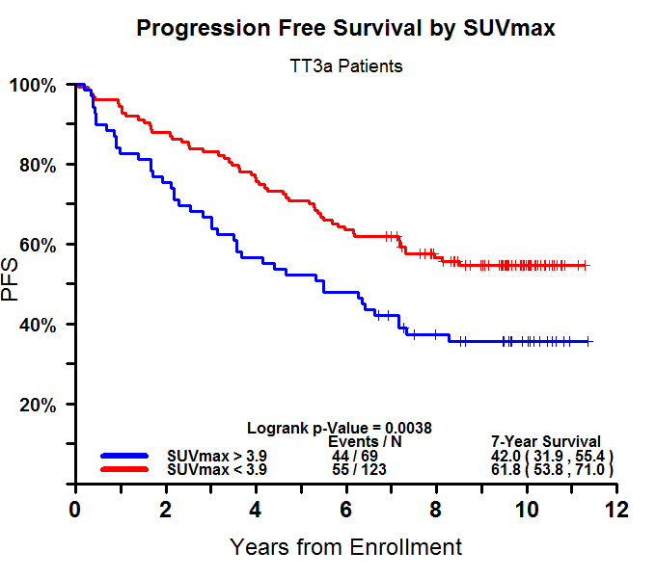
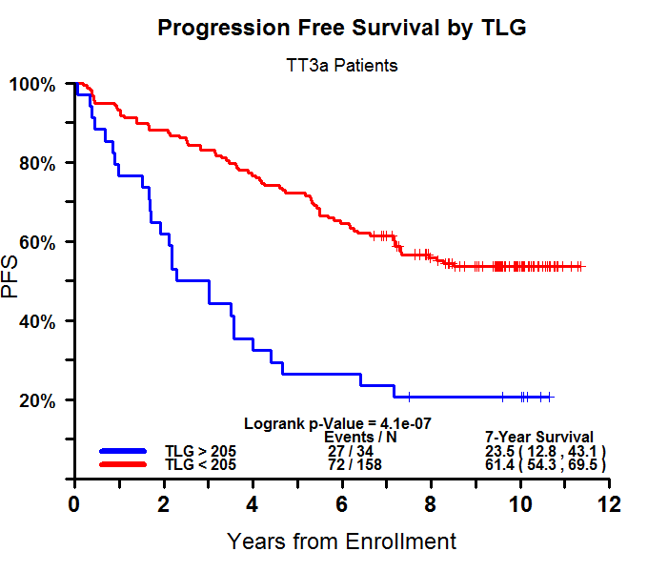
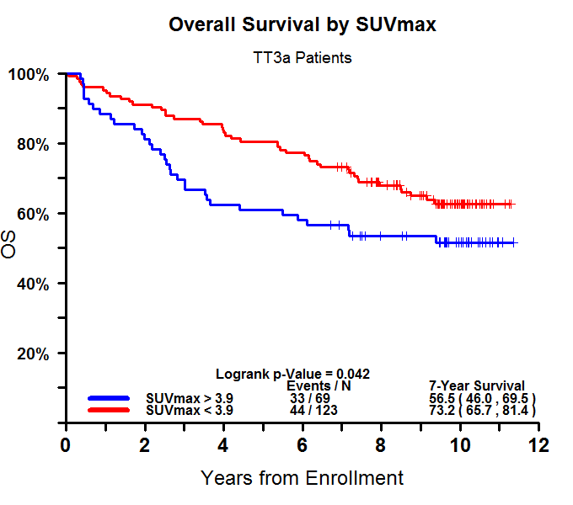
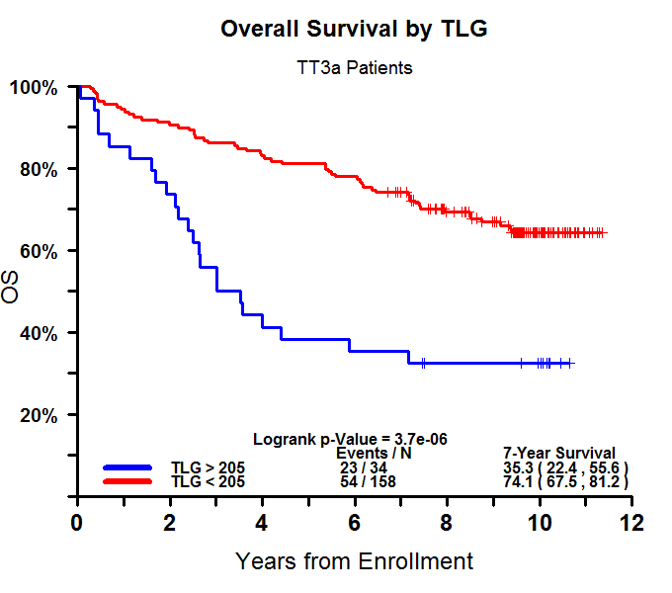
Supplementary Figure 1E: PFS (top) and OS (bottom) for SUV max vs baseline TLG

