Slide 1
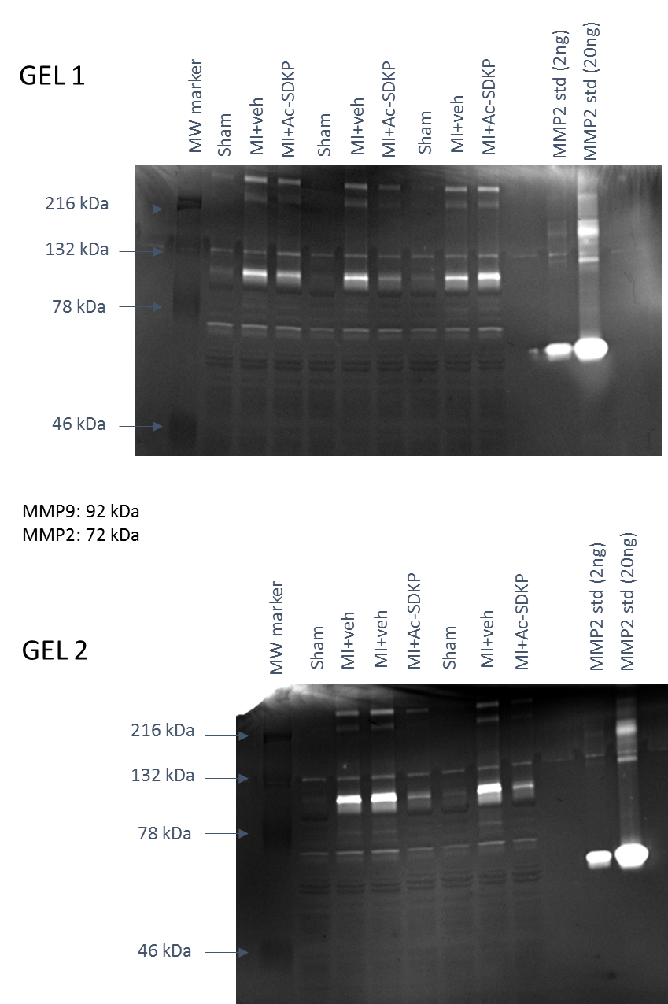
S2 Fig.
Figure 6: original zymograms

