Slide 1

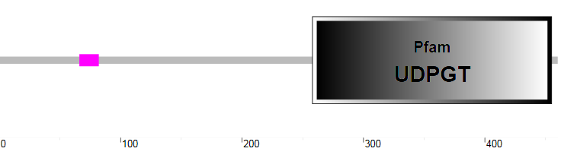
Figure S7
a
b

