Slide 1
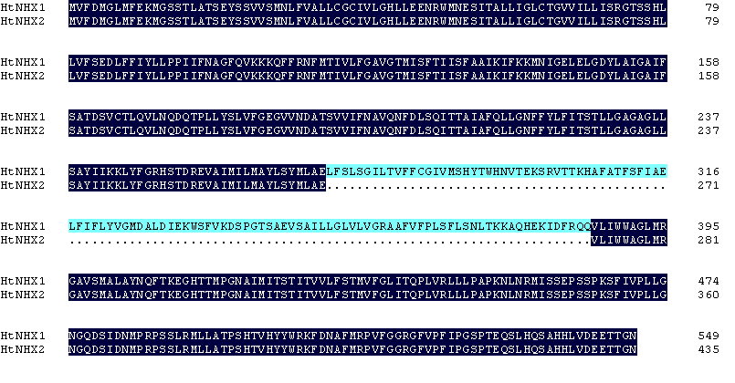
Supplementary Information (Total 6 Figures and 2 Tables)
A
B
C
Figure S1-1.

Slide 2
Predicted transmembrane topology model of HtNHX1
D
Predicted transmembrane topology model-1 of HtNHX2
E
Predicted transmembrane topology model-2 of HtNHX2
F
Figure S1. Bioinformatic prediction of HtNHX1 and HtNHX2 structures.
A: Analysis Alignment of deduced amino acids sequences of HtNHX1 and HtNHX2;
B: phylogenic tree of some known and putative plant K⁺ (Na⁺)/H⁺ antiporters;
C: conserved 8 amino acids region showing the difference between plant type-I and type-II members of NHX family;
D, E and F: predicted transmembrane topology model of HtNHX1 (D) by TMpred (http://www.ch.embnet.org/software/TMPRED_form.html) or by TMHMM2.0 (http://www.cbs.dtu.dk/services/TMHMM/) and the model-1 of HtNHX2 by TMpred (E) or model-2 by TMHMM2.0 (F).

Slide 3
A
B
C
Figure S2. Isolation of single copy inserted rice lines of HtNHX1 or HtNHX2 expression.
Southern Blot analysis (A) and identification of the inserted localization (B), and expression abundance of HtNHX1 and HtNHX2 relative to Actin (C) in the rice genome,. P: Probe; M:Maker; The genomic DNA of WT （wild type), HtNHX1 and HtNHX2 expression lines were all digested with BamⅠand HindⅢ.

Slide 4
a
b
A
c
d
ab
a
ab
b
B
c
ns
C
a
ns
b
Figure S3. Effects of overexpression of HtNHX1 and HtNHX2 on grain yield, harvest index, and NPK concentrations in the rice grown in low K supplied soil.
A, B: The rice was grown in K supplied soil with 0.15g-K/kg (+K) or without K fertilization (-K). Soil properties were described in Table S2. C: Concentrations of total N, P and K in the harvested straws from no K fertilizer (-K) treatment.
WT: cv. Nipponbare of rice; X1-1, 1-2: two T2 individual transgenic lines of expressing HtNHX1; X2-1, 2-2: two T2 individual transgenic lines of expressing HtNHX2. Different letter(s) on the column indicates the significant difference at probability at 5%. ns: no significant difference.

Slide 5
a
b
b
c
ns
Figure S4. Effects of HtNHX1 and HtNHX2 expression on ammonium N acquisition and distribution under low N and K supply condition.
The rice seedlings were grown in 0.3mM (NH4)₂SO₄ and 0.25mM KCl solution for two weeks and then ¹⁵N labelled (¹⁵NH₄)₂SO₄ was presented in the culture solution for 24h for analyzing ¹⁵N concentration in the root and shoot. Different letter on the column indicates the significant difference at probability at 5%. ns: no significant difference.

Slide 6
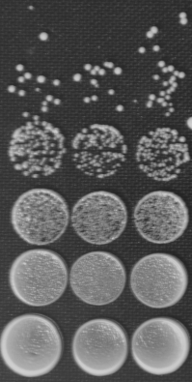
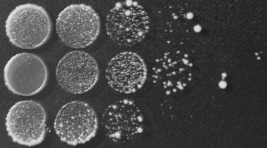
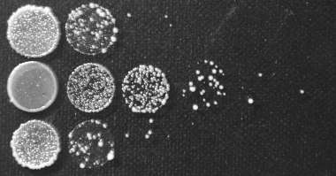
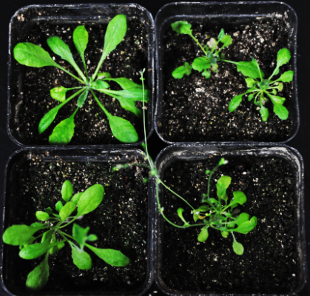
Vector
A
HtNHX1
HtNHX2
0 μg/ml Higromycin
20μg/ml Higromycin
30μg/ml Higromycin
0 μg/ml Hygromycin
25 μg/ml Hygromycin
WT
B
WT
nhx5:6
nhx5:6
HtNHX1
HtNHX1
HtNHX2
HtNHX2
Figure S5. HtNHX1, but not HtNHX2, functioned in enhancing tolerance to external hygromycin in both nhx1 mutated yeast cells (A) and Arabidopsis (B).
The seeds of WT and nhx5:6 were germinated in normal ½ MS medium for one week, while the seeds of the transgenic lines expressing HtNHX1 or HtNHX2 were germinated in the ½ MS medium containing 25 mg/L hygromycin for one week, then all the seedlings were transplanted in the culture medium in a greenhouse for 6 weeks before being photographed.

Slide 7
Supplemental Table 1. The primers used in the experiments
Degenerate primers for cloning HtNHX1/2 fragment
Primer name | Sequence (5' to 3’)
P1: | 5’TCCCATTA(C,T)AC(A,T,C)TGGCACAATGT3’
P2: | 5’GTTAT(A,C,G)GT(A,G)CT(T,C)GTGATCAT3’
P3: | 5’TCCAGAGTAACAACCAAGCACGCC3’ (for 5’ RACE PCR)
P4: | 5’TGGCACAATGTCACCGAGAAATC3’ (for 5’ nested RACE PCR)
P5: | 5’GCATTCCCAGGCATTGTTGTGTGA3’ (for 3’ RACE PCR)
P6: | 5’ CCAAAAAGGCCCAACACGAGAAGA 3’ (for 3’ nested RACE PCR)
P7: | 5’CCCCCCAAGATTCAATTTTTAGAT3’
P8: | 5’- GCACCTTAAAACCAAAACTCAACAC -3’
The primers for HtNHX1/2-cDNA for construction of overexpression
Primer name | Sequence (5' to 3’)
pTCK303-HtNHX-F pTCK303-HtNHX-R HtNHX-pyes2.0-F HtNHX-pyes2.0-R | GACGGAT CCATGGTGTTTGATATGGGATTAATG ATCGAGCTCCTAGTTTCCGGTGGTTTCTTCA AAGCTTAACACAATGTCTATGGTGTTTGATATGGGATTAAT TACGAATTCCTAGTTTCCGGTGGTTTCTTCAT
The primers for HtNHX1/2-cDNA for construction of sub-localization
Primer name | Sequence (5' to 3’)
HtNHX-N-F | CCGGAATTCATGGTGTTTGATATGGGATTAATG
HtNHX-N-R | CGCGGATCCGGTTTCCGGTGGTTTCTTCATCA
HtNHX-C-F | CCGGAATTCGATGGTGTTTGATATGGGATTAATG
HtNHX-C-R | CGCGGATCCCTAGTTTCCGGTGGTTTCTTC
HtNHX1-Del-R | CAATAGAATTGCACTGTCTTTCACAAAGCTCCATTTTTC
HtNHX1-Del-F | GCTTTGTGAAAGACAGTGCAATTCTATTGGGCTTGG
HtNHX2-Cp-R | CACTTCAGCTGATGTCCCCGGGCTCTCAGCTAGCATGTAAGAAAG
HtNHX2-Cp-F | AGCCCGGGGACATCAGCTGAAGTGGTTTTAATATGGTGGGCTGGTC
Del：deletion. Cp: complementation.

Slide 8
Supplemental Table 2. The properties of the soil used in the experiments
The primers for semi-quantitative RT-PCR and real-time qRT-PCR of HtNHX1/2
Primer name | Sequence (5' to 3’)
Semi-HtActin-F | CGACGGAGACAATAACACTGG
Semi-HtActin-R | CGGTGAAGCAGTGGTGATGAAC
Semi-HtNHX1-F | TTGAGTGGCATTCTCACAG
Semi-HtNHX1-R | ATGGACGGTGTGACTTGG
Semi-HtNHX2-F | ATGACCATTGTTCTATTCGG
Semi-HtNHX2-R | GCCCACCATATTAAAACCTC
qHtActin-F | ATGTATGTAGCCATCCAGG
qHtActin-R | TGTTAGGTCACGCCCAG
qHtNHX1-F | CAGAGTAACAACCAAGCACGC
qHtNHX1-R | GCTGCTCTTCCAACCAATACC
Soil | Organic matter (g/kg) | Total N (g/kg) | Available N (mg/kg) | Available P (mg/kg) | Available K (mg/kg)
Fertile soil (for salt stress test) | 19.7 | 1.7 | 85 | 18 | 133
Low K soil | 21.3 | 1.8 | 92 | 16 | 32
Infertile soil | 6.7 | 0.52 | 45 | 12 | 67

