Slide 1
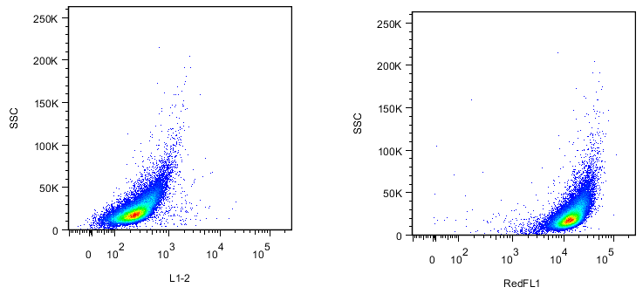
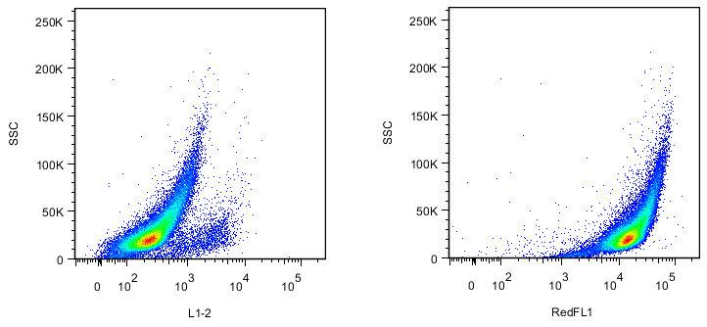
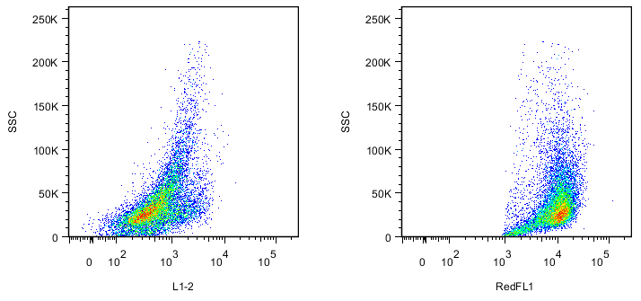
Caspase+
Far-red+
WT N2a
Spontaneous death
WT N2a
Drug-induced killing
WT N2a
T-lymphocyte
Mediated cytotoxicity

Slide 2
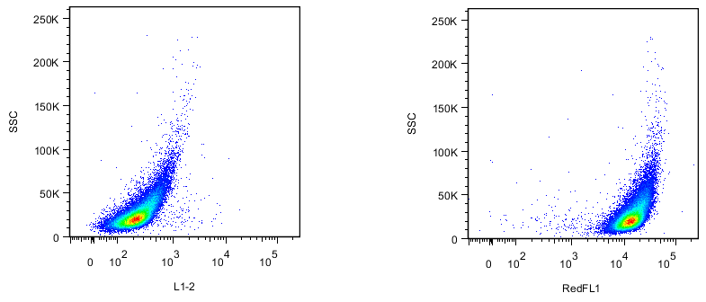
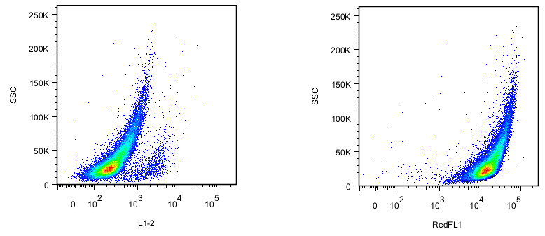
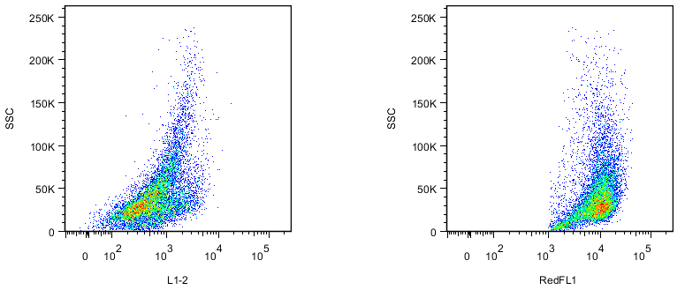
Caspase+
Far-red+
WT N2a+a-PDL1
Spontaneous death
WT N2a+a-PDL1
Drug-induced killing
WT N2a+a-PDL1
T-lymphocyte
Mediated cytotoxicity

Slide 3
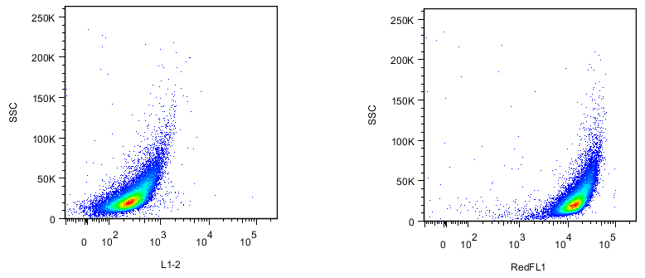
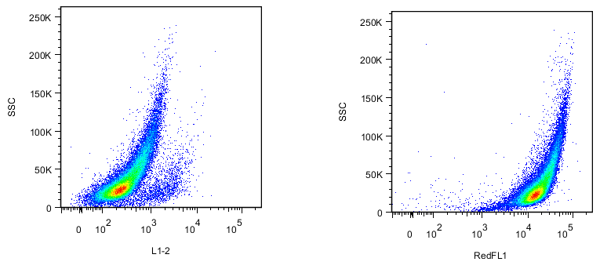
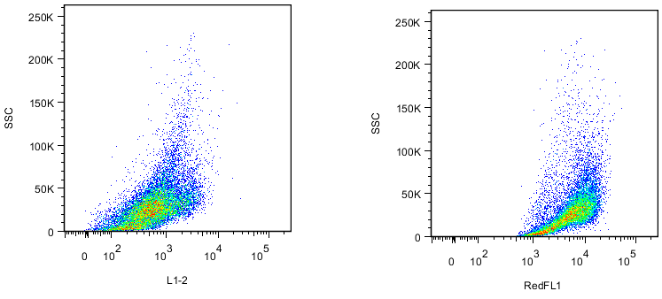
Caspase+
Far-red+
WT N2a+IFN
Spontaneous death
WT N2a+IFN
Drug-induced killing
WT N2a+IFN
T-lymphocyte
Mediated cytotoxicity

Slide 4
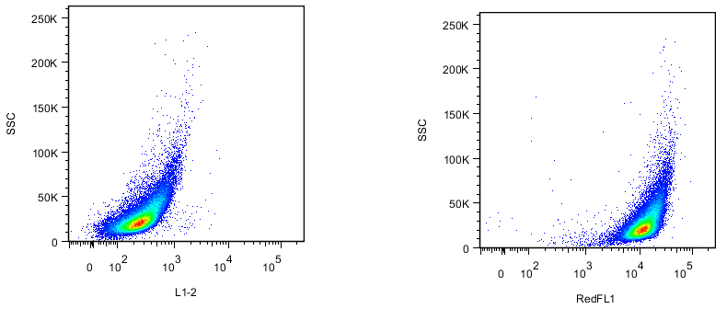
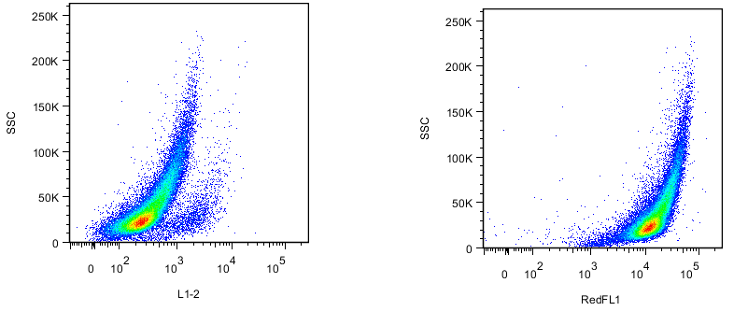
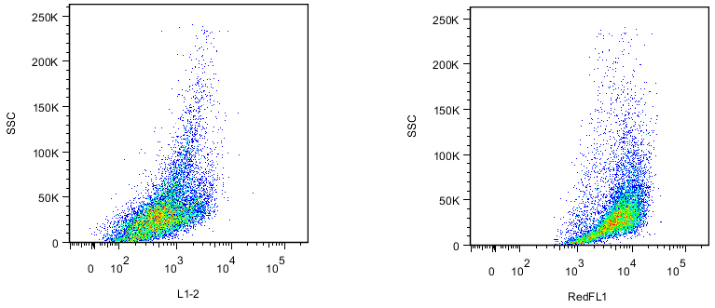
Caspase+
Far-red+
WT N2a+IFN+a-PDL1
Spontaneous death
WT N2a+IFN+a-PDL1
Drug-induced killing
WT N2a+IFN+a-PDL1
T-lymphocyte
Mediated cytotoxicity

