Slide 1
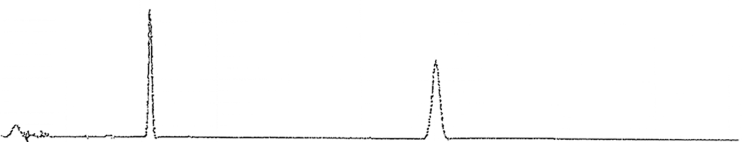
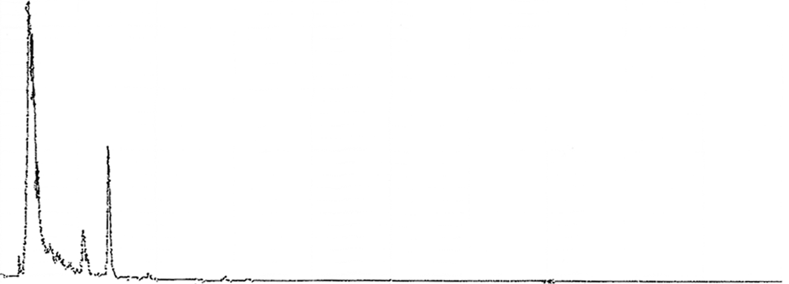
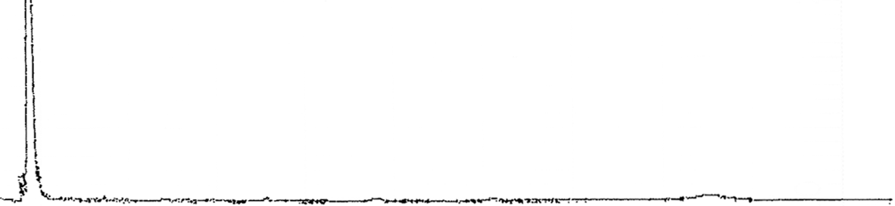
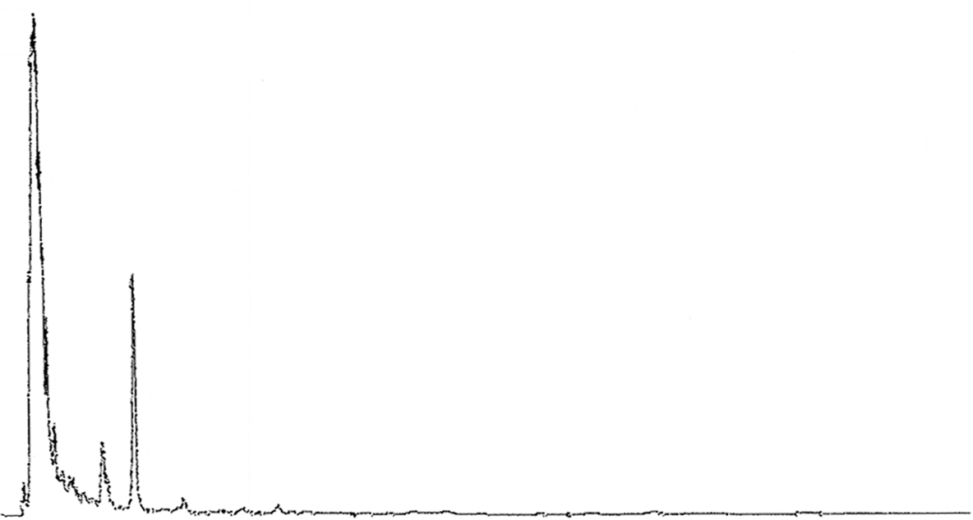
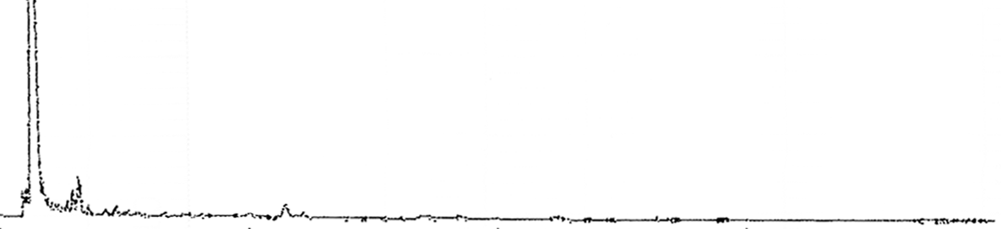
A
Grifolic acid
DCA
Standard compounds
B
Cell extract
C
Culture supernatant
D
Cell extract (elicited)
E
Culture supernatant (elicited)
0 5 10 15 20 25 30 35 40 45 (min)
Supplementary Figure S1. HPLC analyses of R. dauricum cell cultures. Elution profiles of standard daurichromenic acid (DCA) and grifolic acid (A); Cell extract (B) and culture supernatant (C) from non-elicited culture; cell extract (D) and culture supernatant (E) from the culture elicited for 96 h with 100 μM of methyl jasmonate and 9 g/L of β-cyclodextrin.

